Slide 1
What is the most expensive thing in the world?

Slide 2
TRUST
It can take years to earn and a matter of seconds to lose

Slide 3
What is the biggest room in this world?

Slide 4
The room for improvement

Slide 5
Water security, quality and getting ready for a drought
Mohyuddin Mirza, Ph.D., P.Ag
drmirzagreen@gmail.com
780 885 0652

Slide 6
Water security is knowing all about water use from A to Z
Your water needs year round?
Water source
Making water useable for plants
Water quality, Living water, dead water
Water contamination with herbicides
Water use efficiency
Water recycling
Drinking water

Slide 7
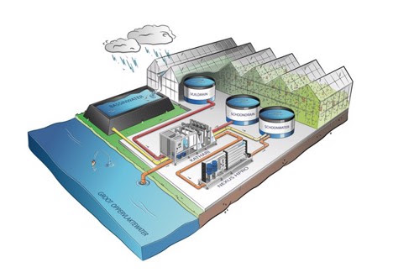
Greenhouse farming water is becoming ever-scarcer: what are the alternatives?

Slide 8
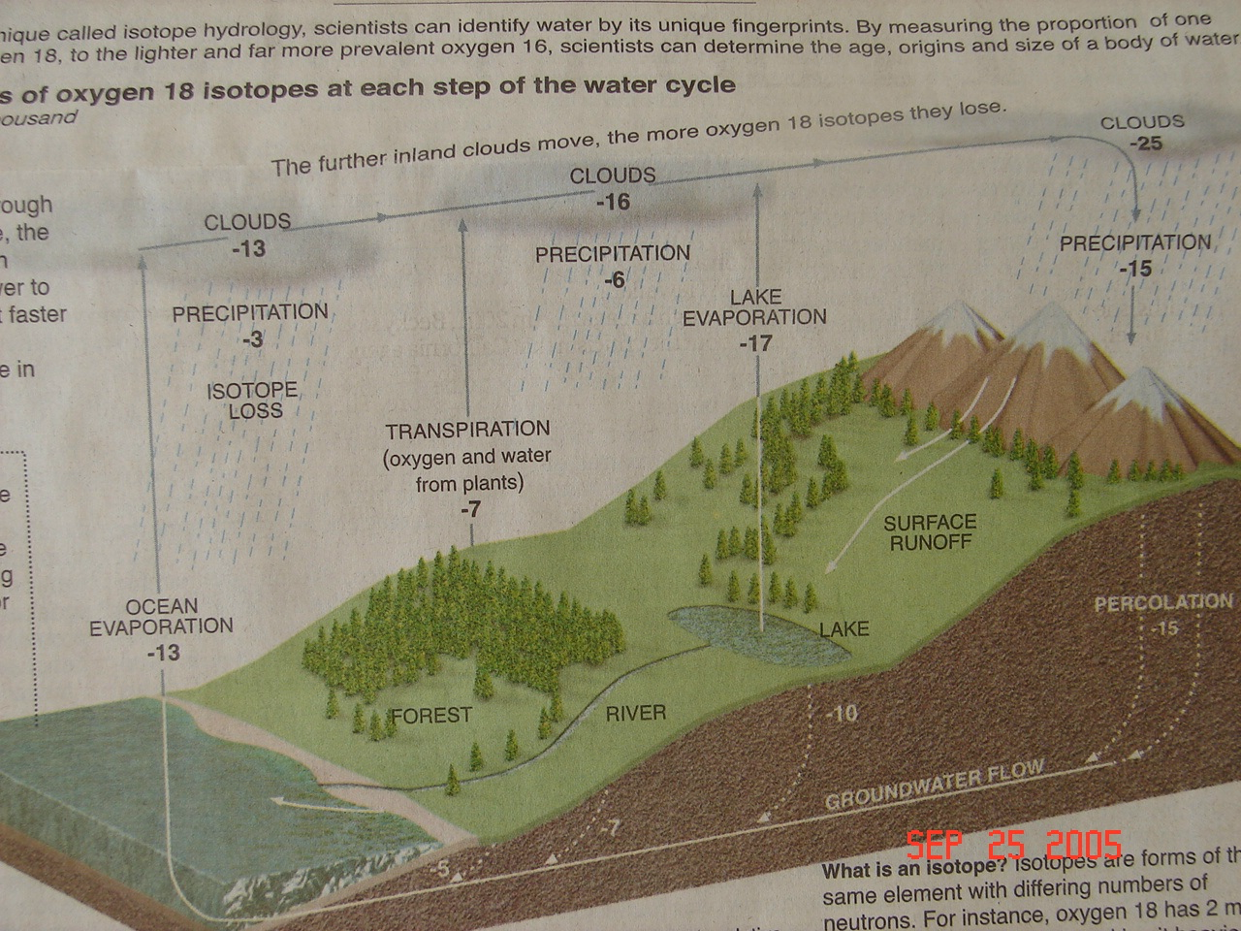
Global Perspective

Slide 9
There is a story behind this
Drought
Dug out running dry
Searched for water from other farmers
Some farmers said, they don’t have enough to share
One shared and later found it had very high sodium

Slide 10
Water: Fascinating Facts
Did you know that it takes 500 kg of water to move through a plant to make 1 kg of dry matter.
About 100L/m2/year goes into the air, causes condensation and needs to removed or collected
The chemical structure (Two hydrogen atoms + One Oxygen atom) is structurally simple, yet biologically profound

Slide 11
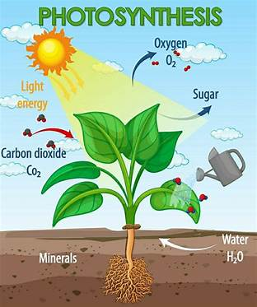
Understanding the business of plants

Slide 12
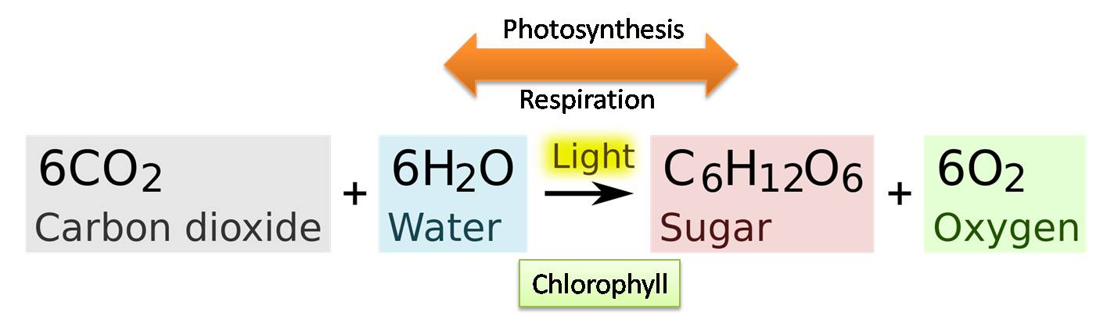
The Fundamental process

Slide 13
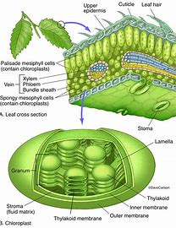
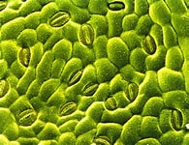
Water regulator stomata and food storage chloroplasts

Slide 14
Plant’s nutrient needs
CO2
Water
Light
Carbohydrates made (Carbon, hydrogen, oxygen). These are used for further developing and growth of roots, shoots, fruit, stems, leaves

Slide 15
Plant’s needs of minerals/nutrients
Nitrogen (NO3, NH4, NH2, Nitrite)
Phosphorus
Potassium
Calcium
Magnesium
Sulfur
Iron, Manganese, Copper, Zinc, Boron. Molybdenum, Chloride, silicon, cobalt

Slide 16
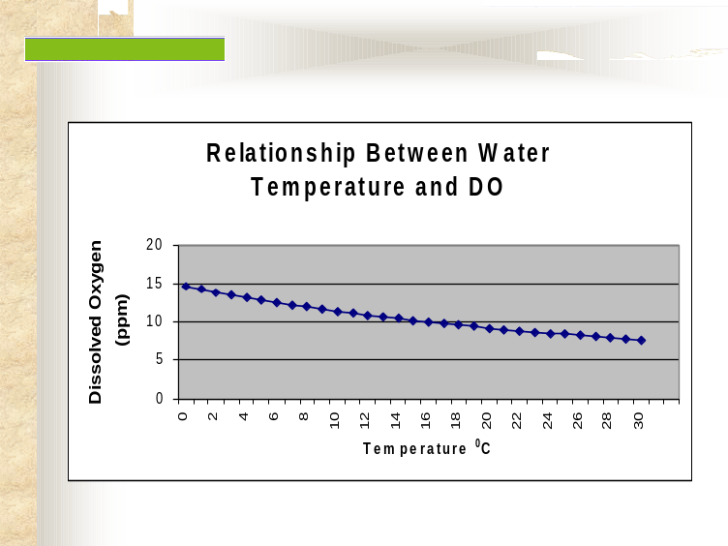
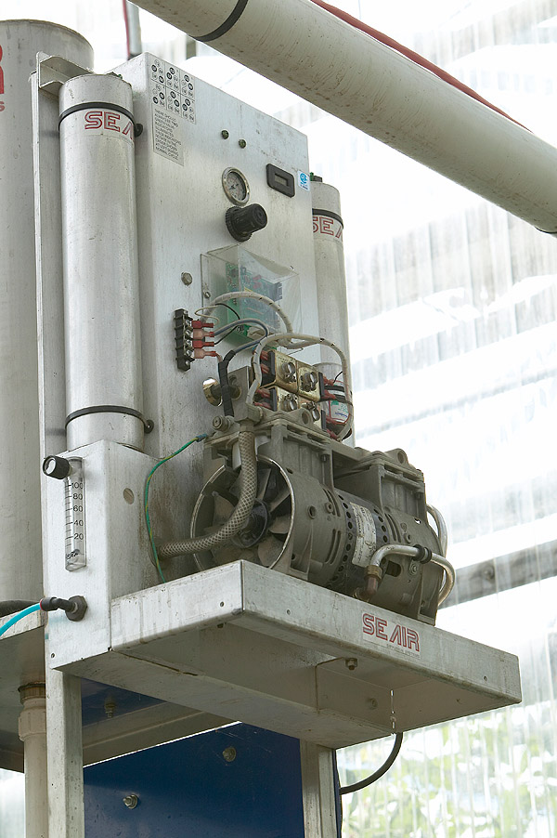
Water: facts
Water at 4C has the maximum solubility for oxygen: 9-11 ppm
As the temperature rises, the solubility goes down

Slide 17
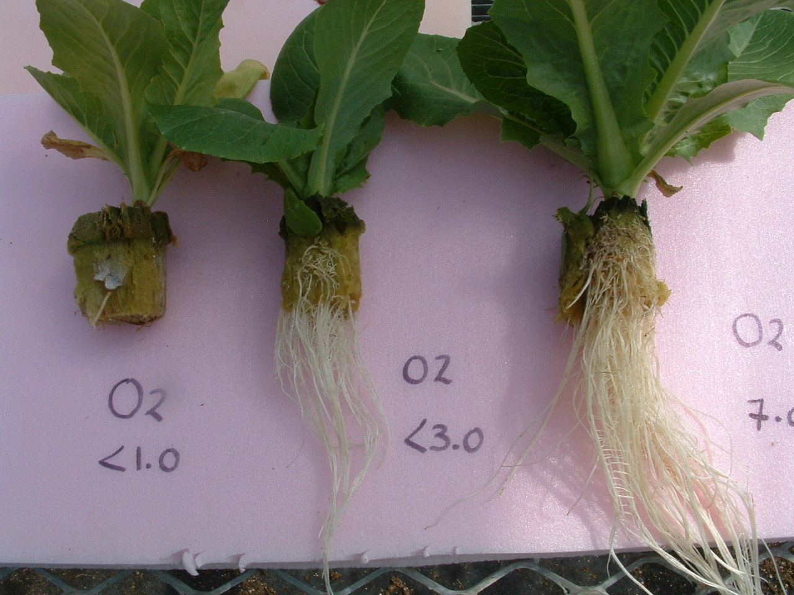
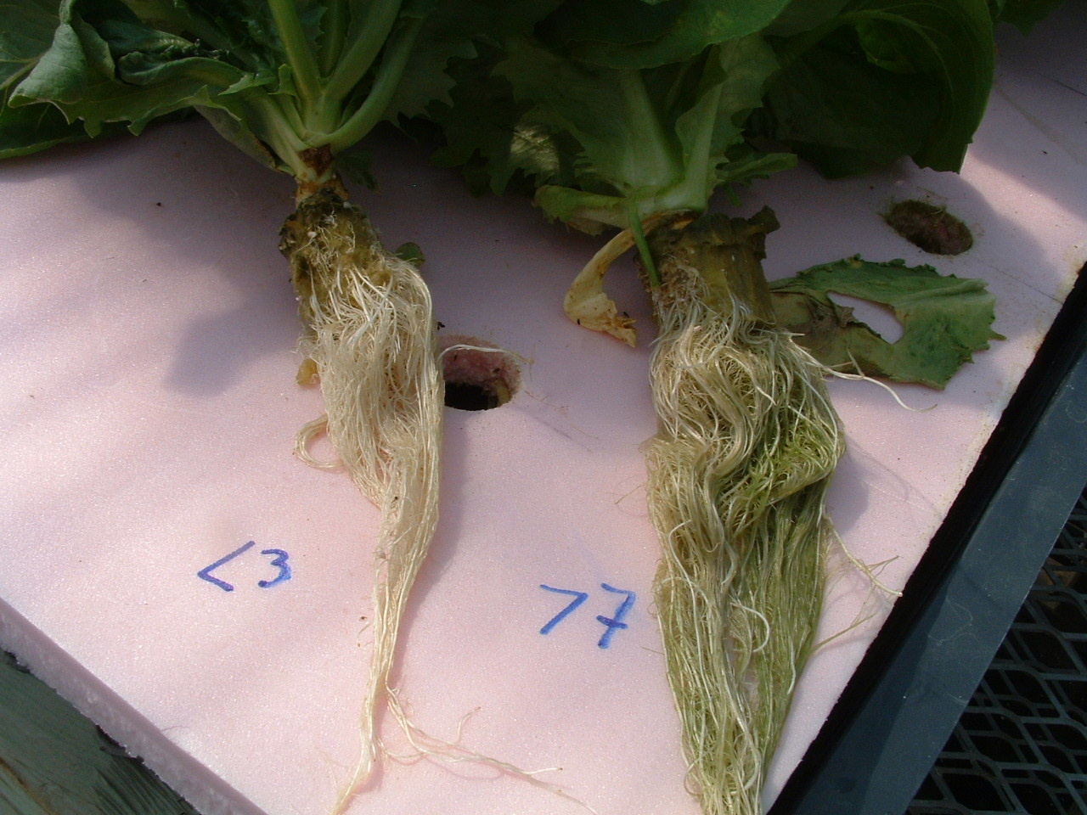
Water: facts

Slide 18
Water use in greenhouse
Irrigation – Dissolved nutrients
Relative Humidity
  Moisture deficit – transpiration
  Condensation – Diseases
  Other uses of water – washing, misting, sprays, drinking, leaching.

Slide 19
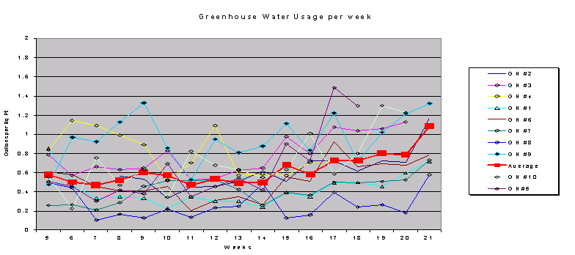
Greenhouse water use in various greenhouses

Slide 20
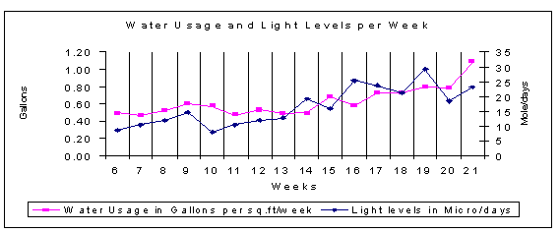
Greenhouse water use

Slide 21
Some Facts About Water Use in Alberta 2020 data
- 37% of growers use municipal water
- 32% use dugout/pond
- 22% use well water
- 7% use water from irrigation canals
- 2% use water from rivers

Slide 22
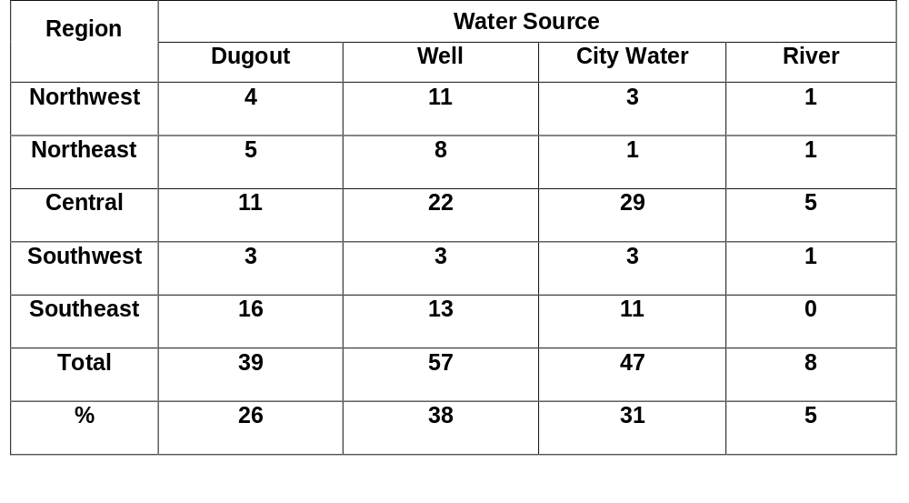
2012 data Saskatchewan

Slide 23
Region | Water Quality |  | Collection of Water
 | Hard Water | Soft Water | Yes | No
Northwest | 4 | 0 | 3 | 1
Northeast | 2 | 2 | 0 | 6
Central | 18 | 4 | 2 | 20
Southwest | 3 | 3 | 1 | 6
Southeast | 10 | 4 | 2 | 15
Total | 37 | 13 | 8 | 48

Slide 24
Region | Sodium Level Tested |  | Water Treatment
 | Yes | No | Reverse Osmosis | Distillation | Water Conditioning | Others* | None
Northwest | 0 | 5 | 0 | 0 | 0 | 1 | 4
Northeast | 0 | 8 | 0 | 0 | 0 | 2 | 6
Central | 13 | 13 | 0 | 0 | 0 | 5 | 16
Southwest | 4 | 3 | 1 | 0 | 0 | 1 | 5
Southeast | 5 | 14 | 1 | 0 | 0 | 3 | 15
Total | 22 | 43 | 2 | 0 | 0 | 12 | 46

Slide 25
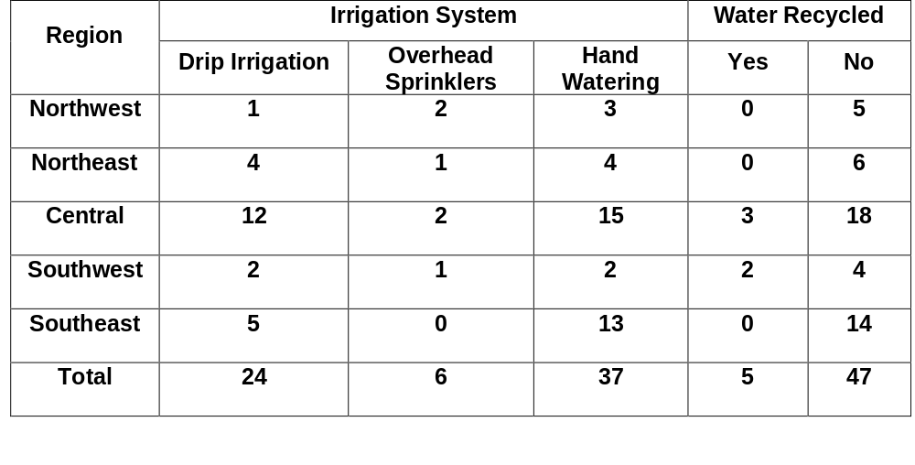

Slide 26
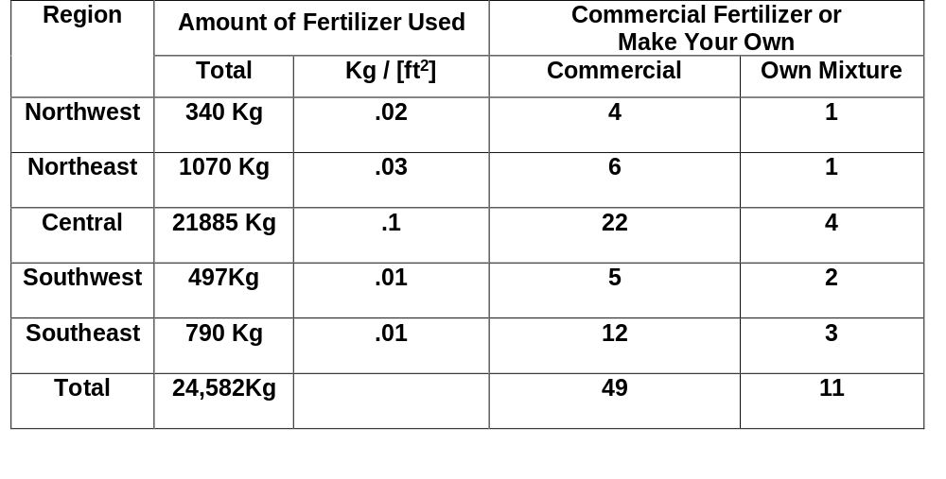

Slide 27
Data from Alberta
35% knew the amount of water they use, (12% in 2006 )
65% did not know and did not keep records on water use
Average water use, 2.3 m3/m2 or 53 gallons/ft2/year
45 % collect water from roof and 55% do not

Slide 28
Water Quality
- 43% - Hard water - Bicarbonates >200ppm
- 60% - Soft Water- Bicarbonates < 100ppm
- 39% - Medium- Bicarbonates 150 ppm
- 60% - Sodium > 100 ppm
- Least understanding how to manage sodium

Slide 29
Testing of Water
- 90% test for chemical analysis
- 10% did not test
- 21% tested for E.coli
- 79% did not test for E.coli

Slide 30
Water Treatment
- 79% No Treatment
- 10% Reverse Osmosis
- 3% Distillation (drinking)
- 2% Water conditioning
- 8% Other treatments (Ozone,filters,Acid mixing)

Slide 31
Recycling and Disposal of Waster Water
- 88%(2006) do not recycle water, 71% in 2020
12% recycle water in 2006 and now 29%
62% dispose off waste water in ground/field
12% sewage
26% say no waster water
-

Slide 32
Water Quantity
Water requirements can vary between 0.1 and 7 liters of water/m2/day.
Varies according to plant species, plant size, R.H, solar radiation,heating and rate of ventilation.
The total annual requirement for year round greenhouse operation exceeds the annual rainfall.
We need water from other sources

Slide 33
Water Quantity
Well water
Dug-out/pond
Irrigation Canal
Directly from River/creek
We need storage for winter

Slide 34
Water Legislation
Dug-Out
Leached water
How much water can be taken from rivers
Find out about any legislations for withdrawing water and putting it back.

Slide 35
Water: Chemical Quality
Analysis for greenhouse irrigation.
Don’t use coke bottles or jam jars
Plastic bottles available from Labs.
Private labs. Have to pay for the analysis
Analysis of water for health use can be interpreted for quality.

Slide 36
Another water analysis
Analysis Description |  | Units
pH |  | 7.87
Electrical Conductivity |  | 1310 uS/cm 1.310 mS/cm
Calcium |  | 116 mg/L or PPM
Magnesium |  | 94.5 mg/L
Sodium |  | 55.3 mg/L
Potassium |  | 17.1 mg/L
Sulphates (SO4) |  | 238.0 mg/L High but manageable
Chlorides |  | 44.1 mg/L
Fluoride |  | 3.09 mg/L Very High for Dracaena
Iron |  | 0.01 mg/L
Manganese |  | 0.008 mg/L
Nitrate and Nitrite |  | 0.12 mg/L, < 0.005 696 mg/L – About 600 mg need to be neutralized for pH adjustments
Bicarbonates
SAR: Sodium Absorption Ratio
Sodium ÷ Ca + Mg in Meq and under-root
- 2.78
Copper, Zinc,Boron and Molybdenum

Slide 37
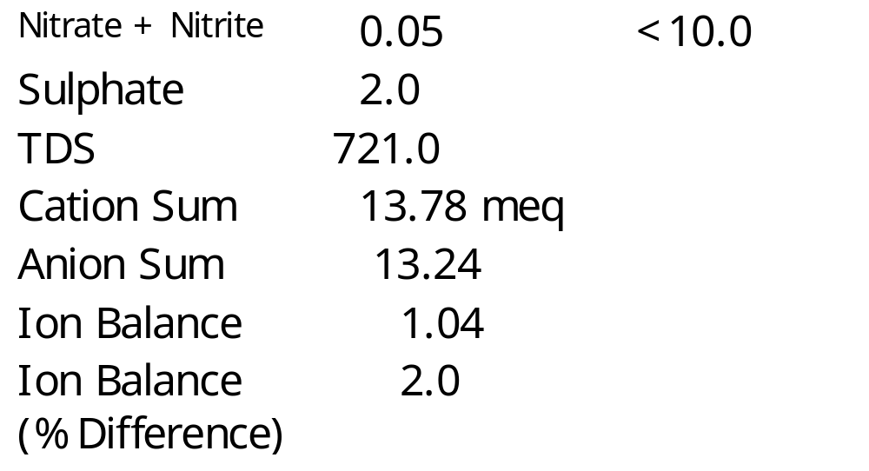
Water: Chemical Quality

Slide 38
Water quality depends on several factors
Growing System? Drain to waster or recircualting.
Good drainage for leaching purposes
Type of crops grown. Peppers need far higher boron than other crops. Poinsettia need higher molybdenum. Fluoride > 1 ppm toxic to dracaenas.
Other uses of water, like misting, washing of produce, cooling, transport of produce.

Slide 39
Making Decisions
pH
  Can be adjusted with acids (use of ammonium nitrogen)
  Must prepare a pH curve
  It is logarithmic
  Bicarbonates affect pH changes
  Bicarbonates need to be neutralized
  Very pure water, add bicarbonates 50 ppm to provide some buffering

Slide 40
Making decisions
Electrical Conductivity (E.C.)
  E.C. values below 0.8 mS and SAR of less than 4.0, good quality water
  E.C. values above 0.8 and below 2.0 mS, water becomes marginal and need SMP to use this water
    Good drainage of the medium
    Regular leaching
    Frequent testing of growing medium

Slide 41
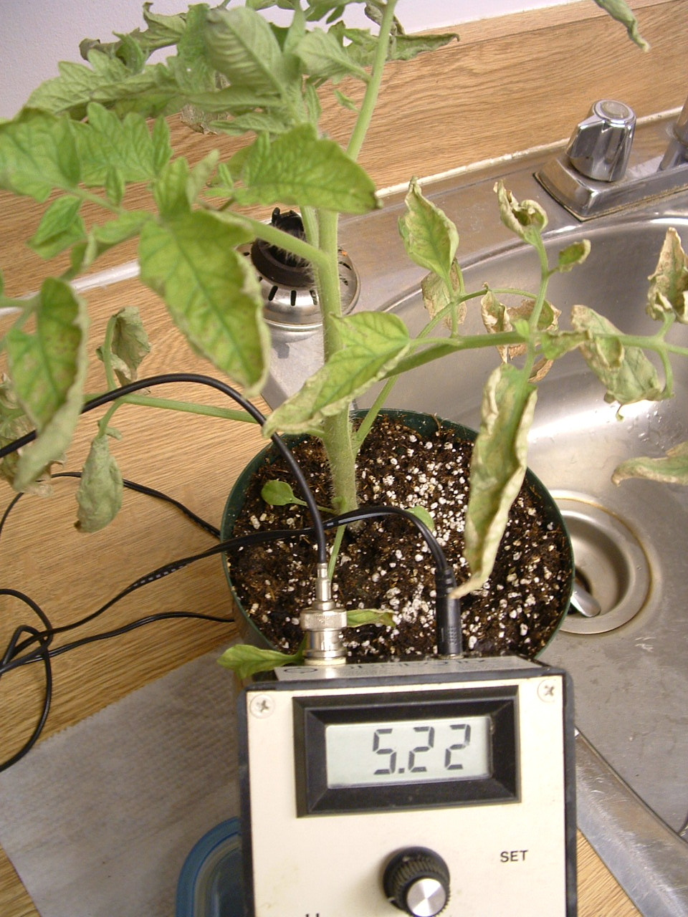
E.C.
E.C. over 2.0, water not suitable
  E.C. also important from plant growth viewpoint.
  Higher the E.C. less water is available for plant growth.
  Water E.C. and fertilizer E.C. add up

Slide 42
Specific ions
N,P,K. Although for fertilization purposes, these elements are usually added, presence of high levels is indicative of contamination.
Ca and Mg: All of the Ca is not available for plant growth. Contribute to hardness.
Bicarbonates: Over 250 ppm causes problems like leaf residues, plugged emitters. Can be neutralized with acids

Slide 43
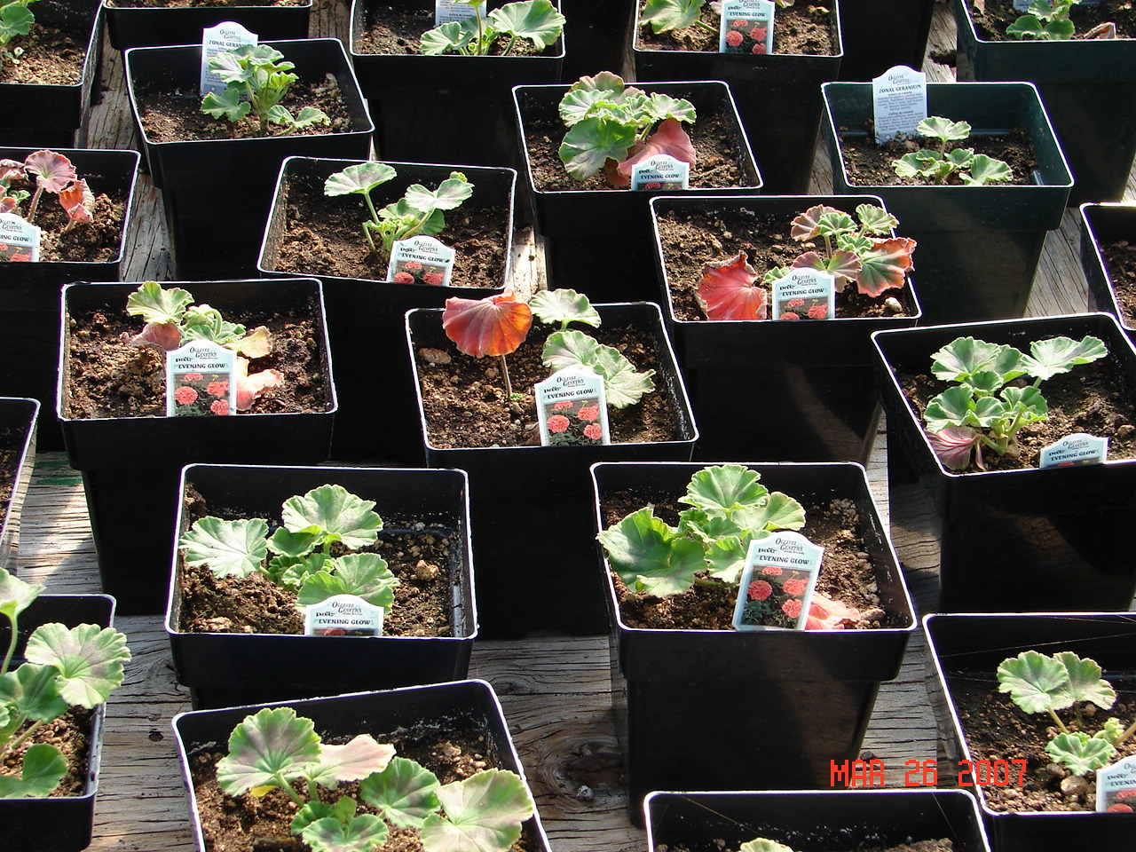
Specific ions
Sodium: Not required for plant growth
Can become toxic
Antagonistic to K,Ca,Mg
Destroys growing media texture.
Make media water logged
Need to be removed

Slide 44
Specific Ions
Sulphates: Generally very high in Alberta water supplies.
Over 100 ppm is high
Relatively easy to leach
Contribute towards higher E.C.
Fe^{+++:} Over 0.25 ppm not desirable
Plugged emitters
Iron bacteria
Can be removed through iron filters.

Slide 45
Specific Ions
Boron: It can be quite toxic and should be carefully checked. Less than 0.5 ppm
Zinc: Can be toxic when water is collected from galvanized frame. Test frequently before adding zinc.
Manganese: Can become toxic if sawdust is being used. Check when to start feeding additional Mn

Slide 46
Specific ions
Copper: Over 0.25 ppm needed in organic media.
Fluoride: Toxic over 1 ppm especially in case of lilies, dracaena, spider plants
Silicon: About 5 ppm desirable
Aluminum: Can affect P uptake

Slide 47
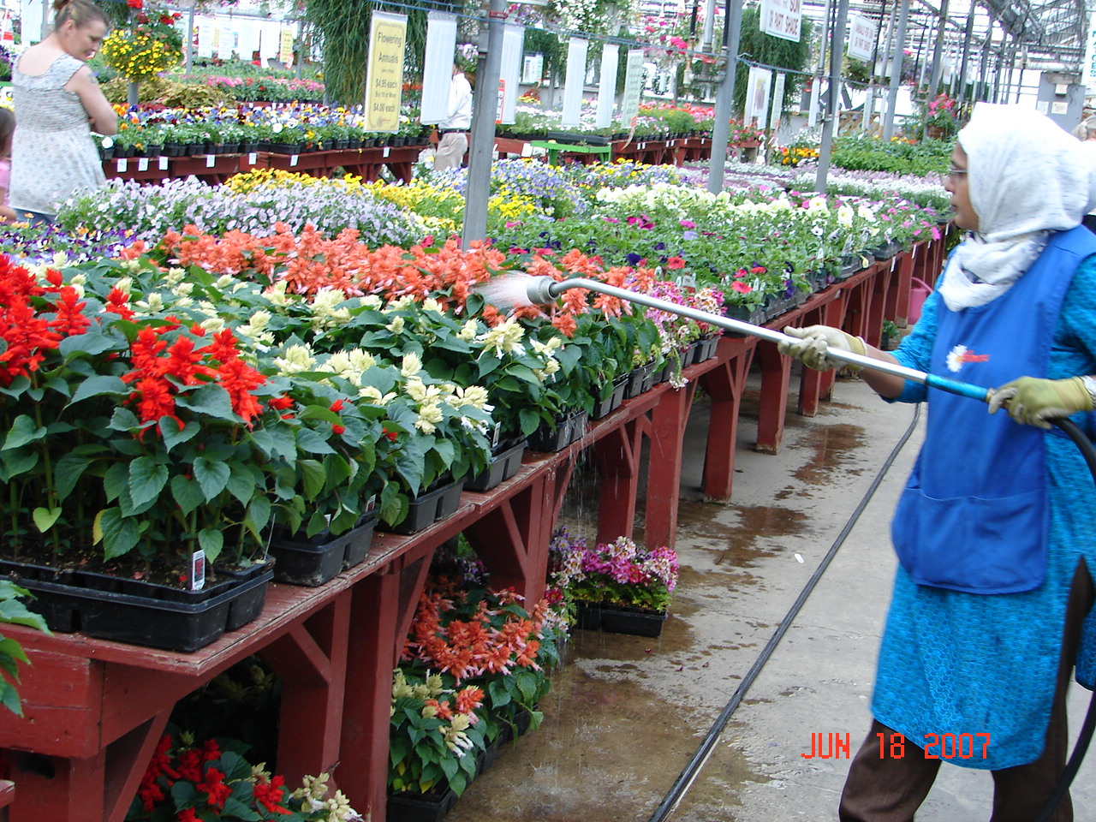
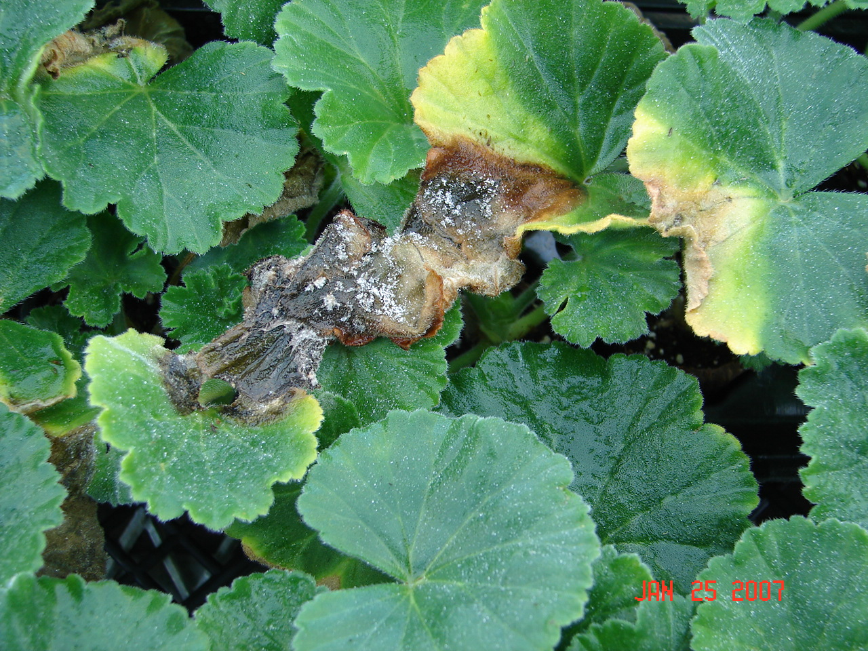
Water Applications – Hand water

Slide 48
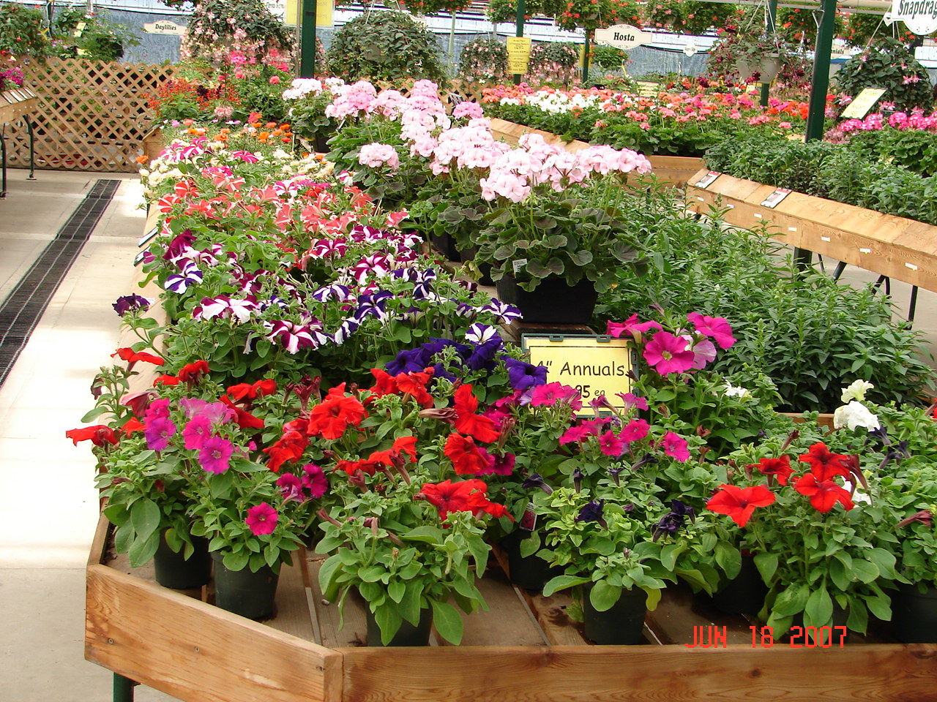
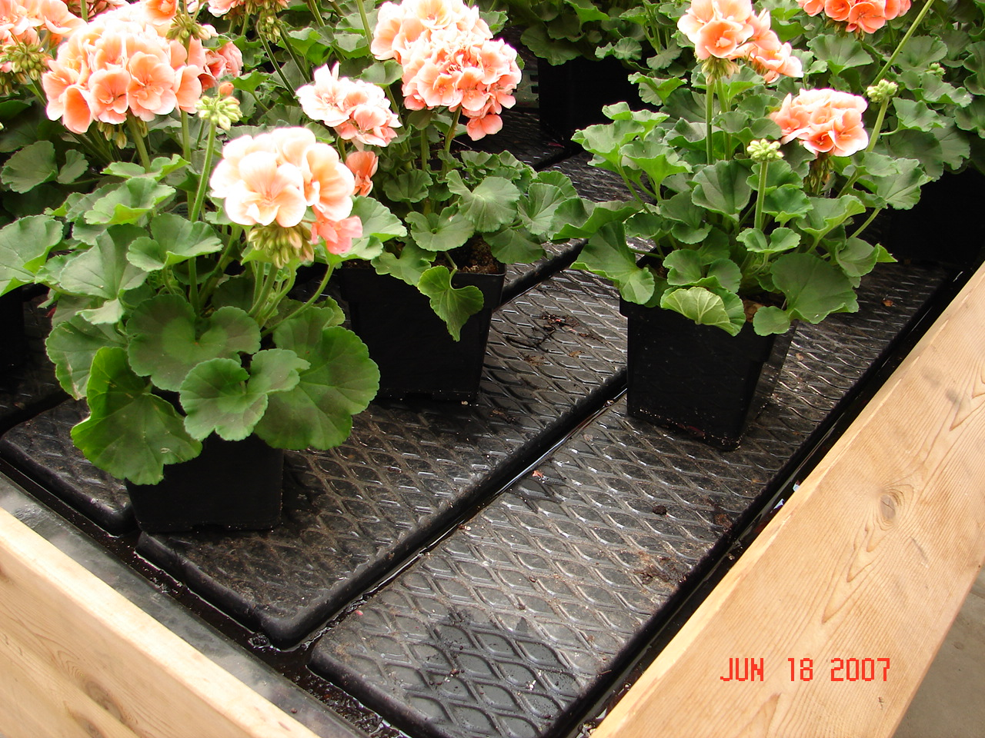
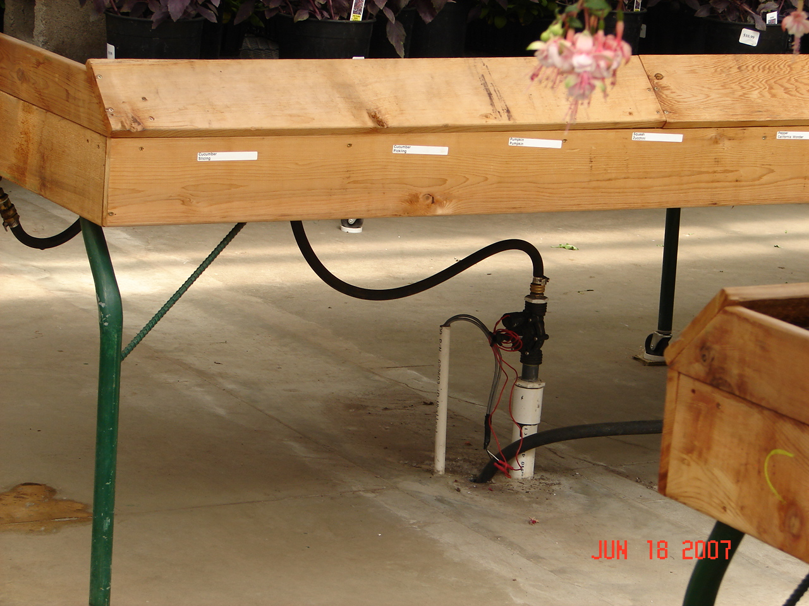
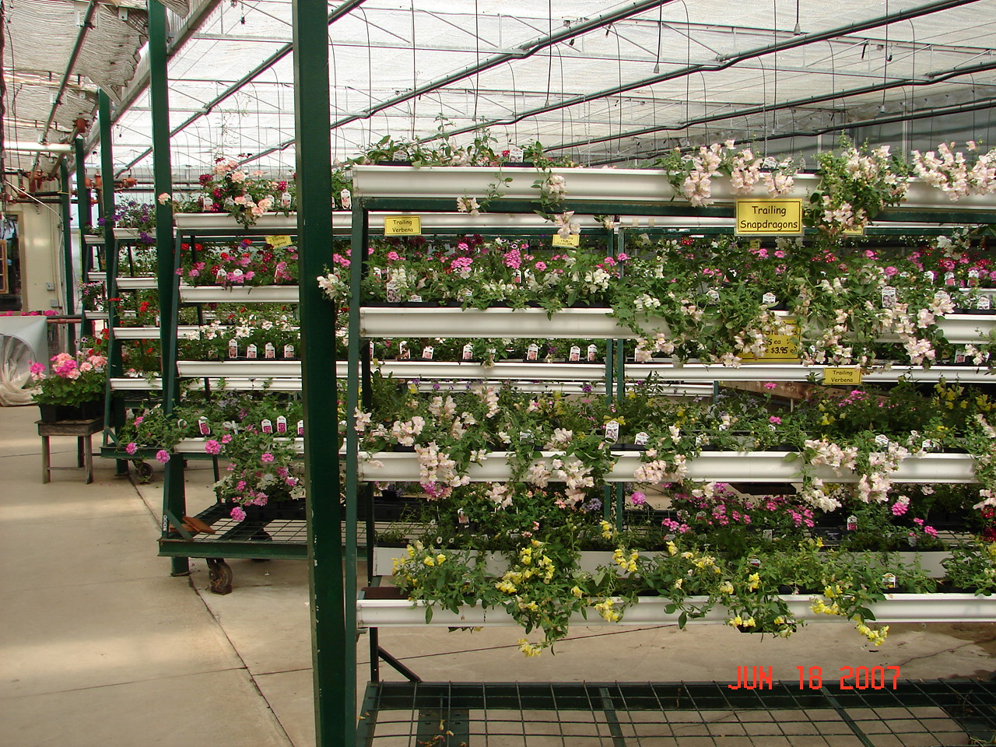
Flood Systems

Slide 49
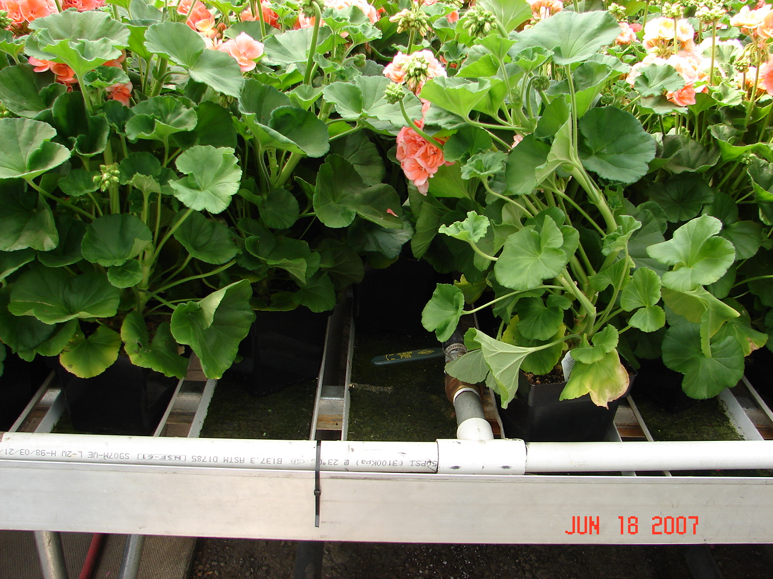
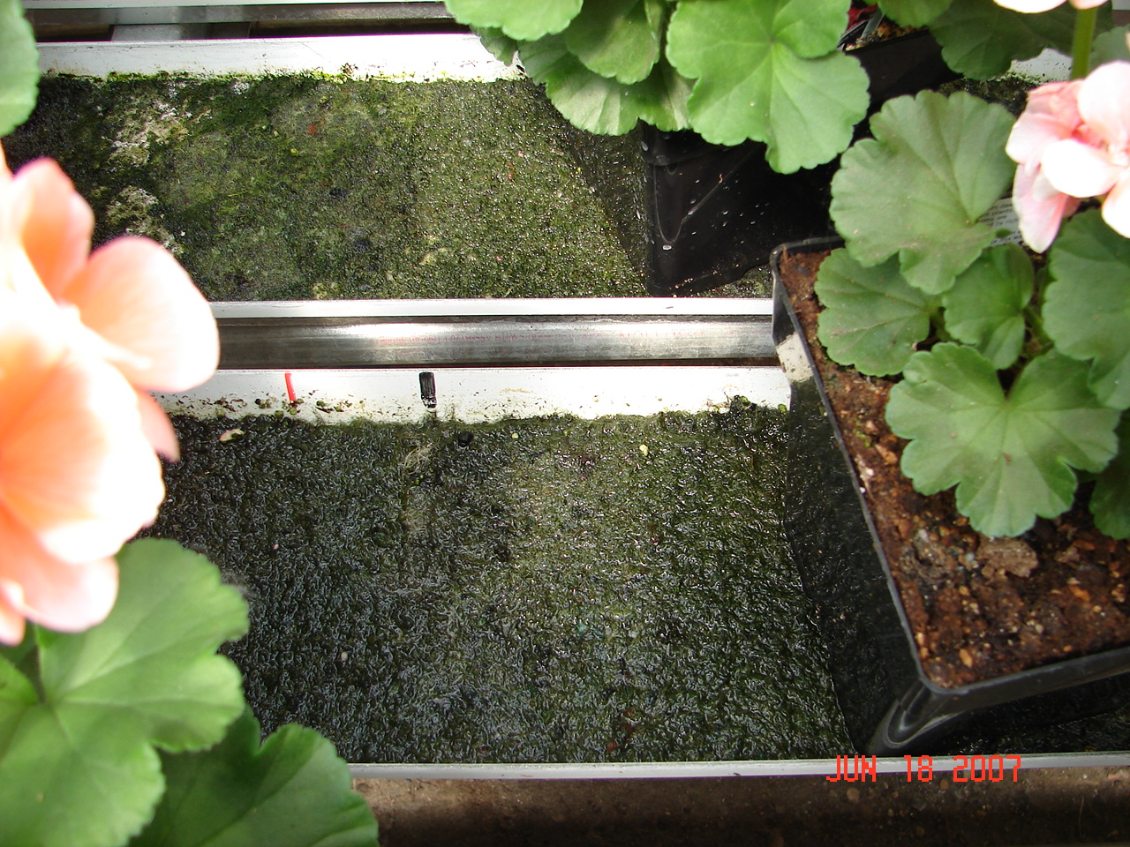
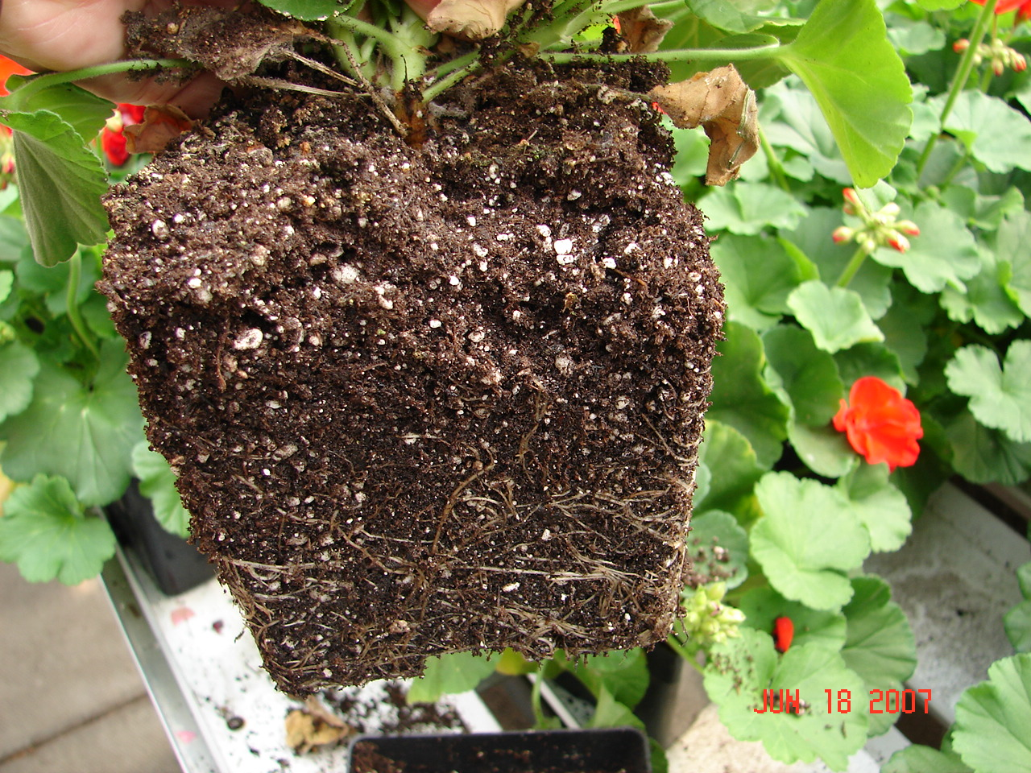
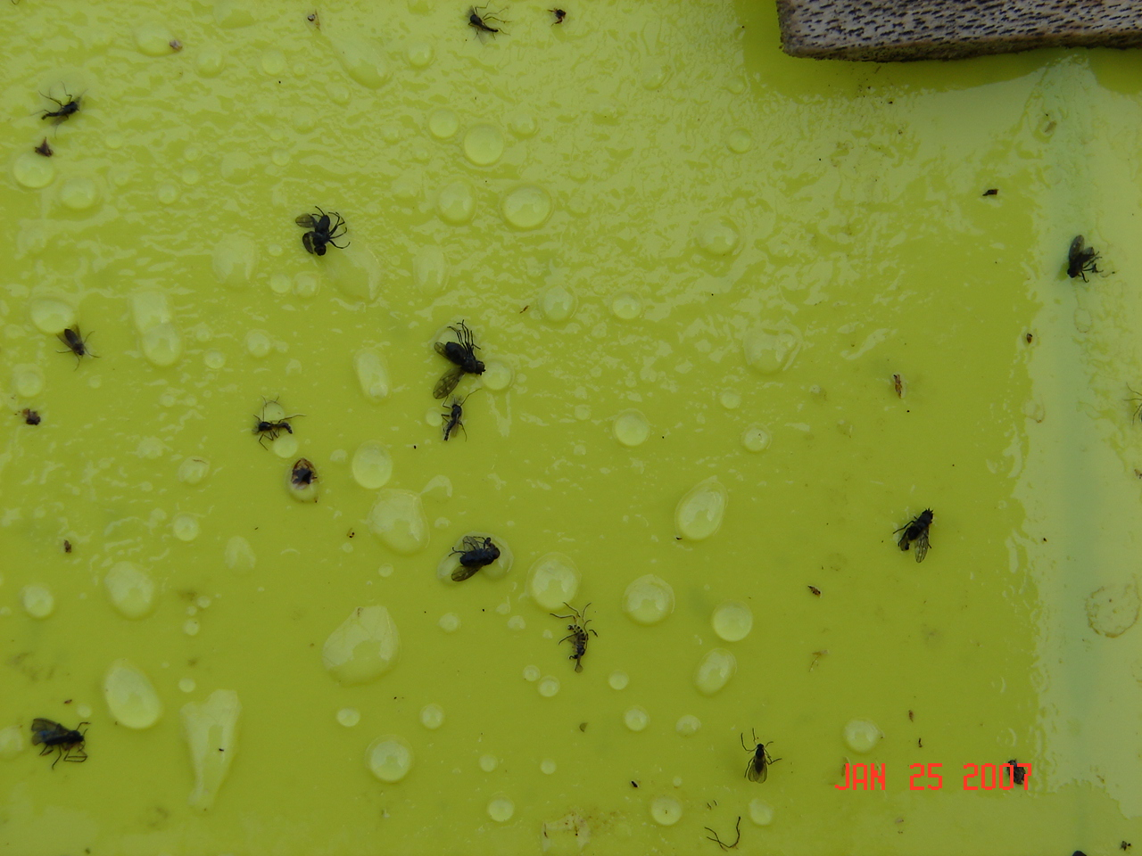
Flood Systems- Algae

Slide 50
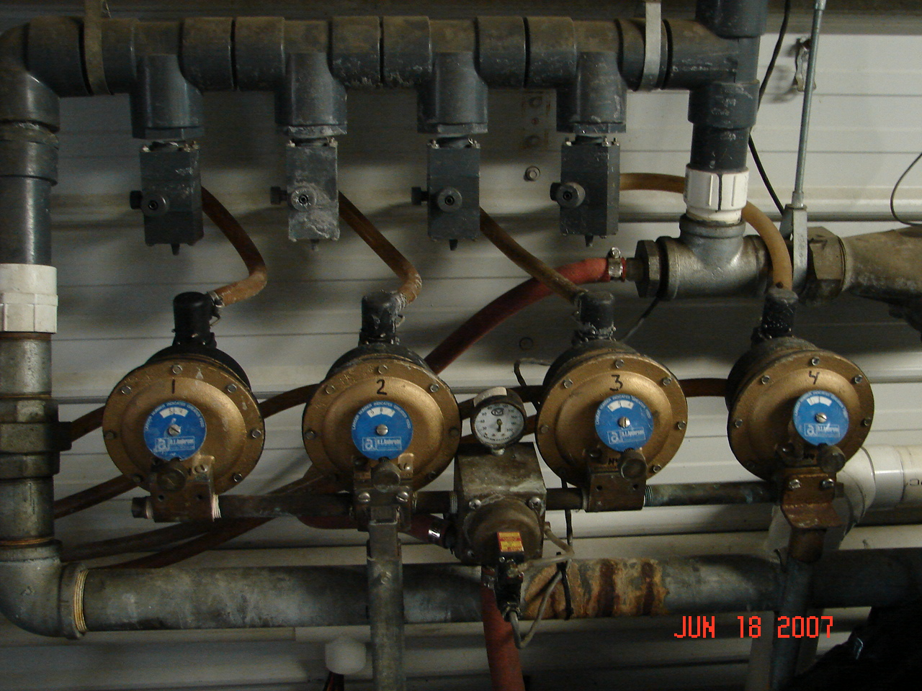
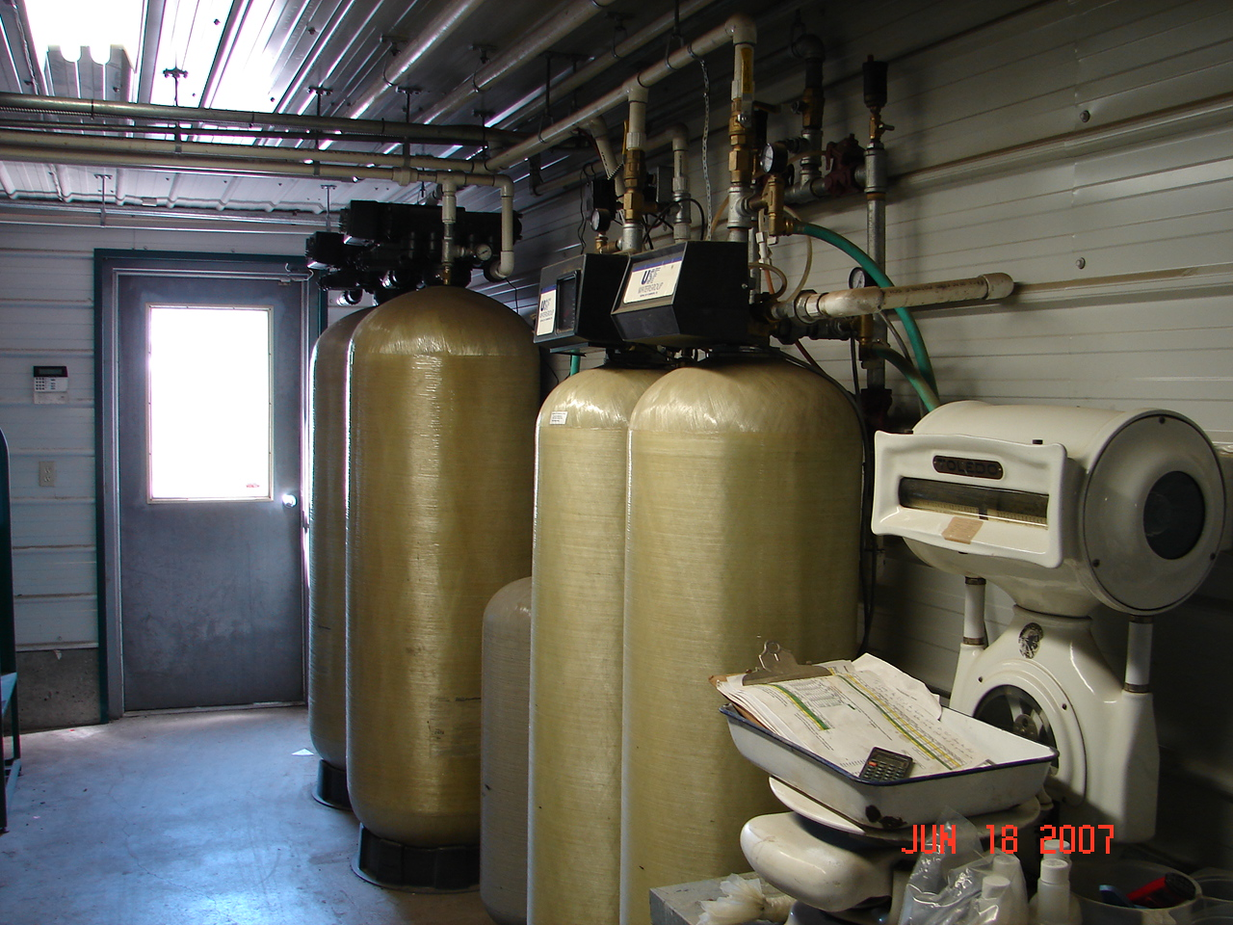
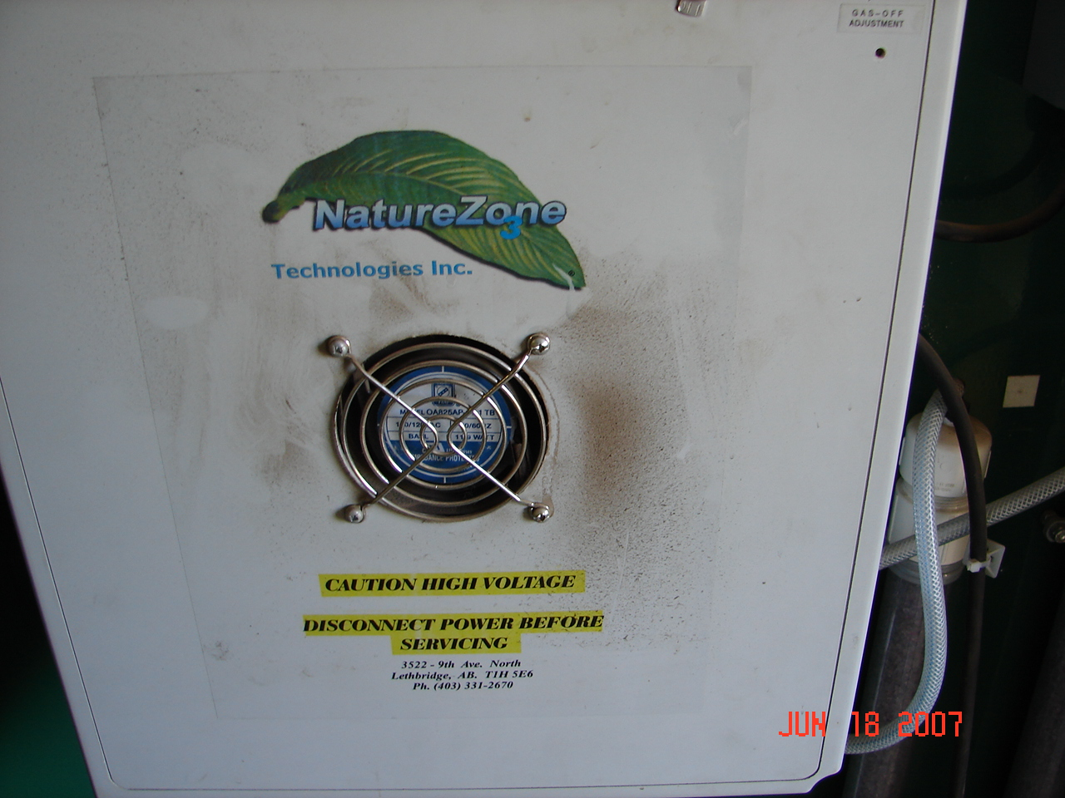
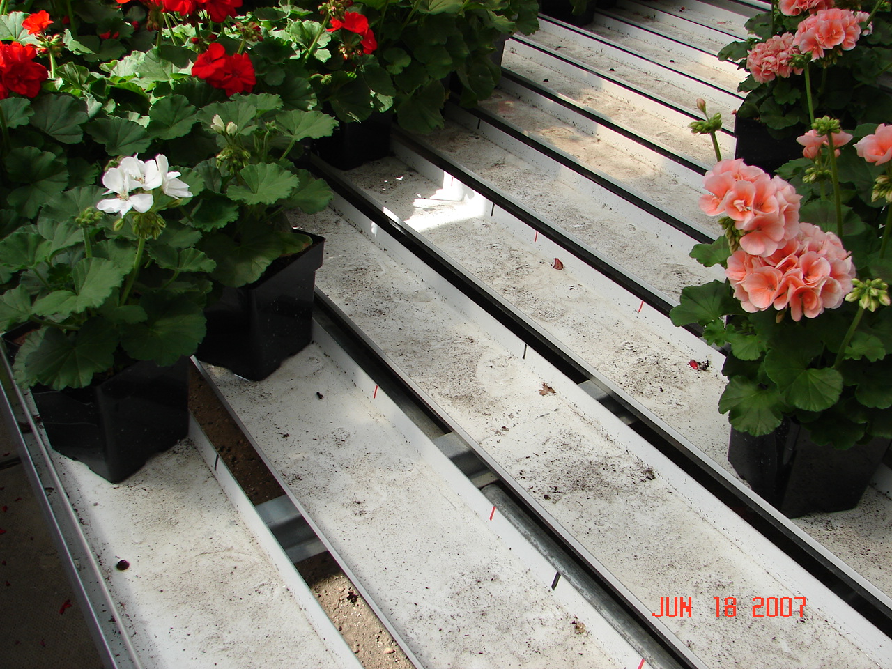
Water Treatment

Slide 51
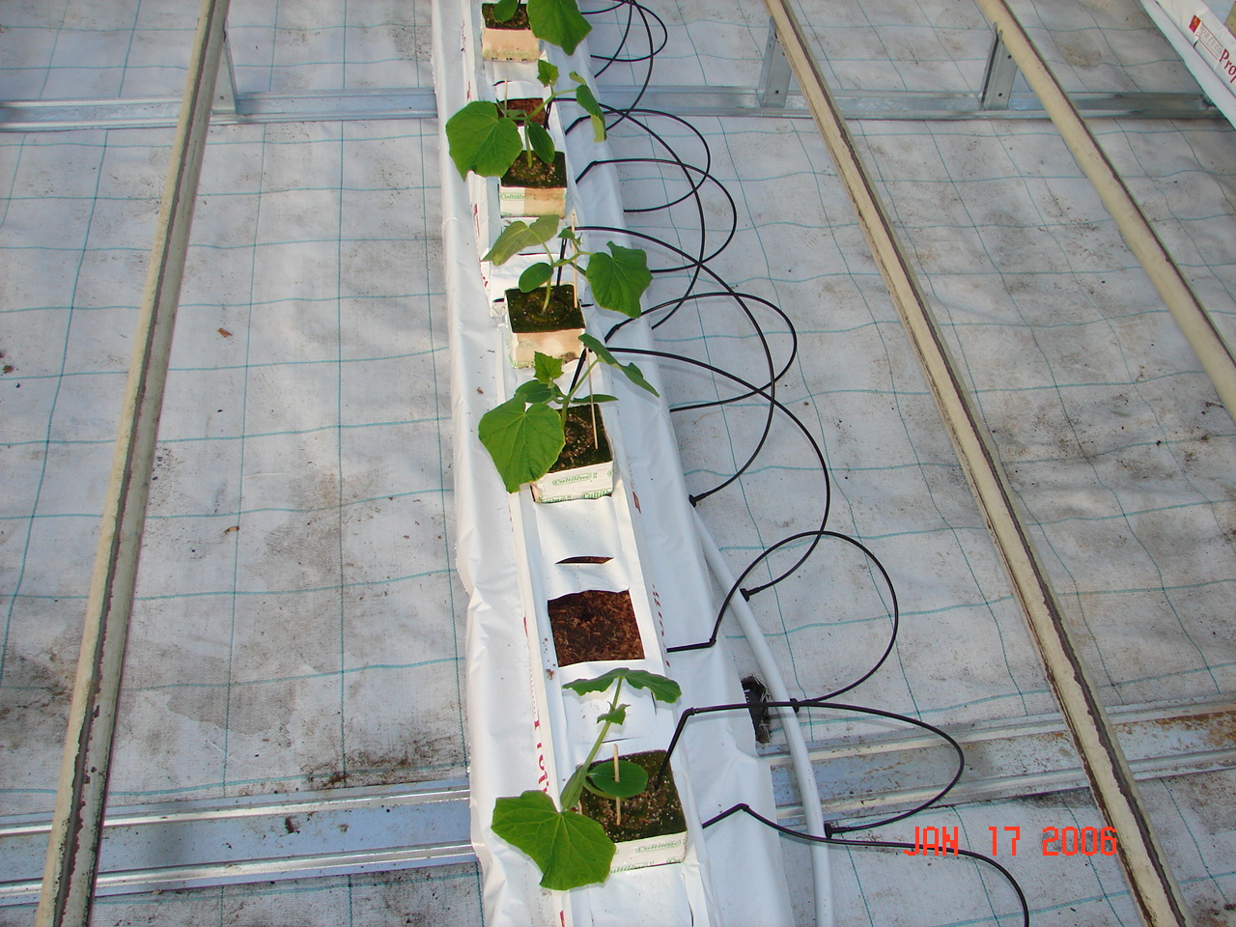
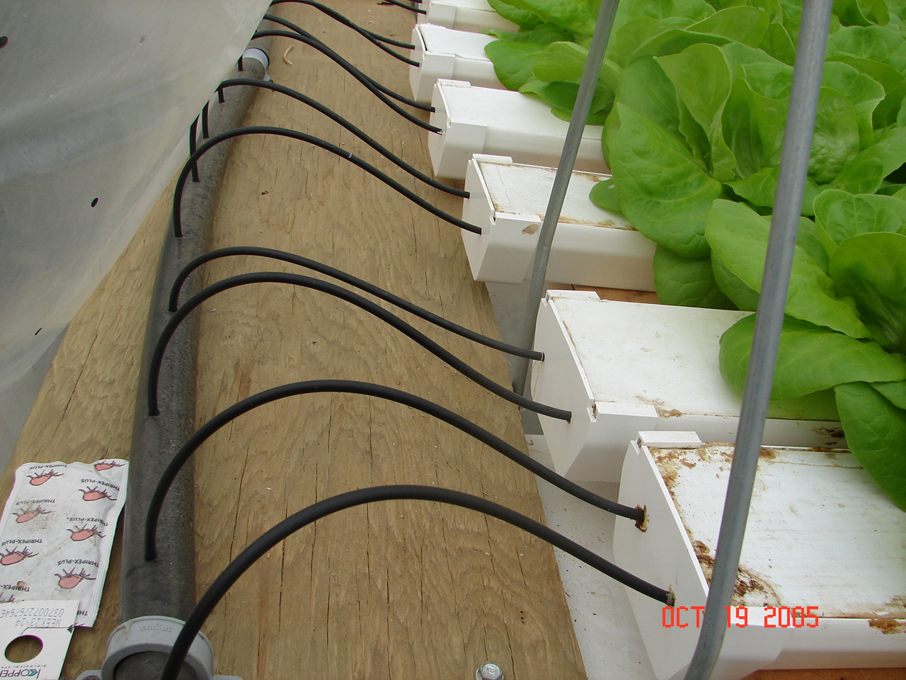
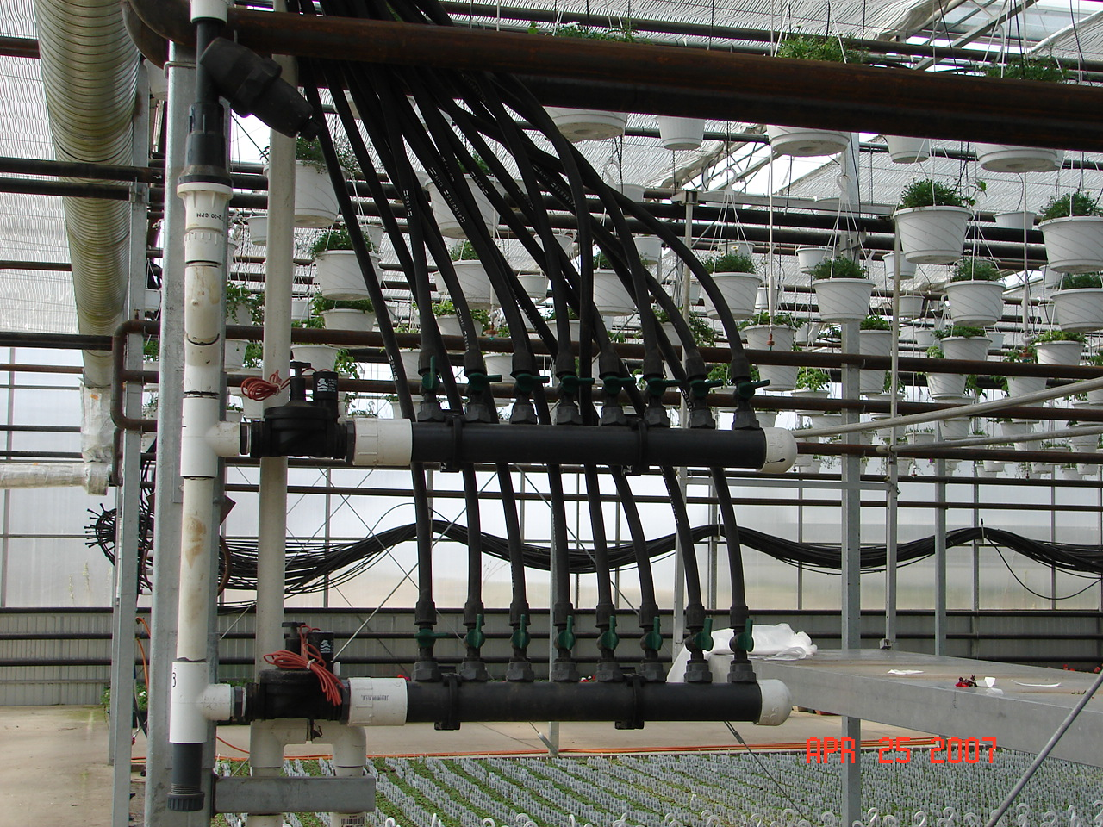
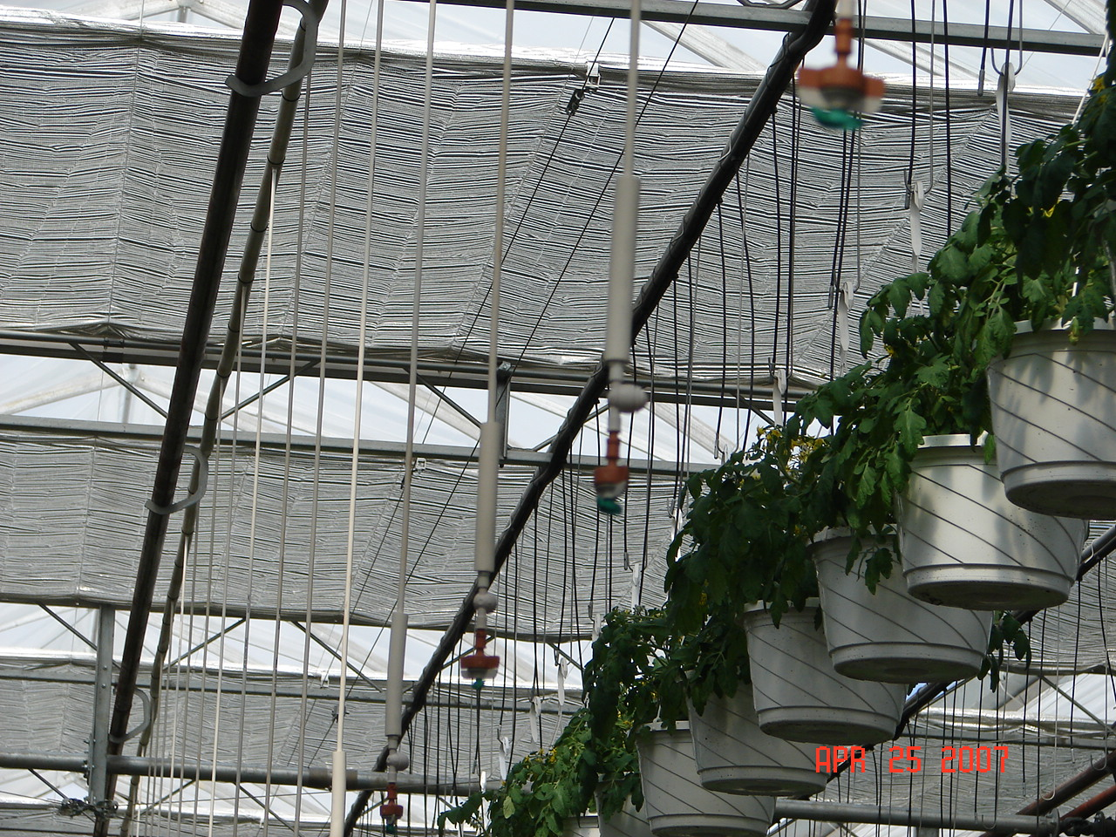
Water Applications

Slide 52
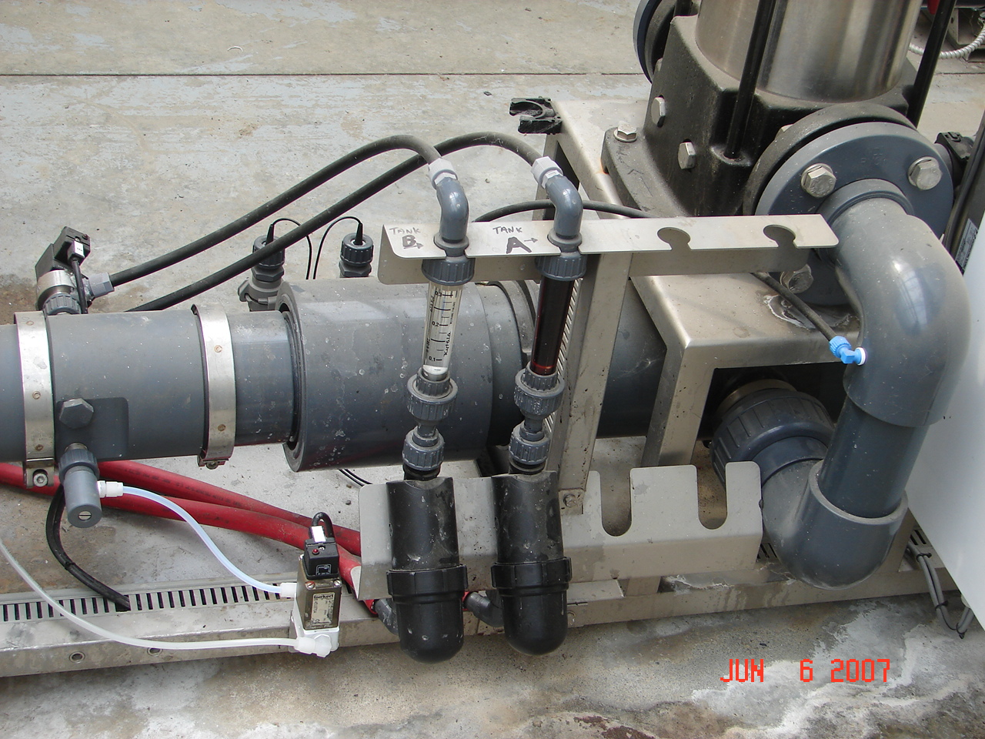
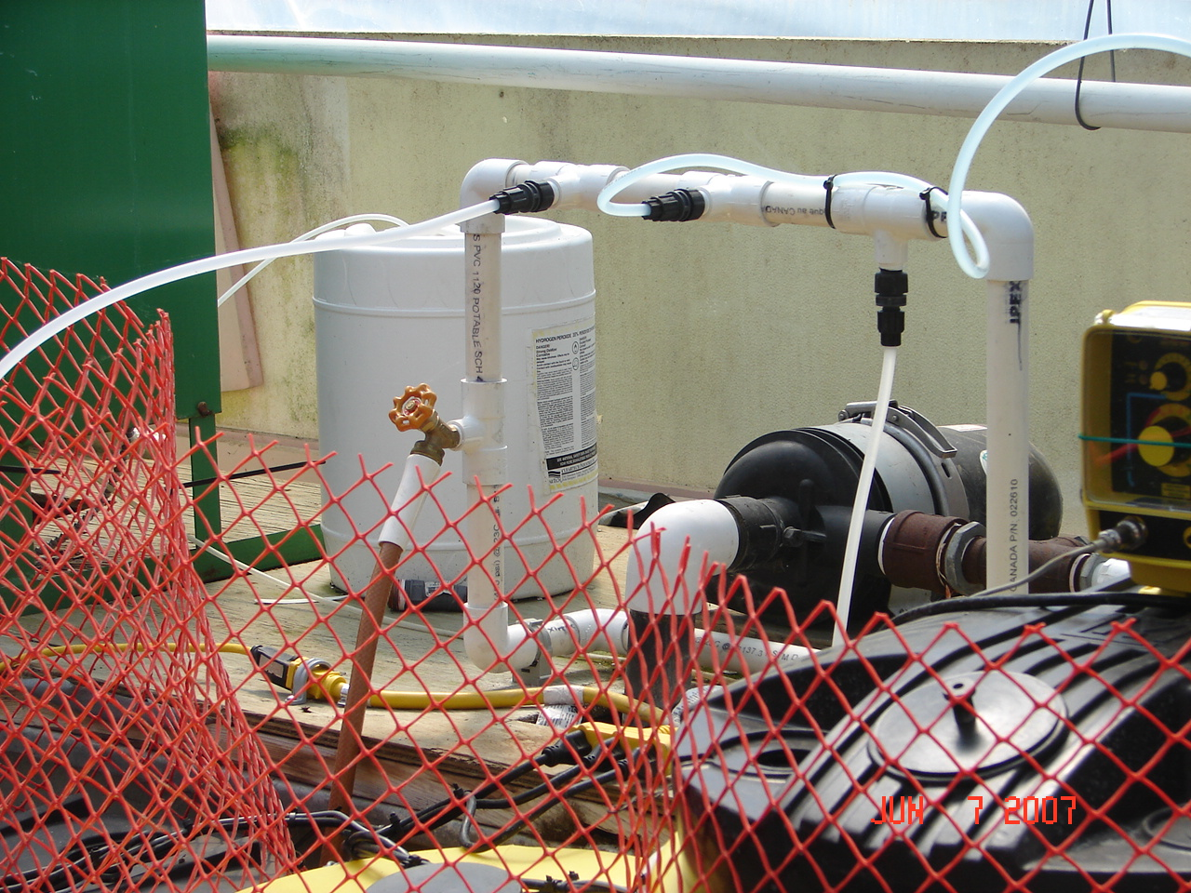
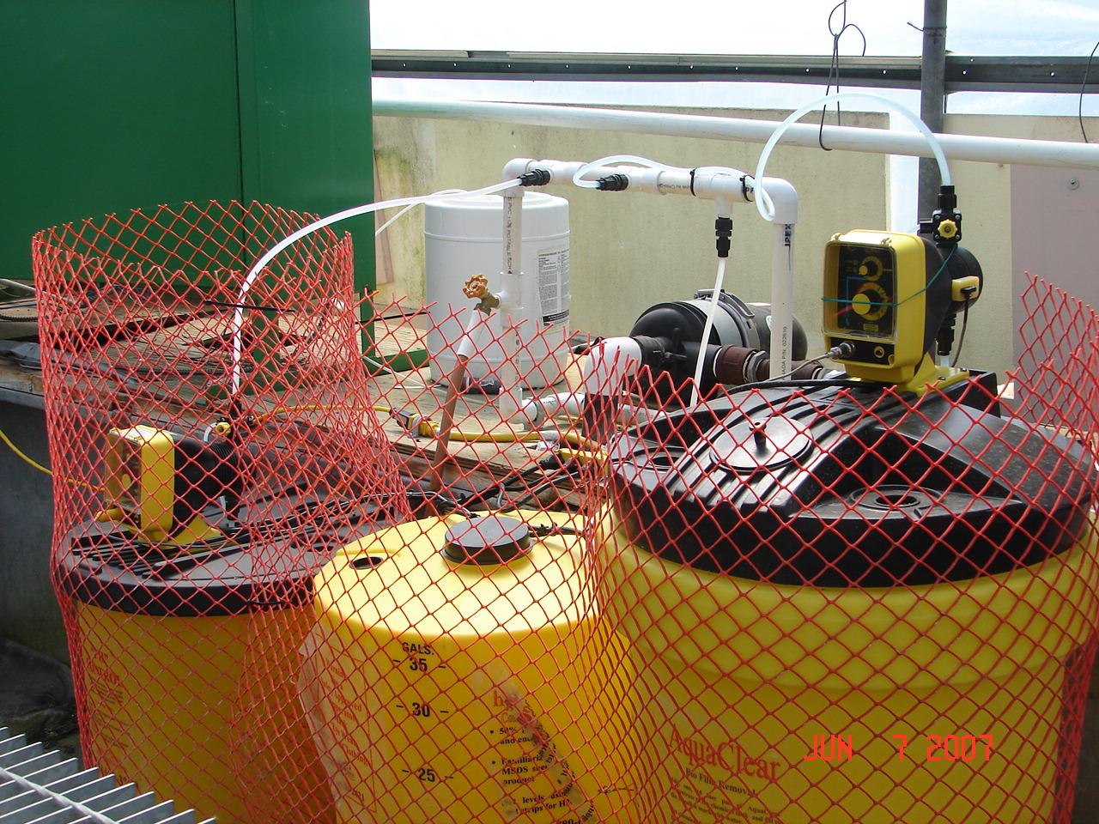
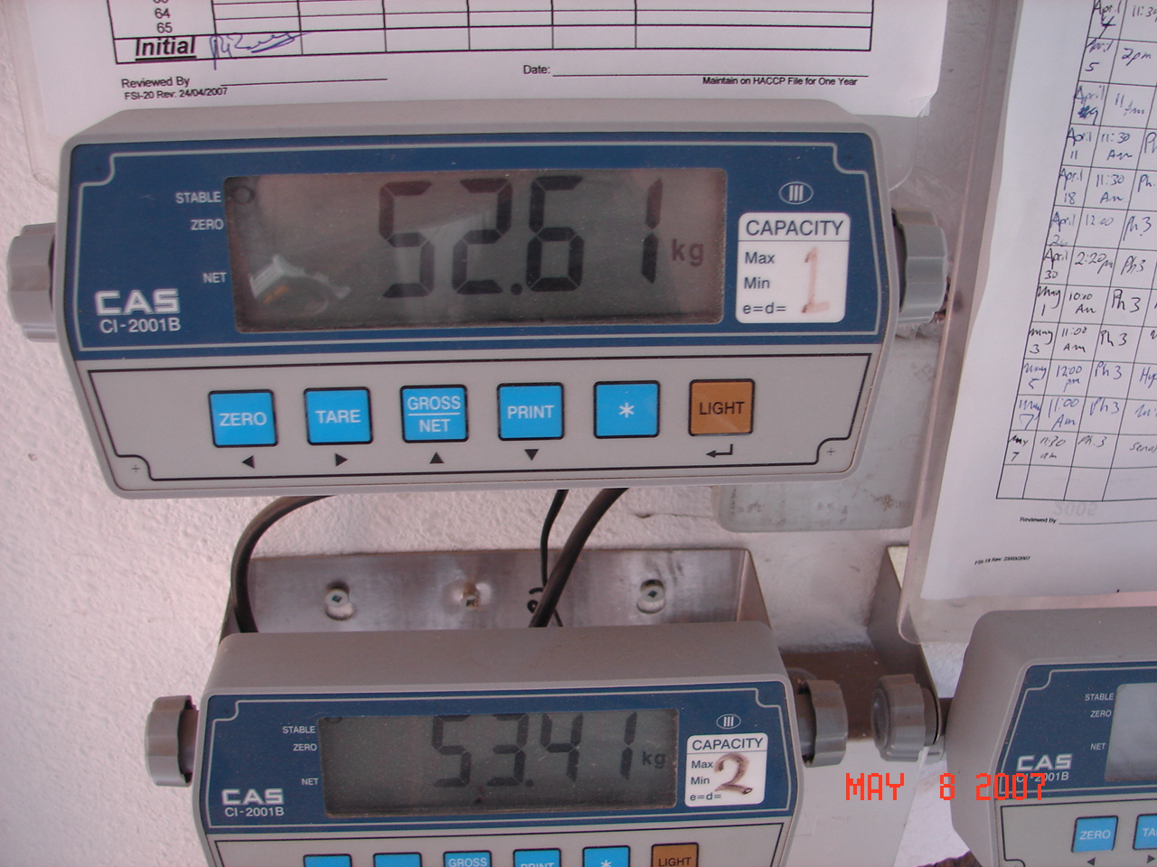
Water Applications

Slide 53
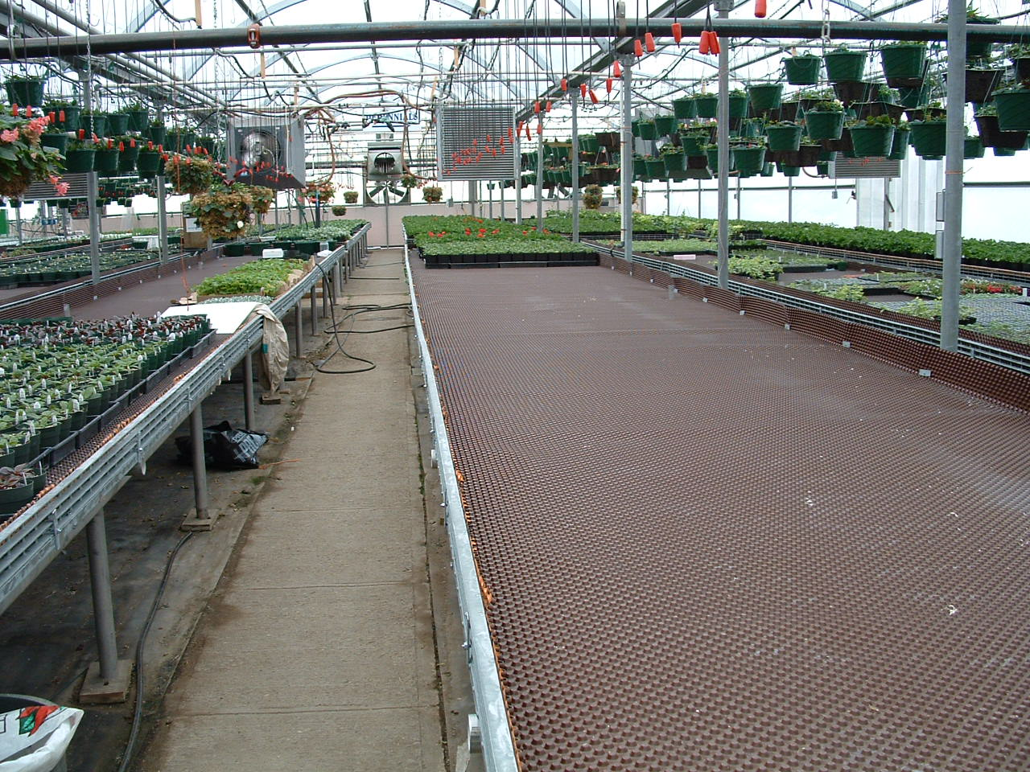
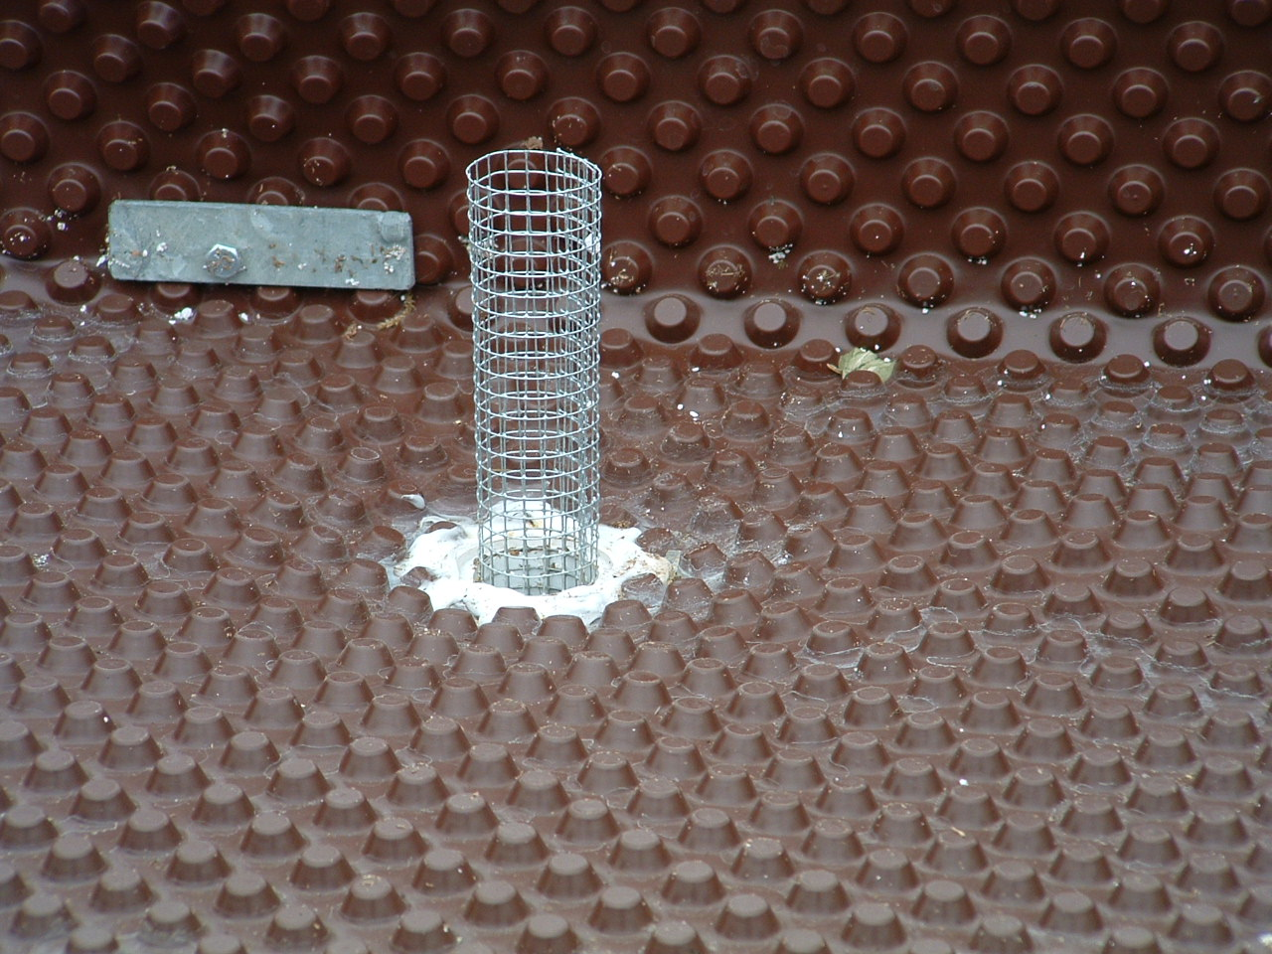
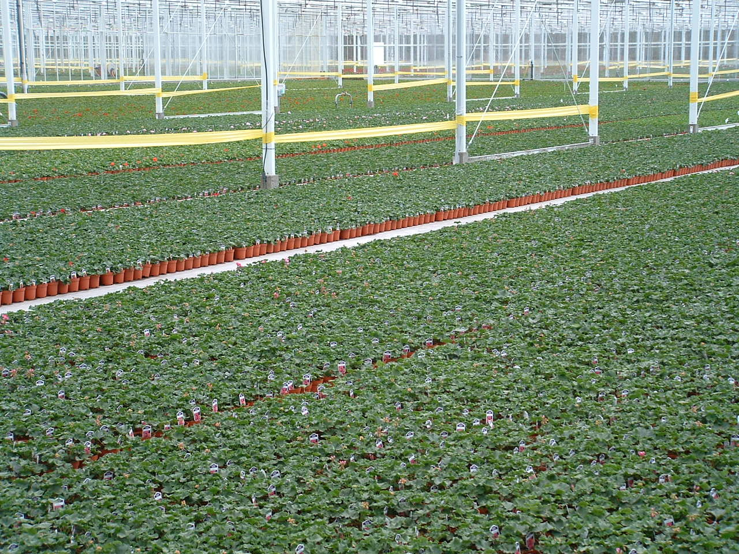
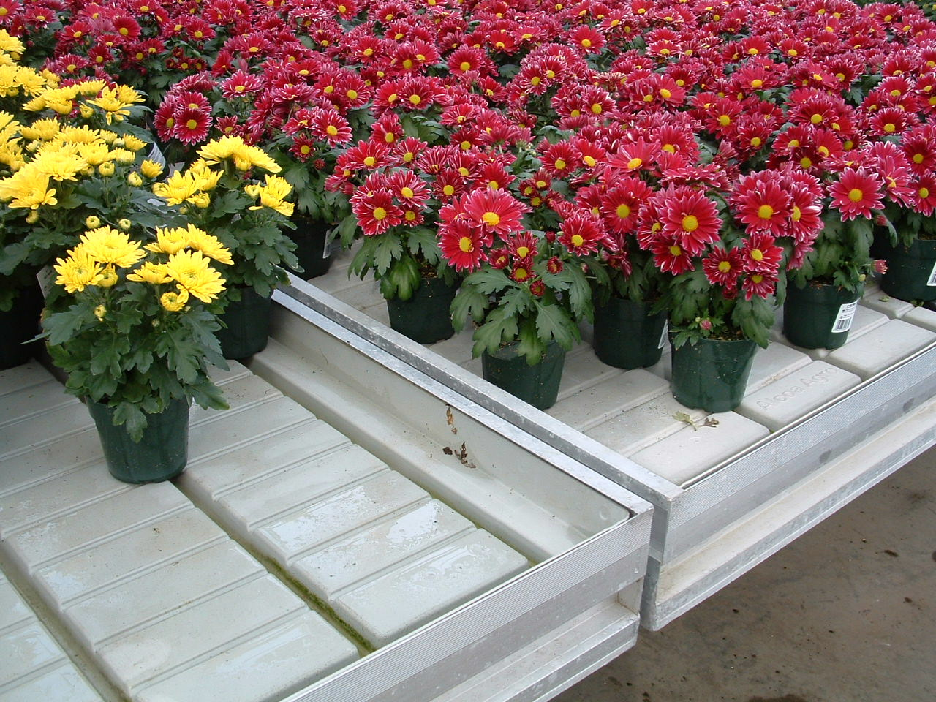
Water Applications

Slide 54
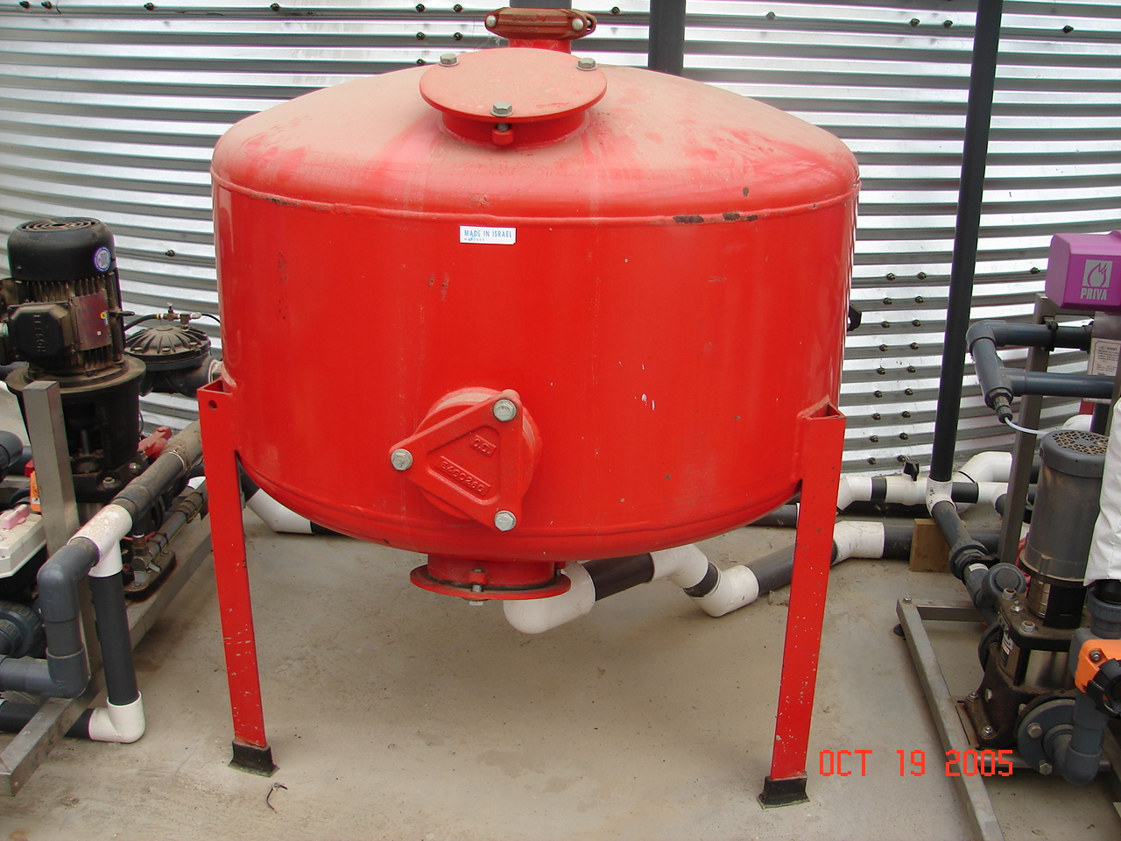
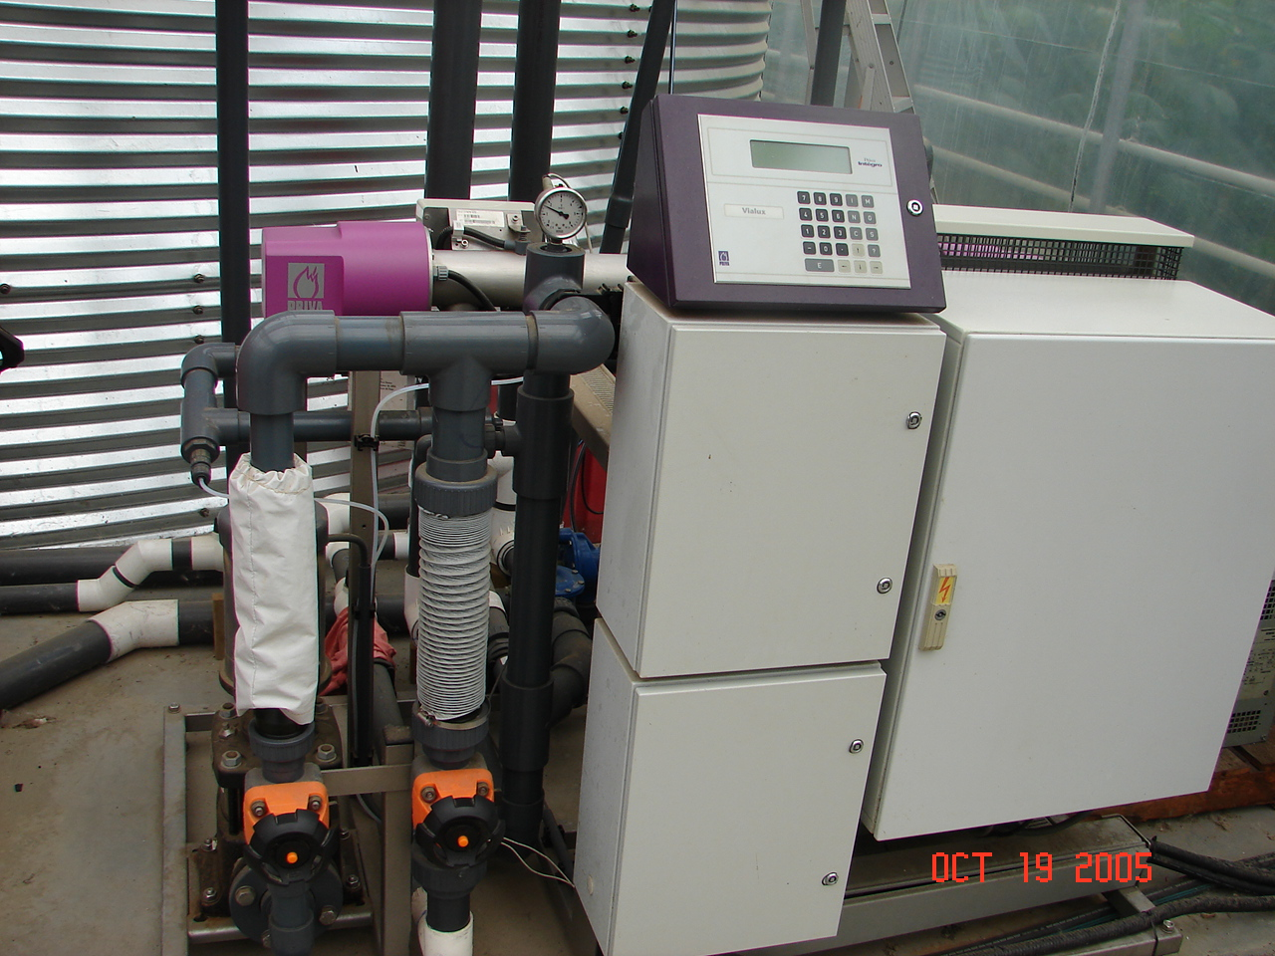
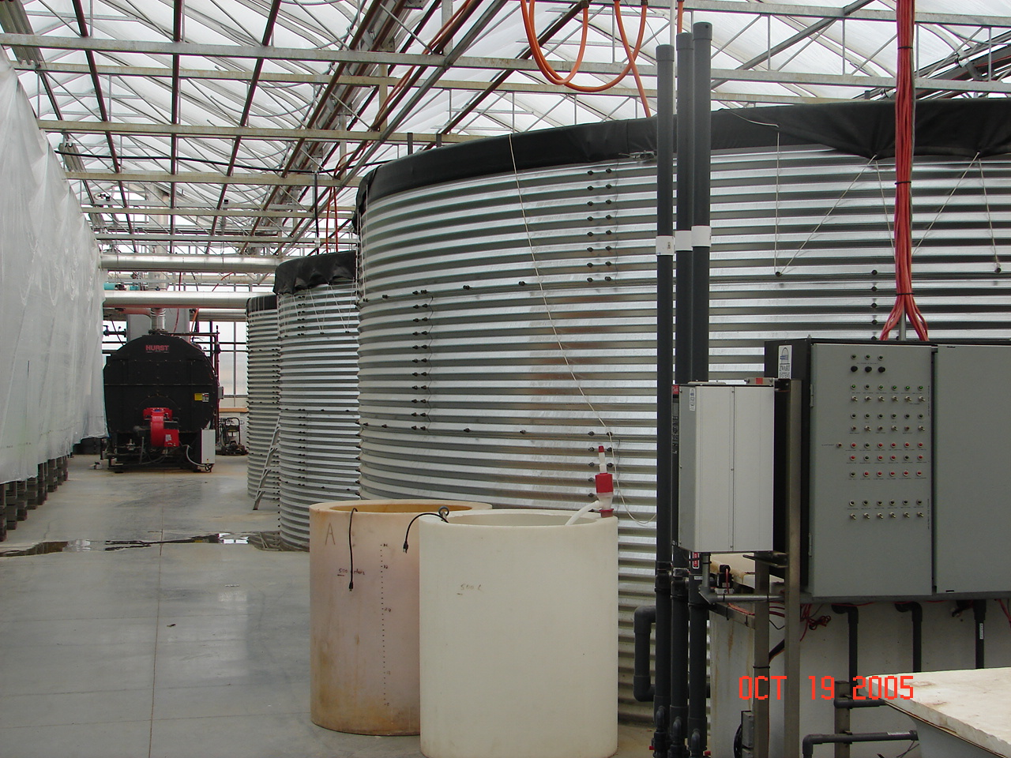
Water use in greenhouses

Slide 55
Water treatment
Distillation
Deionization
Reverse Osmosis
UV, Ozone, ECA water, Hytec water
Water Softeners
Chemical Treatments
  Deflocculation
  Organic/enzymes complex stuff
  Use of hydrogen per oxide

Slide 56
Water contamination
Too close to dairy, elk farming
  Possibilities of E.coli contamination if you are using foliar feeding or spraying.
  Watch for any potential pesticide contamination.
  Water and personal hygiene
  Handling vegetables.

Slide 57
Herbicide contamination
Very Big, Real and Serious Problem
Herbicide coming from spraying of Ditches by counties
Growers bringing water from other dugouts without knowing.
Truck used for watering was contaminated
Drift from sprays.
Contaminated compost because of grass clippings

Slide 58
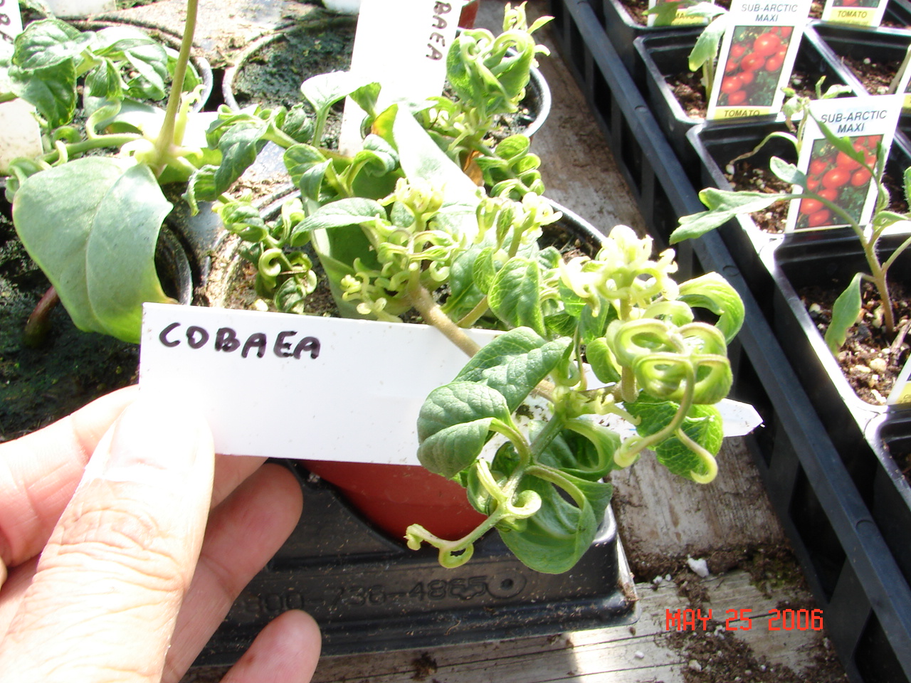
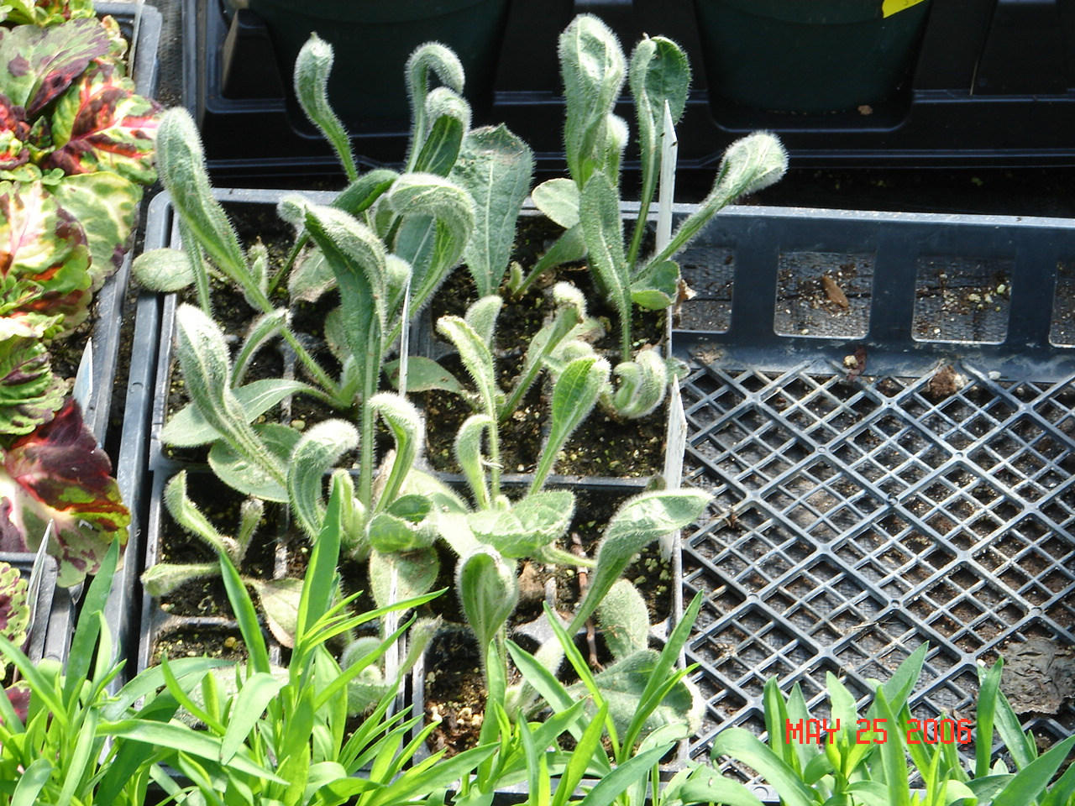
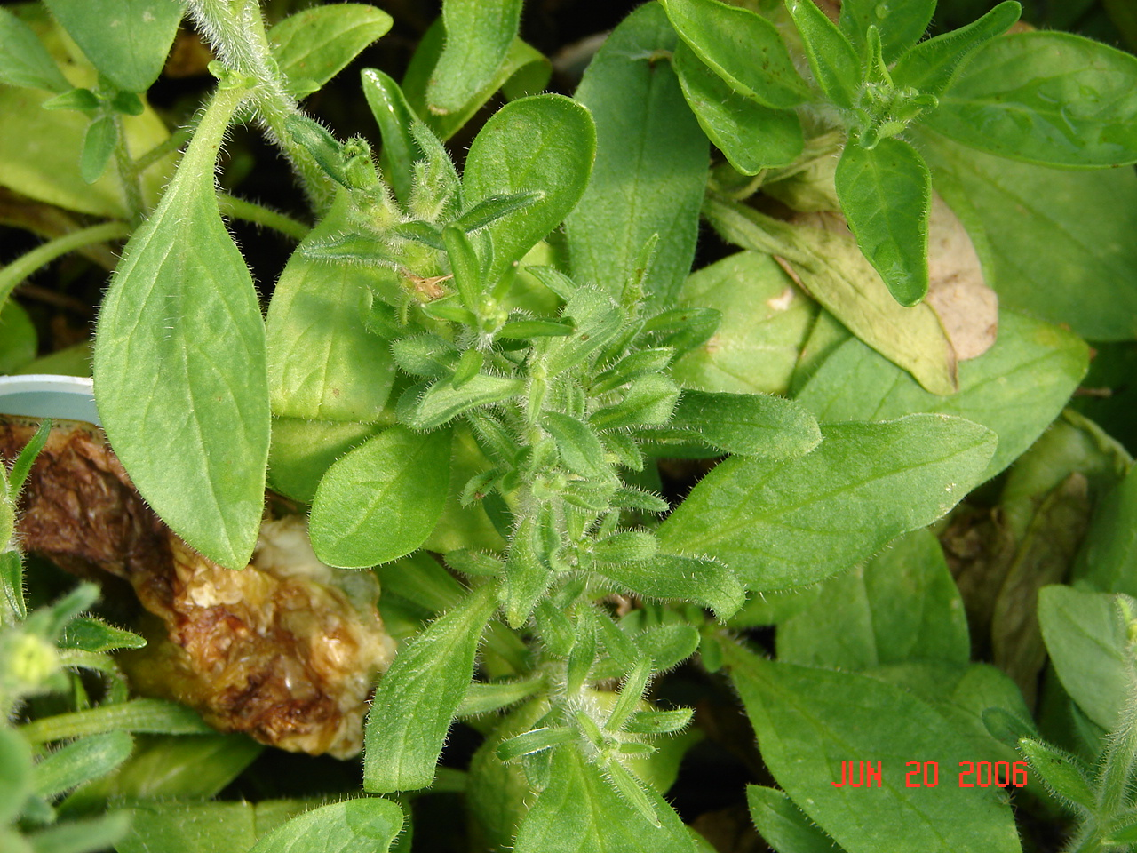

Herbicide

Slide 59



Herbicide Contamination

Slide 60
Algae control in ponds
Can deplete oxygen - Look for color change from dark green to a pale green. Levels below 3 ppm are LOW
Dugout Aeration system
Watershed Management: Avoid run off from sources of manure, maintaining a 30m vegetation buffer
Barley straw- 10 g straw/m2 of water surface, apply in autumn, winter or early spring.

Slide 61
Algae control
Chemical treatments:
  Cutrine-Plus is chelated copper applied at 0.6 to 1.2 gallons per acre of water.
  Copper sulfate: 450 grams/hectare

Slide 62
Microbial Contamination
Pythium, Fusarium
  Sand Filtration
  Use of Chlorine 1-5 ppm
  Use of Ozone, UV for disinfection
  Heat Pasteurization
  Hydrogen per oxide 10-100ppm

Slide 63

Leaching data

Slide 64

Fertilizers

Slide 65
Plants Needs
Carbon Hydrogen and Oxygen
Nitrogen, Phosphorus, Potassium, Calcium, Magnesium and Sulfur
Iron, Manganese, Copper, Boron, Molybdenum, Chloride and silicon
Plants are non-selective, absorb from root zone
Nutrient needs vary on growth stage and plant decides on it’s own
Climate directly affects the uptake of nutrients

Slide 66
Premade Fertilizers
10-52-10
12-2-14 (6 Ca 3 Mg)
20-8-20
20-2-20
14-0-14 (6 CA 3 Mg)
15-0-15 (11 Ca)
7-11-27, 15-10-30
5-6-27 Plus
High Phosphate
Low phosphate but has calcium
Good N-K Balance – has NH4
Low phosphate
Good calcium and magnesium
Higher calcium
Higher N:K ratio

Slide 67
Some mistakes about the use of fertilizers
Complete fertilizer do not contain Calcium.
Calcium and Phosphate and Sulphate are only mixed in tanks as diluted solution, not in concentrate tanks
pH has to be monitored and adjusted regularly
Most of the time when a deficiency of a nutrient occurs it is due to pH on alkaline side.

Slide 68
5-6-27 Plus is a new gen fertilizer used with Calcium nitrate
All nitrate nitrogen and 1% ammonium coming with calcium nitrate
Higher N:K ratio for a balanced growth
Always used at 1.6 grams/L to provide a balanced amount of trace element
Adequate magnesium
Plus factor is a blend of special seaweed extract from Norway

Slide 69
Greenhouse Chat is all set starting Feb. 12
A Zoom link will be sent to AGGA members and others who are intrested.

Slide 70
Greenhouse Chat
Topic: AGGA Chat 2024
Time: Feb 12, 2024 07:00 PM Edmonton
Every 2 weeks on Mon, until Jun 17, 2024, 10 occurrence(s)
Feb 12, 2024 07:00 PM
Feb 26, 2024 07:00 PM
Mar 11, 2024 07:00 PM
Mar 25, 2024 07:00 PM
Apr 8, 2024 07:00 PM
Apr 22, 2024 07:00 PM
May 6, 2024 07:00 PM
May 20, 2024 07:00 PM
Jun 3, 2024 07:00 PM
Jun 17, 2024 07:00 PM
Join Zoom Meeting
https://us06web.zoom.us/j/83871639568?pwd=9QmXMJdBG3NGPr62eVVo5BgKbB2w9j.1
Meeting ID: 838 7163 9568
Passcode: 499043

Slide 71
Summary
Water use in greenhouse is determined by the crops, growing media, sunlight, growth stage and other uses.
Basic understanding of quality is needed
Automation where possible
Water treatment options must be understood to make good decisions.

