Slide 1
Nutritional and Pathogen diseases of different greenhouse crops
Mohyuddin Mirza, Ph.D., Professional Agrologist
Edmonton, Alberta
drmirzagreen@gmail.com
780 885 0652
Especially prepared for SGGA, February 8, 2024

Slide 2
Major reasons for deficiencies and toxicities?
Lack of a nutrient as such
Antagonism – Between calcium, magnesium and sodium
Any specific need of crop, e.g. Molybdenum in Poinsettias, Boron in peppers
Water logged conditions, low oxygen in root zone
Biggest problem is pH
Then high EC values

Slide 3
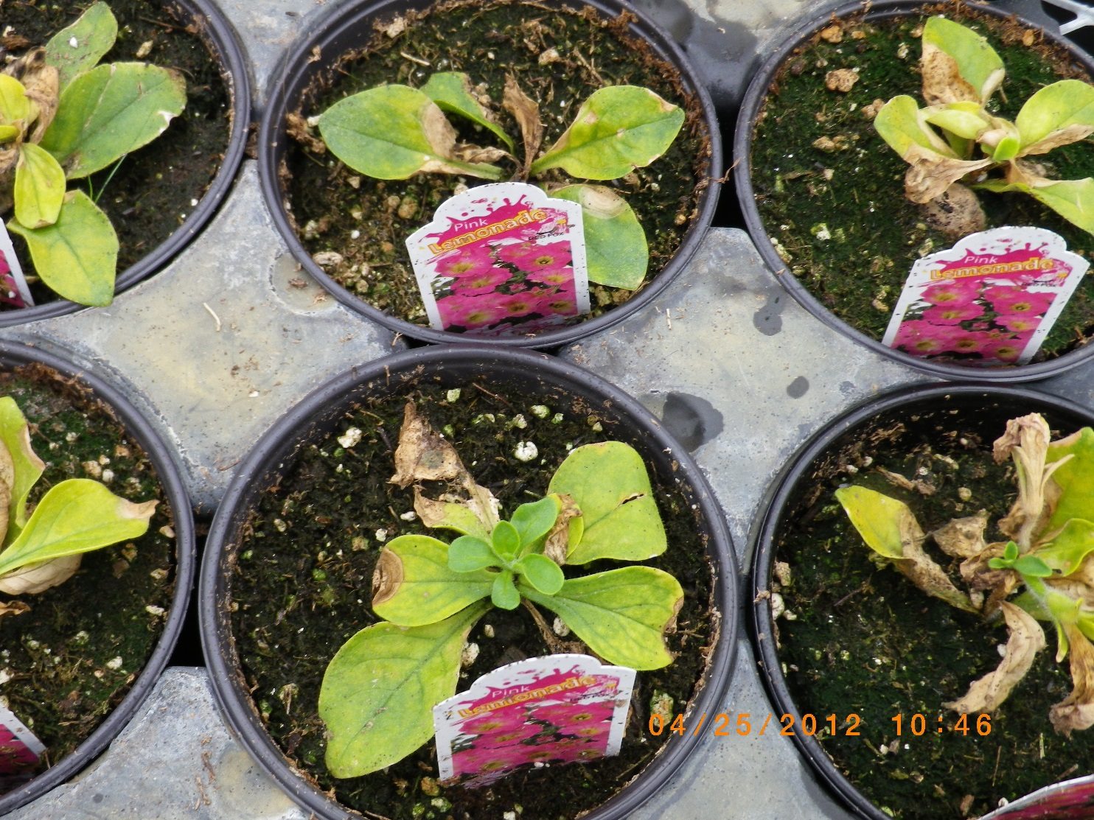
Petunia root rot
Petunia is a flowering plant
Planted in cold soil
Roots did not develop properly
Root rot due to a fungus Pythium
Leaves are showing deficiency of iron because roots cannot absorb iron

Slide 4
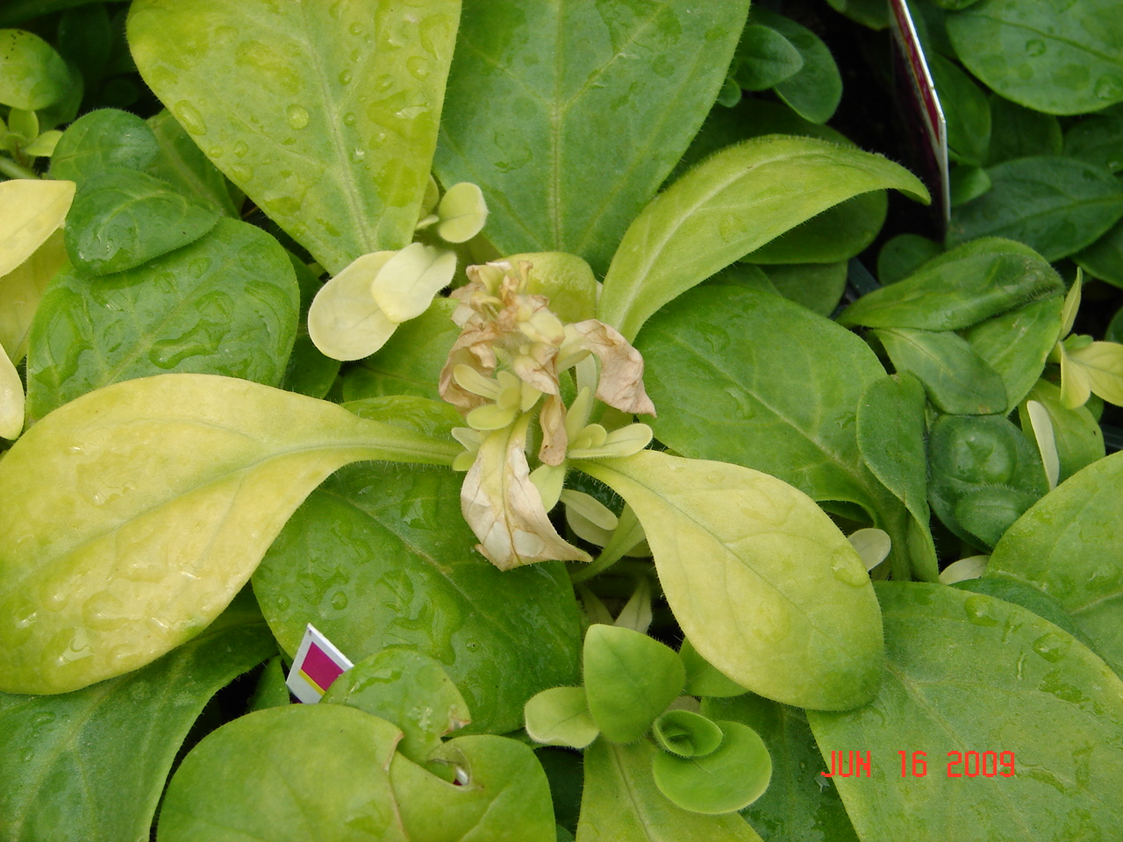
Serious calcium deficiency in Petunias
Calcium is an immobile element and does not move from lower to upper leaves.
Calcium and boron deficiency results in bunchy tops. Growth becomes stunted and yellowish and white later on

Slide 5
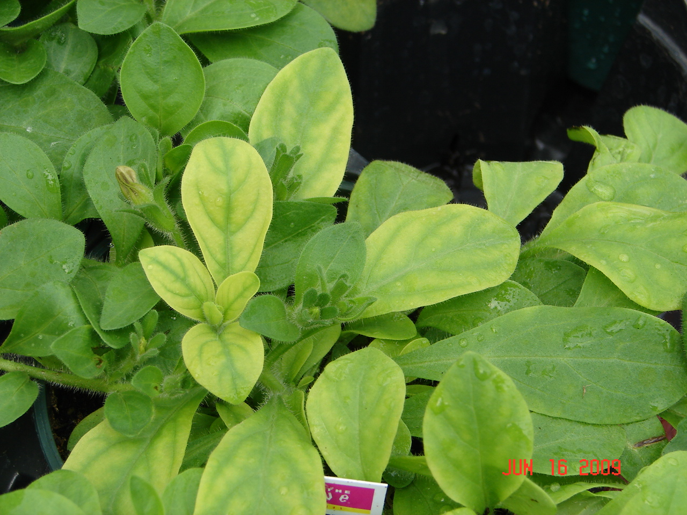
Iron deficiency in petunias
New growth is affected.
Veins are green and interveinal areas are yellow
Reduces photosynthesis of leaves
Mostly due to alkaline pH in the growing medium

Slide 6
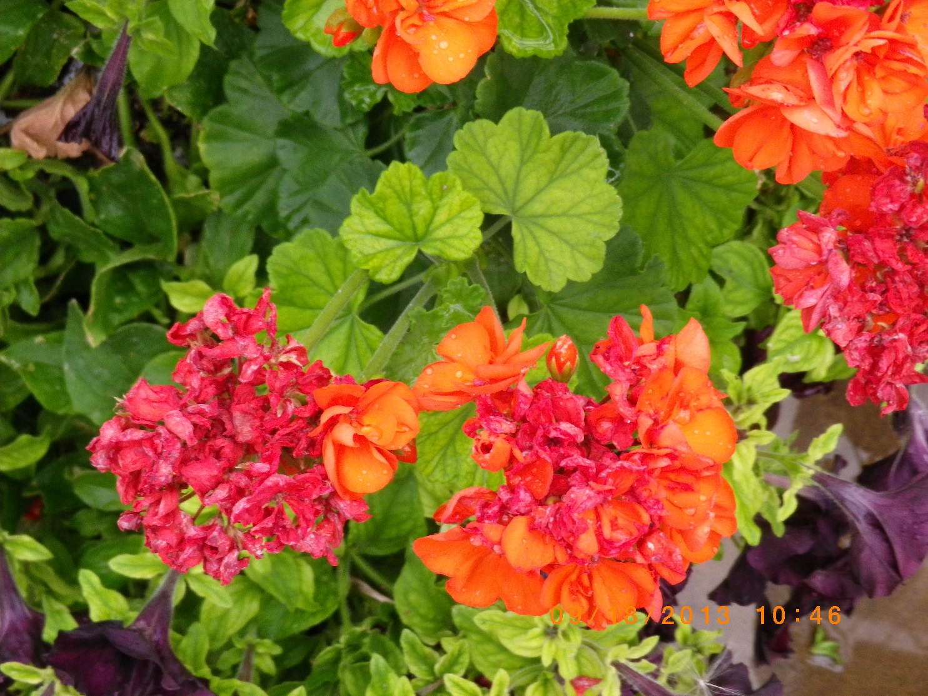
Iron deficiency in geraniums, High pH also Nitrogen deficiency

Slide 7
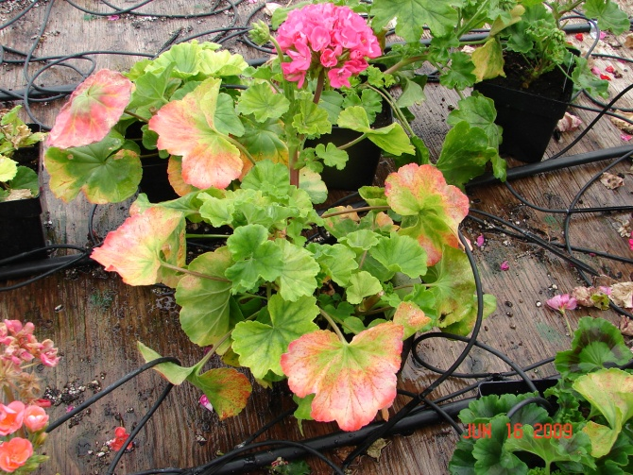
Geraniums showing phosphorus deficiency on lower leaves. Purple color. Generally due to cold temperature

Slide 8
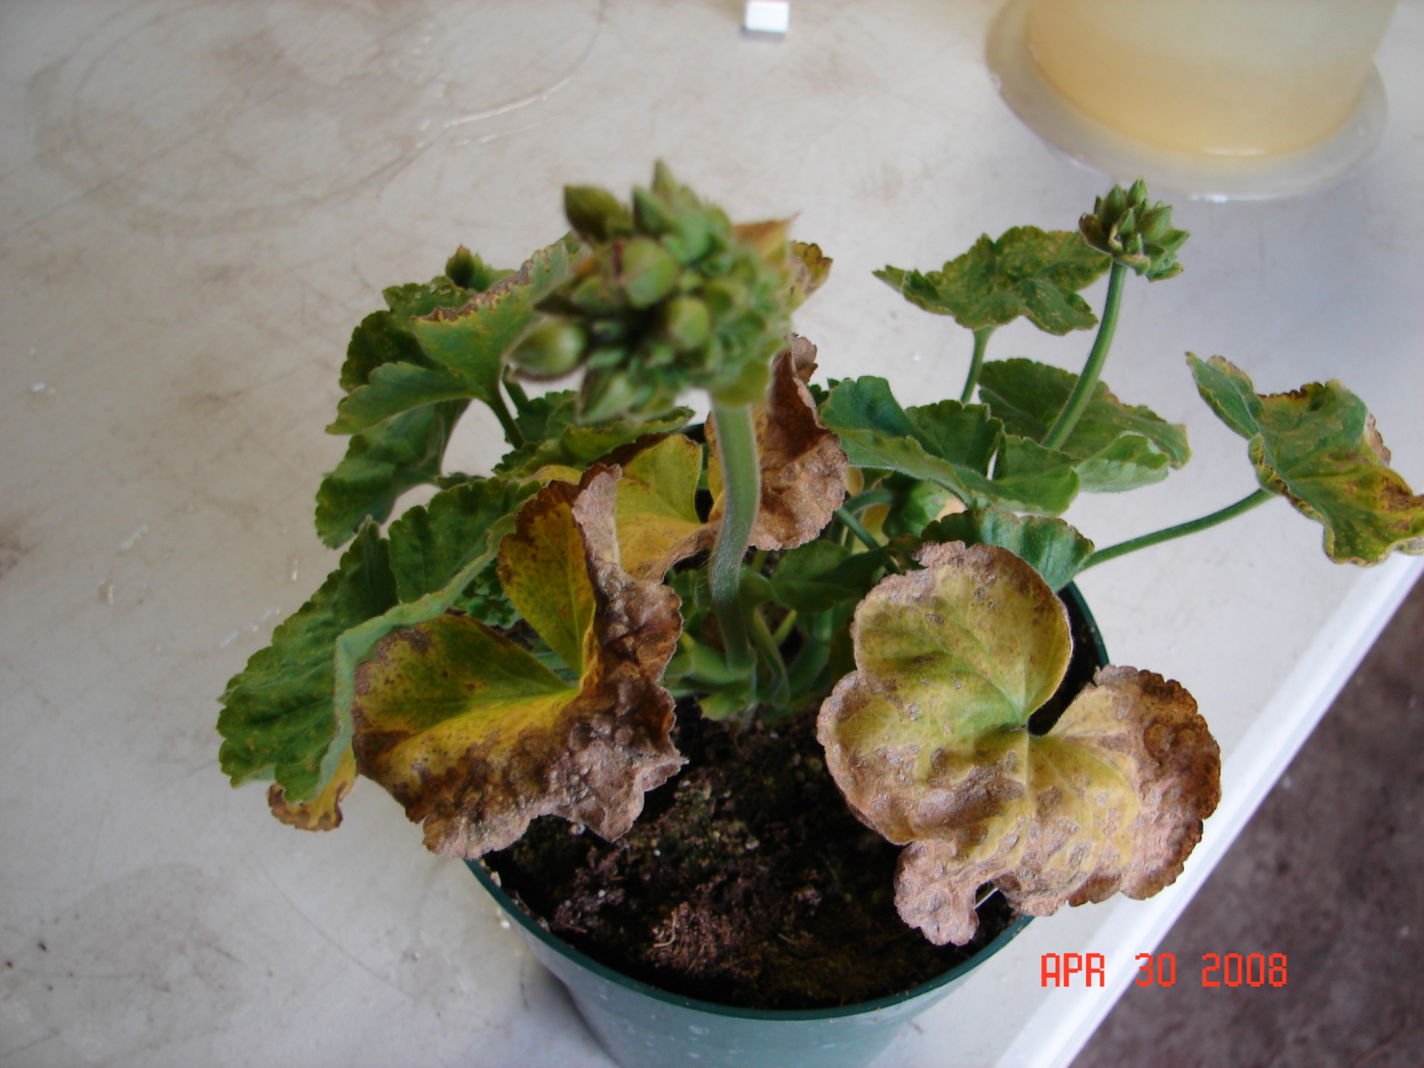
Acidic pH on geraniums. Iron and manganese toxicity. pH going below 5.5

Slide 9
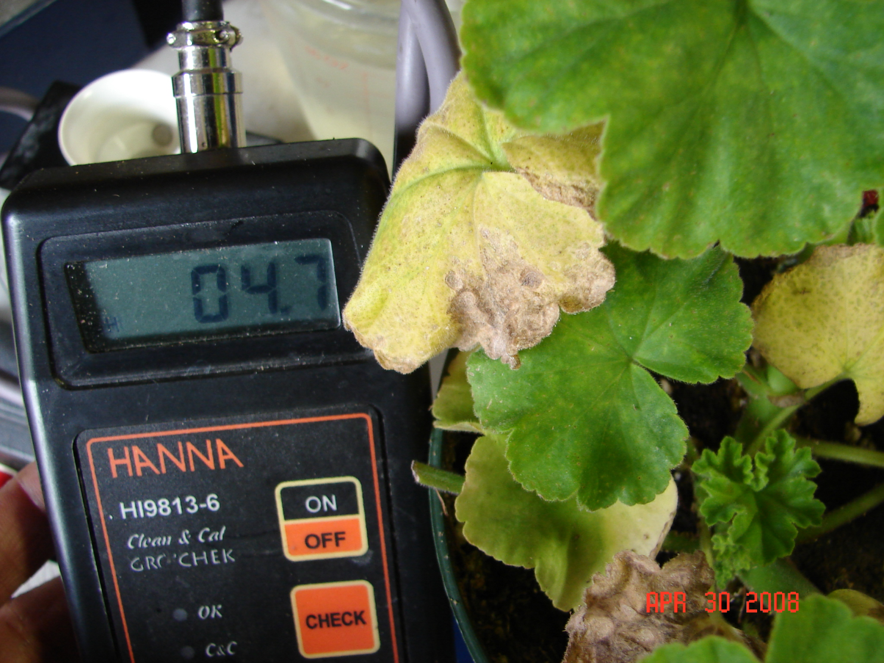
Actual pH readings from affected geraniums

Slide 10
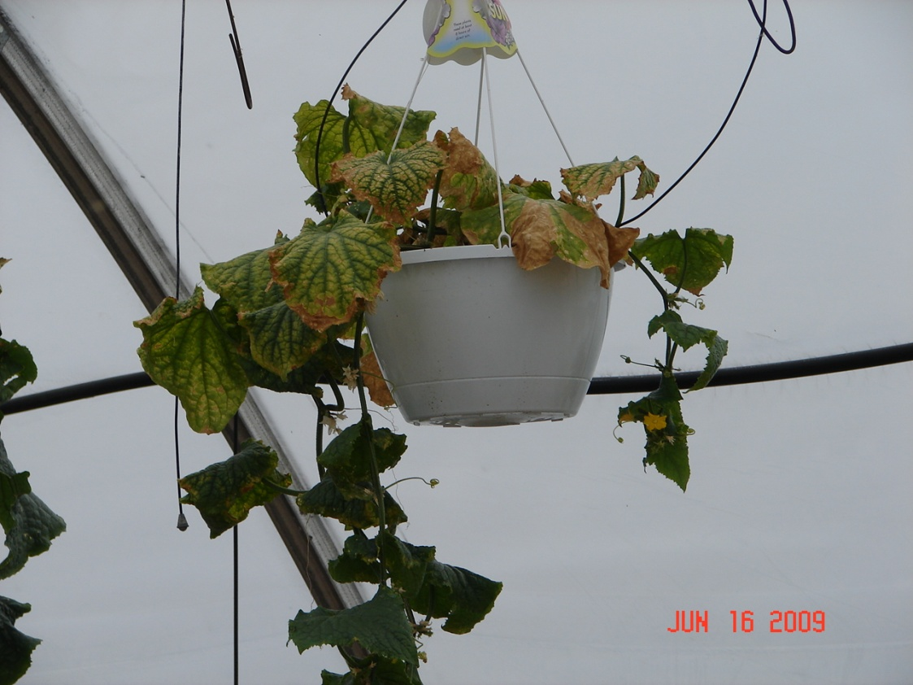
Cucumbers
Heat
Lack of nutrients
Pesticide
High EC

Slide 11
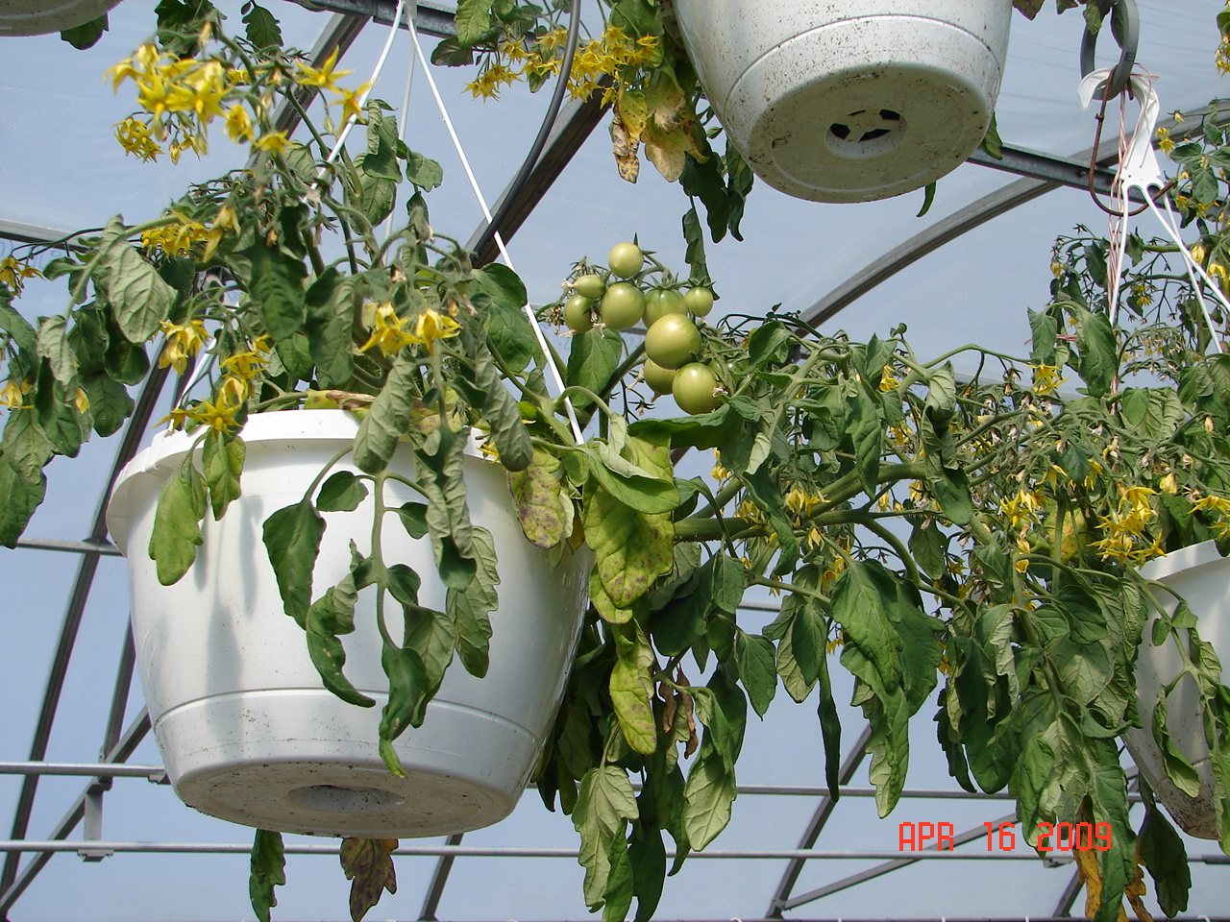
Too much wilting – generative response

Slide 12
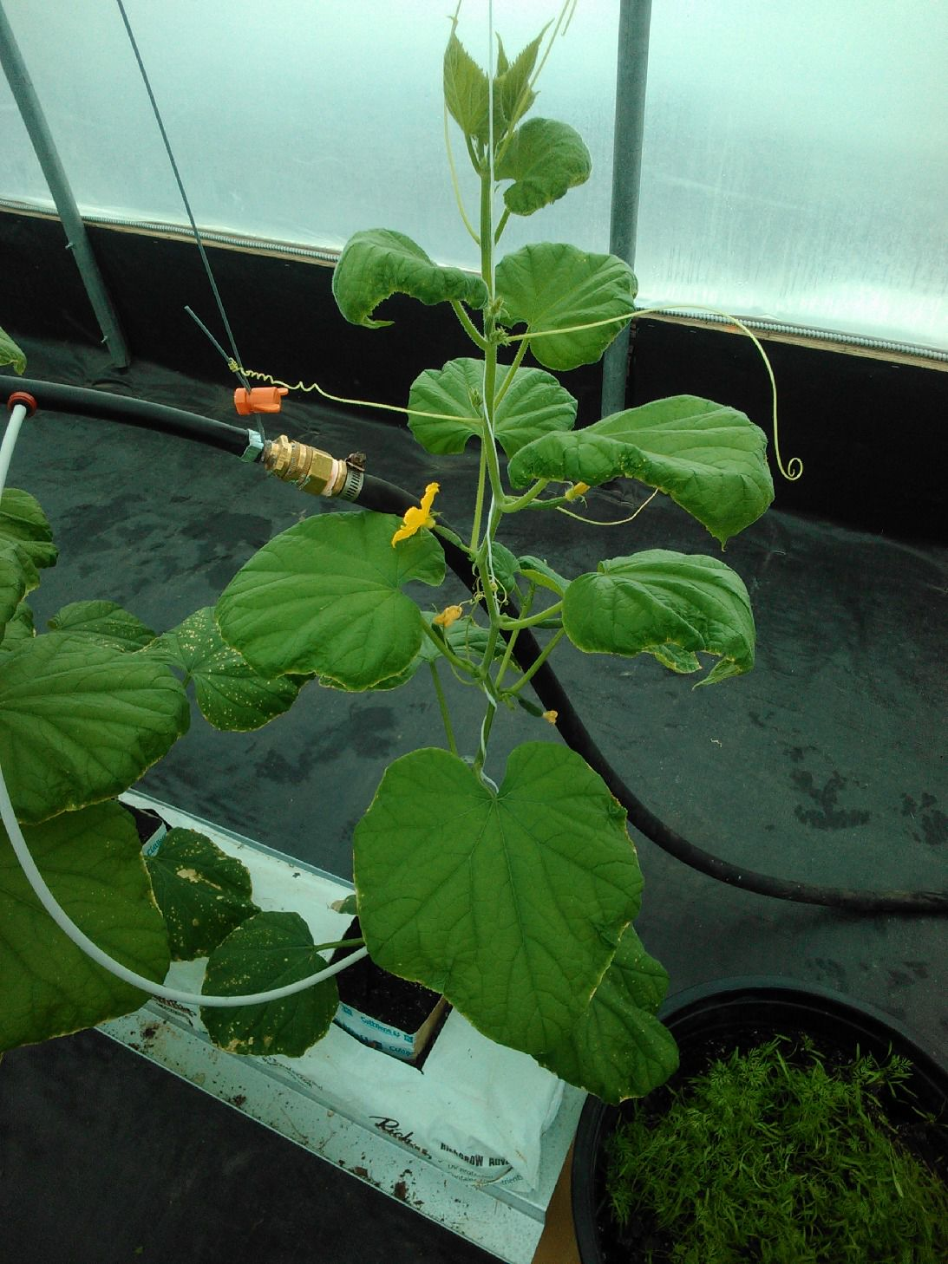
Calcium deficiency in cucumbers

Slide 13
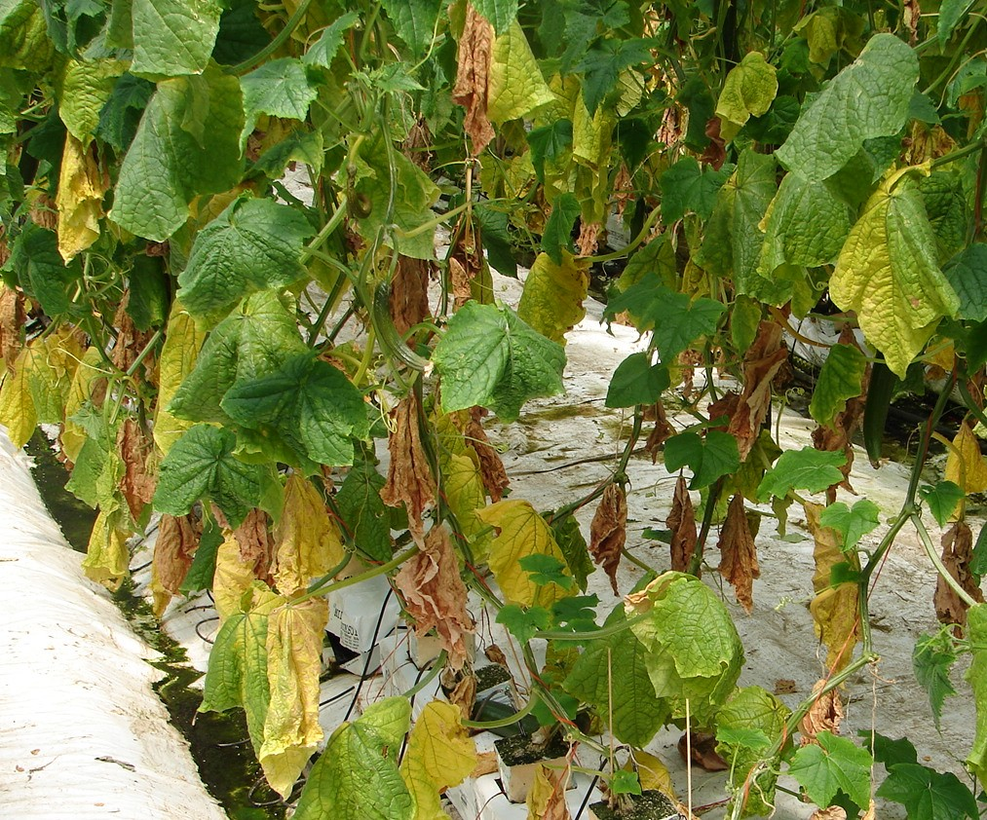
Pollution damage to cucumbers due to incomplete combustion of natural gas for heating

Slide 14
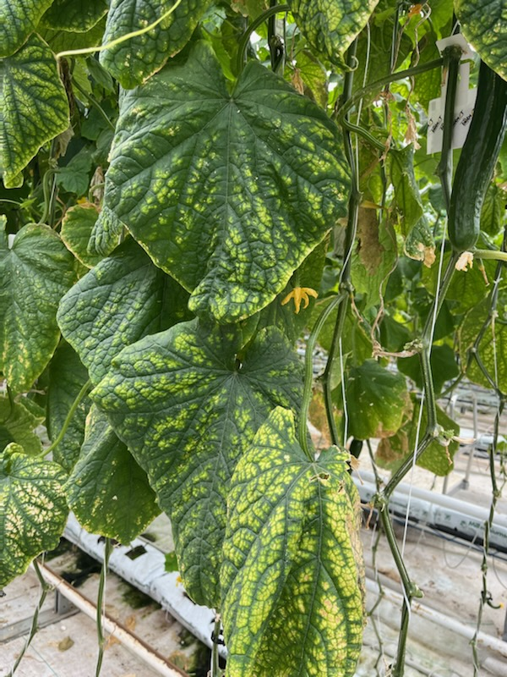
Magnesium deficiency in cucumbers

Slide 15
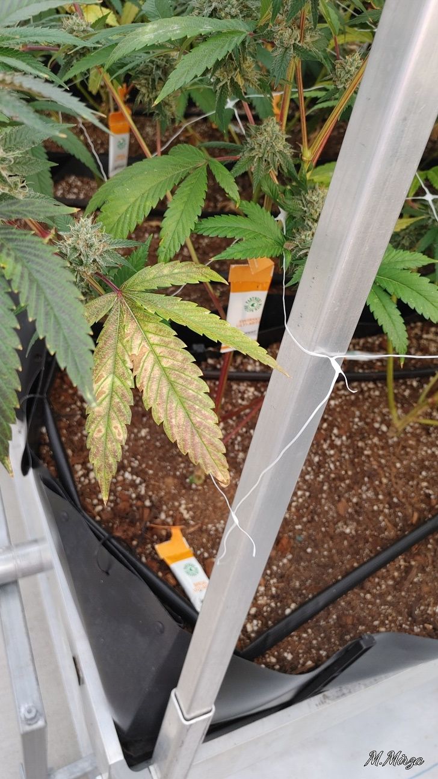
Phosphorus deficiency in cannabis leaves

Slide 16
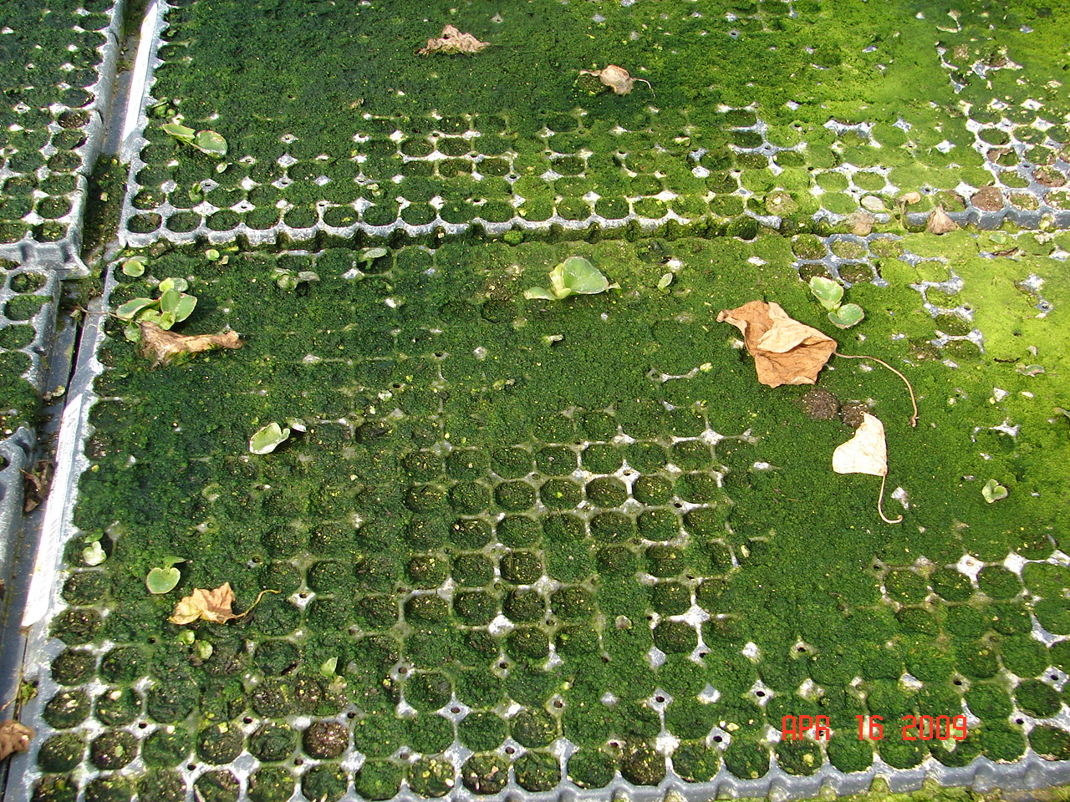
Too much algae effects germination

Slide 17
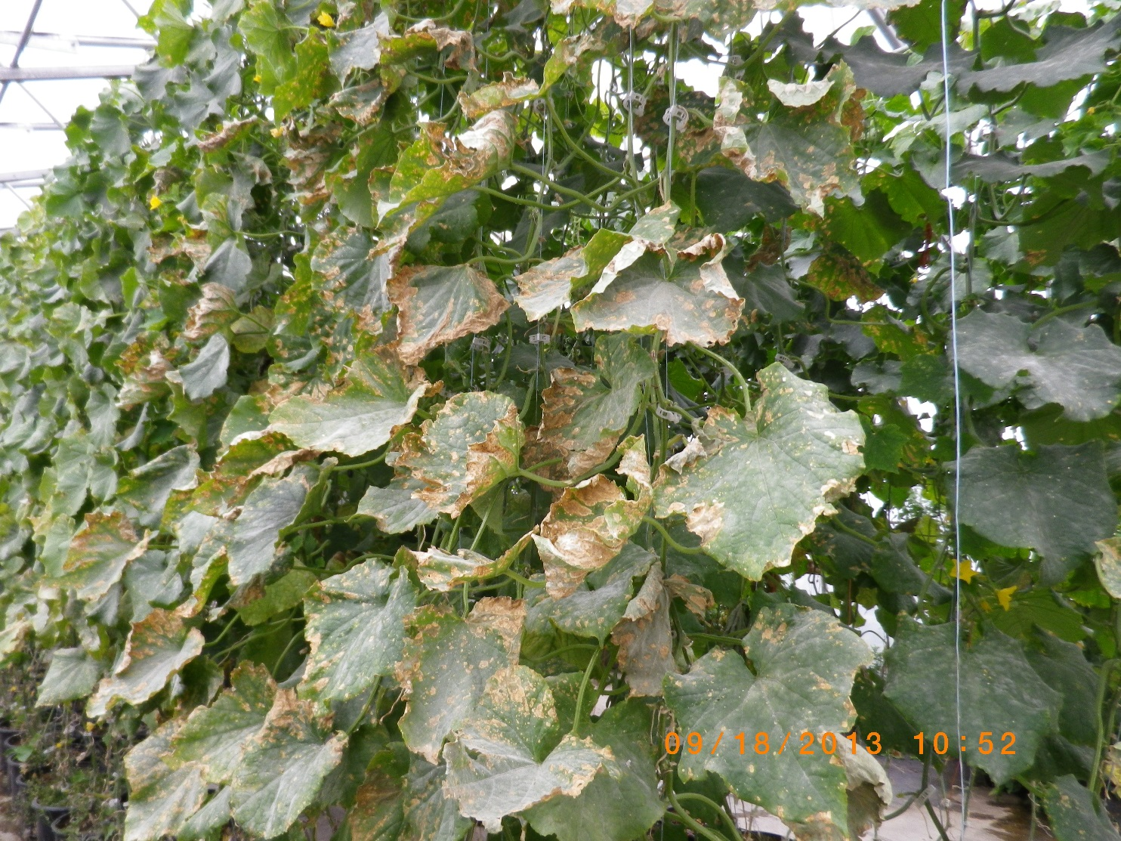
Phosphorus deficiency in cucumbers

Slide 18
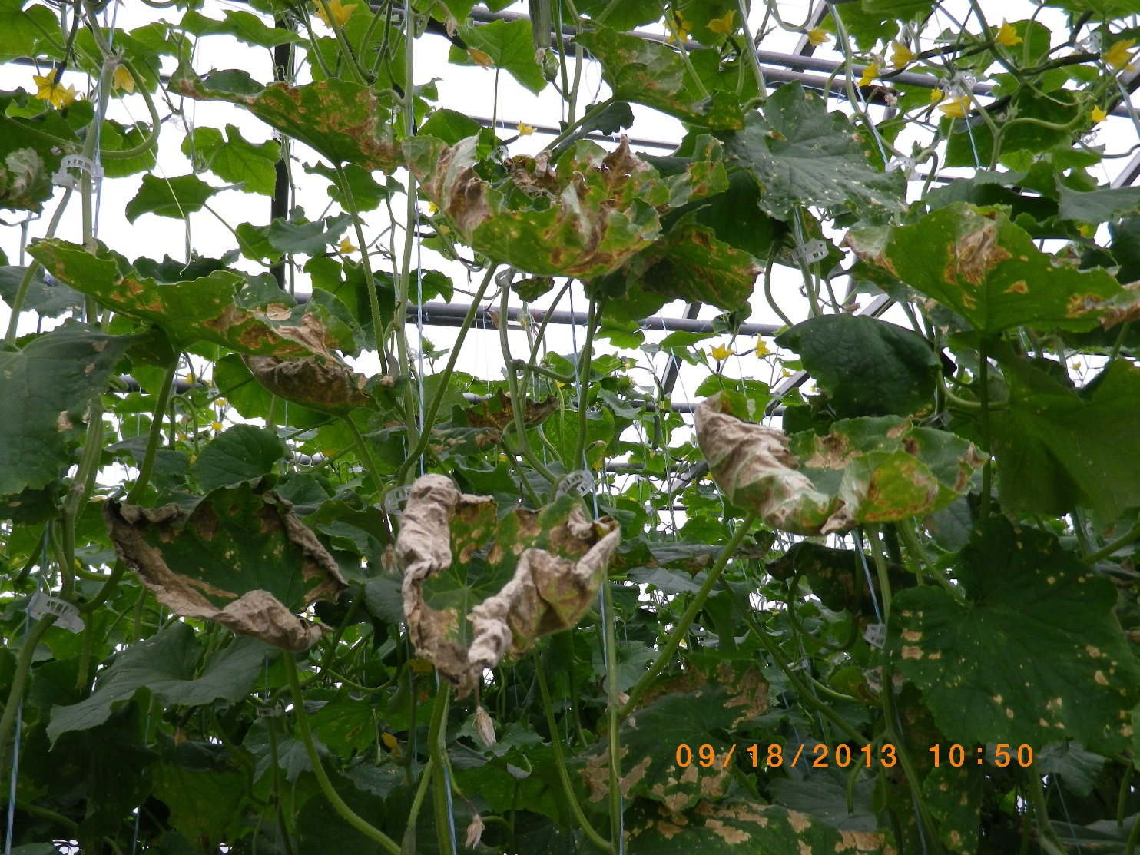
A close up of Phosphorus deficiency

Slide 19
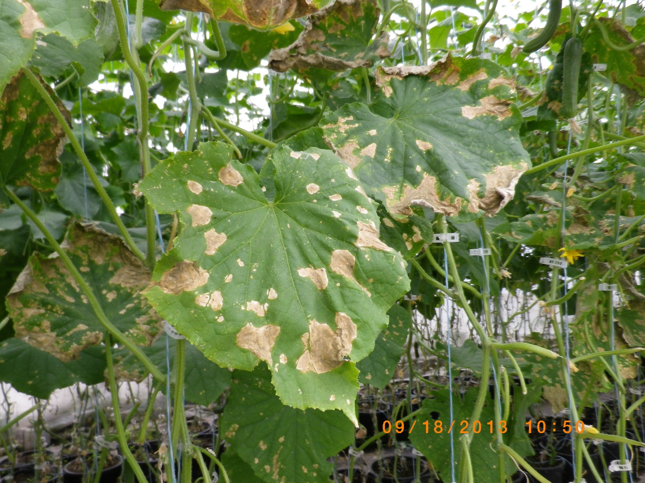
Phosphorus deficiency appears as blotches

Slide 20
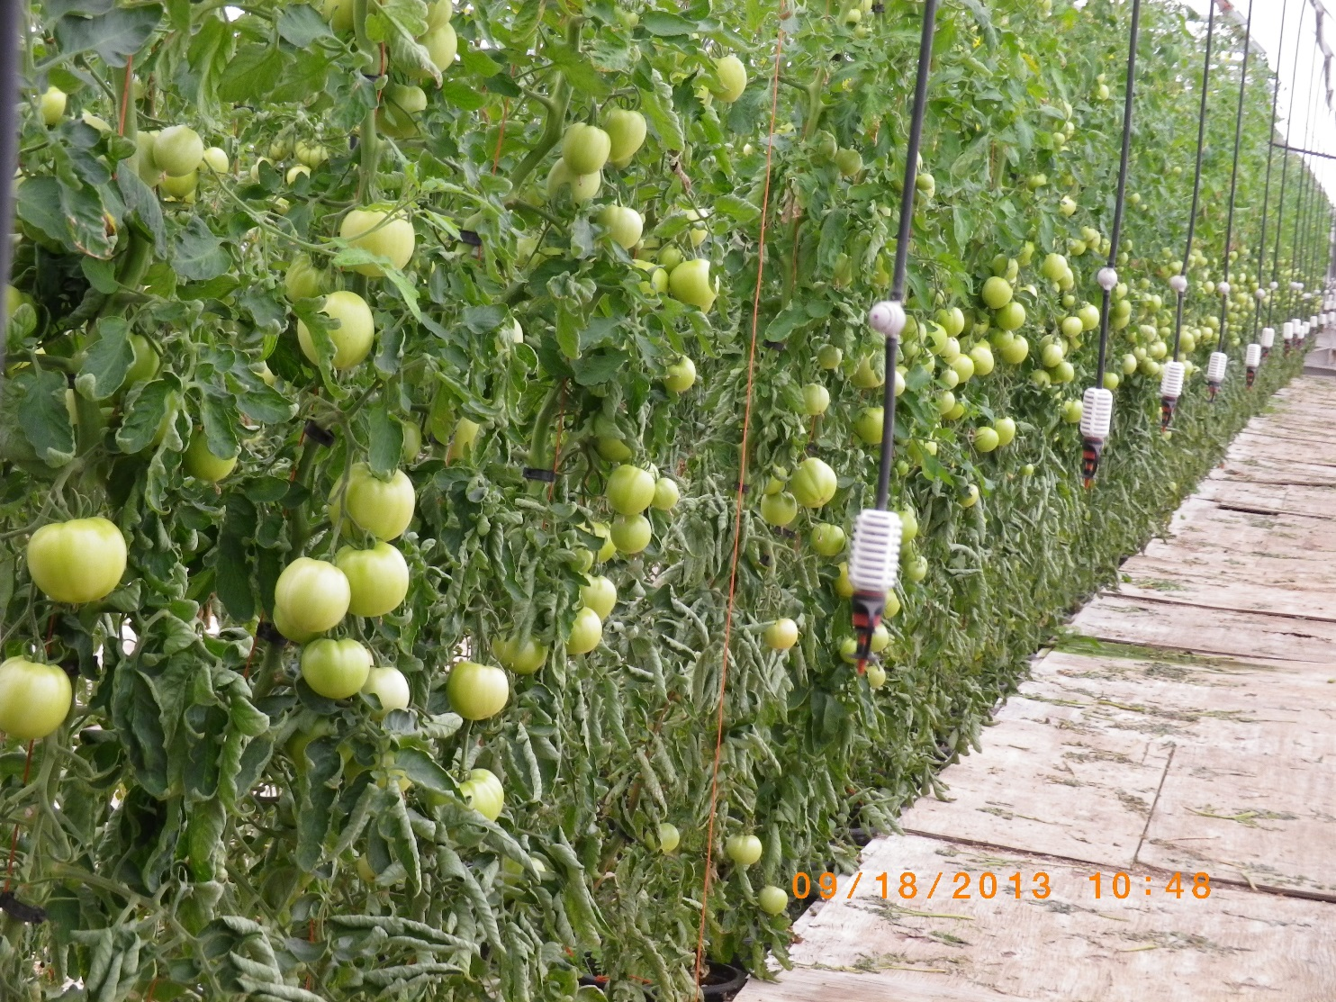
Tomatoes affected by high temperature going above 30C. Leaf role

Slide 21
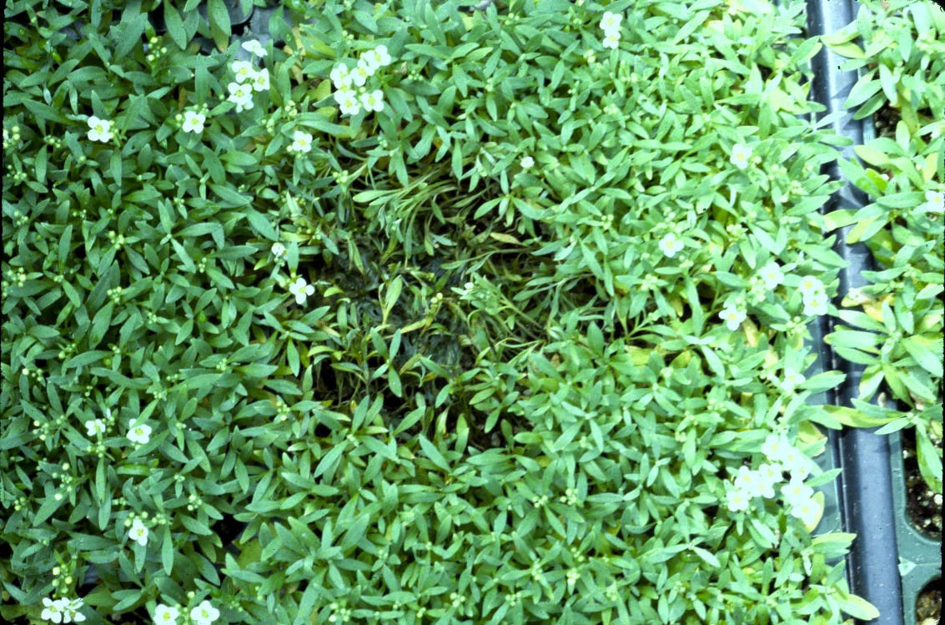
Rhizoctonia damping-off in tomato seedlings
Notes:
On alyssum a patch…once there’s a dense canopy, Rhizoc can spread easily across a flat, even a plug tray wherein plants have their individual ocmpartments

Slide 22
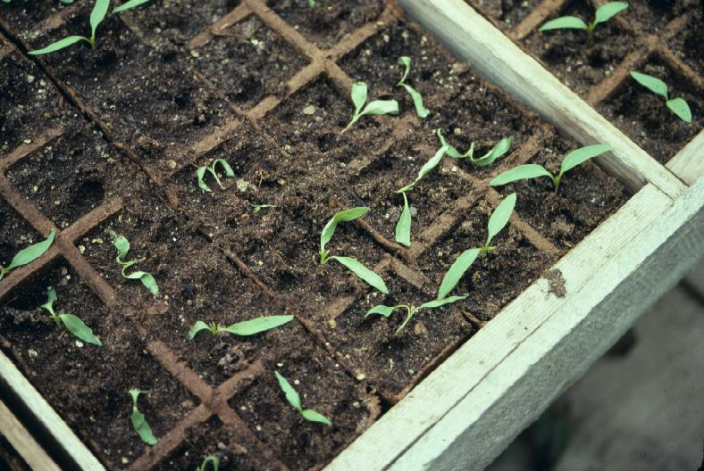

Slide 23
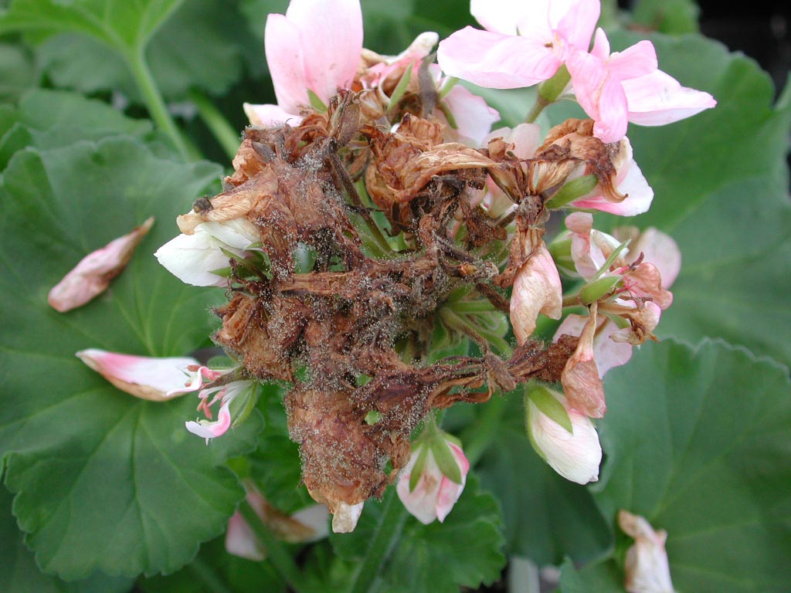
Grey mold Botrytis on geraniums
Disease of cold temperature and condensation

Slide 24
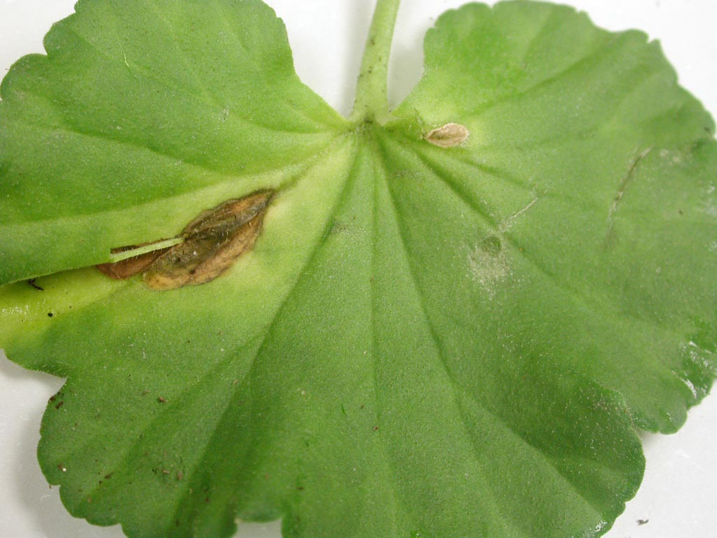
Grey mold Botrytis infection on leaf geraniums

Slide 25
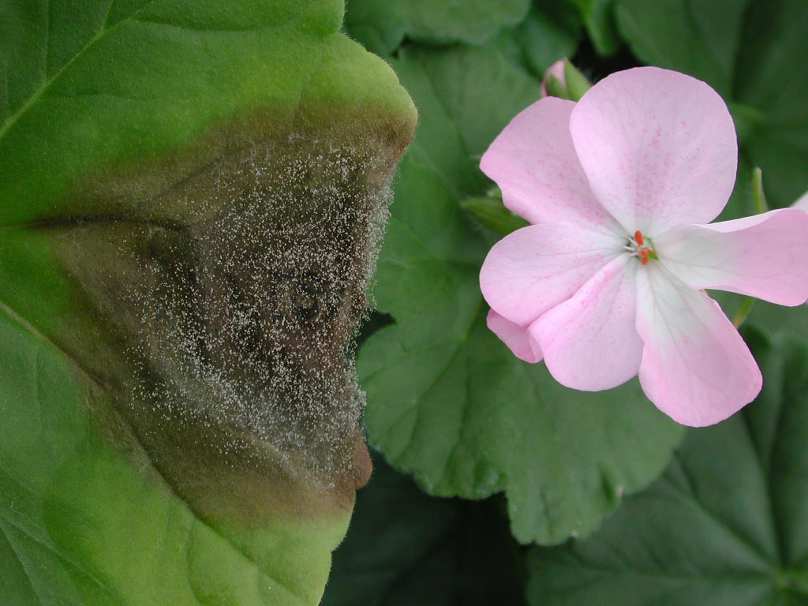
Botrytis on leaves of geraniums. Spores

Slide 26
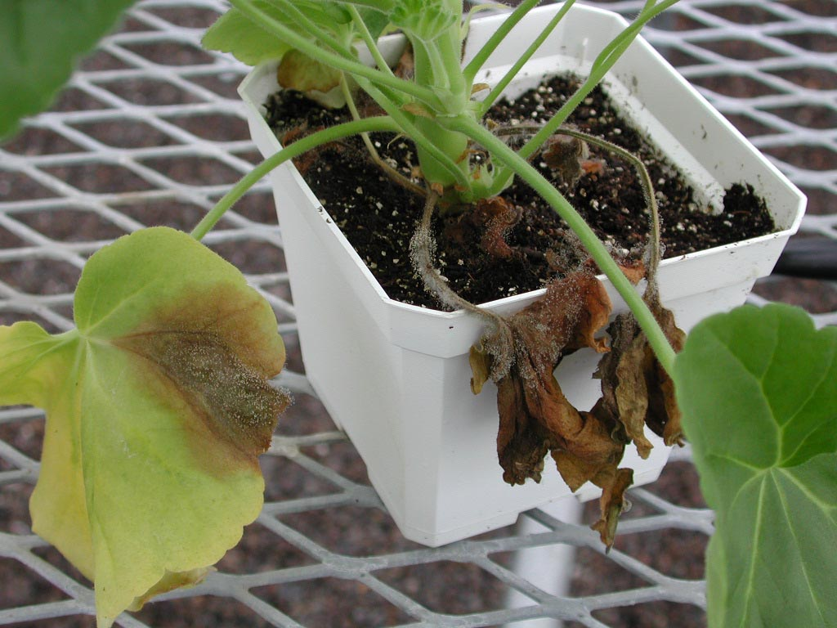
- Botrytis multiplies rapidly on dead and dying leves

Slide 27
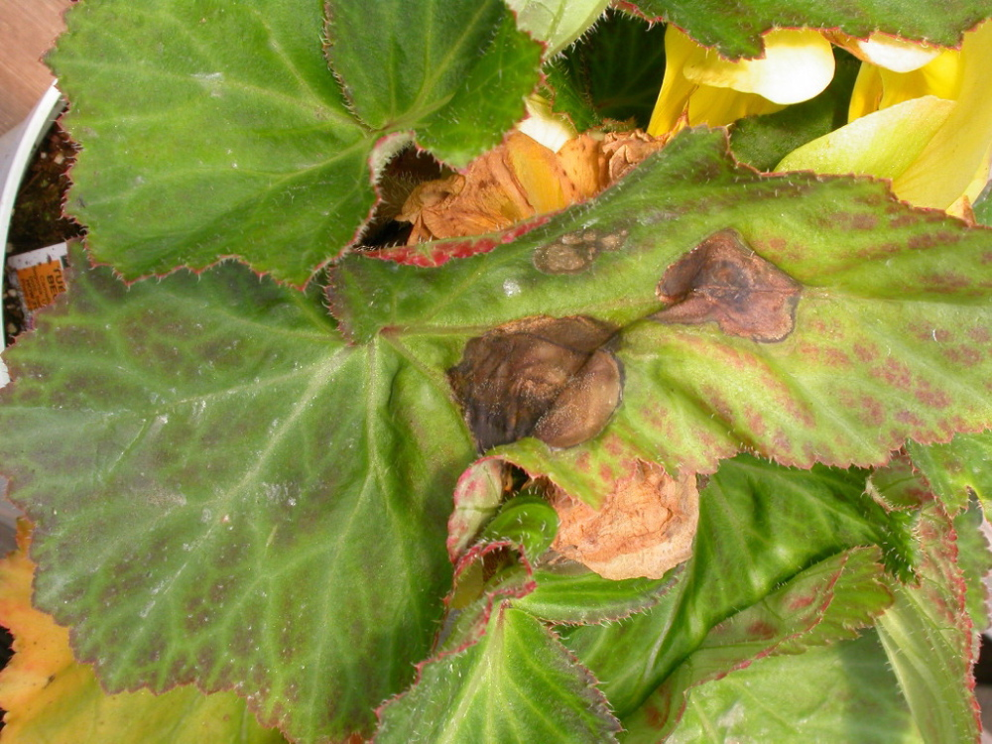
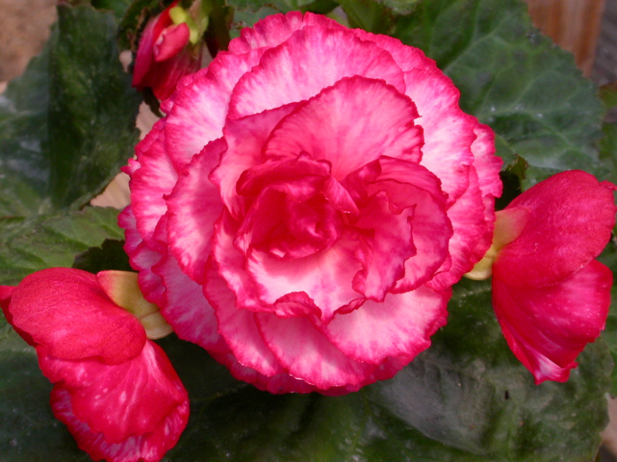
Botrytis
blight
Begonia

Slide 28
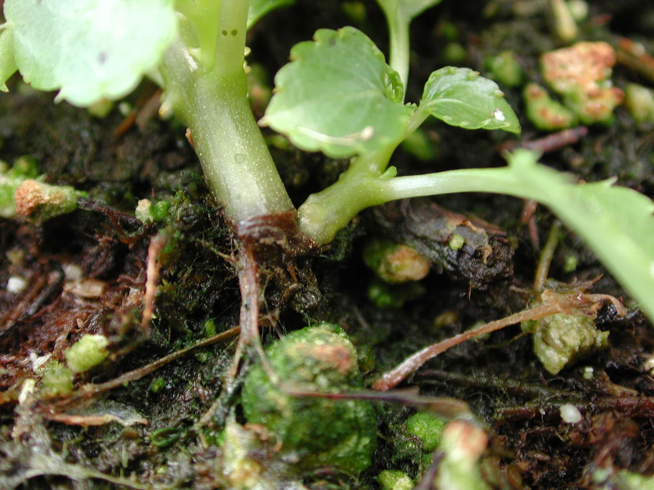
Rhizoctonia stem canker on begonias
Notes:
Canker at the base of an impatiens plant…Rhizoc attacks plants at the soil line

Slide 29
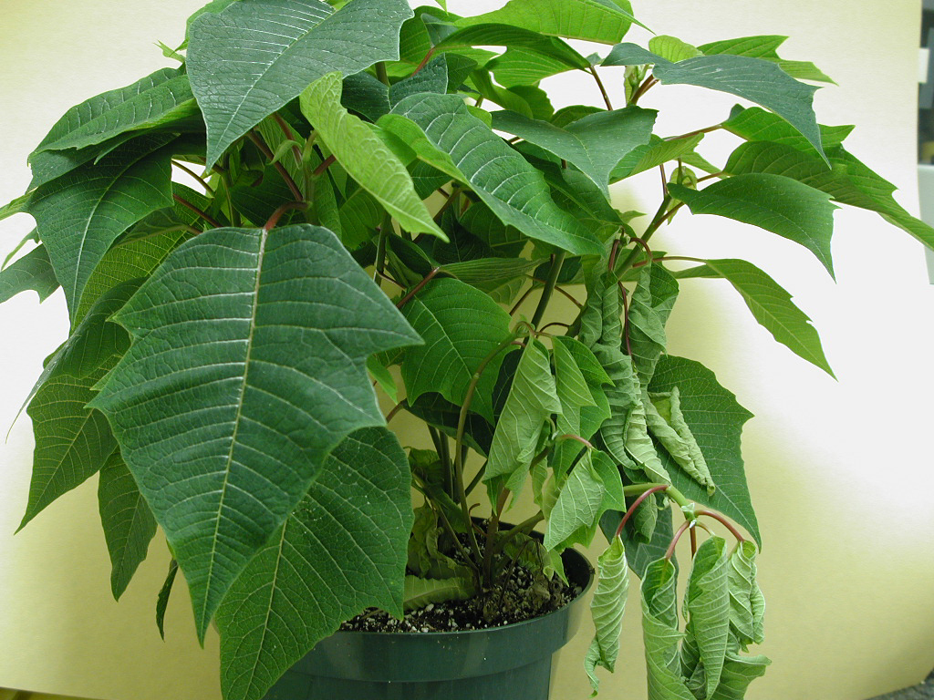
Black Root Rot
Notes:
Wilt on a poinsettia could be due to many different pathogens….

Slide 30
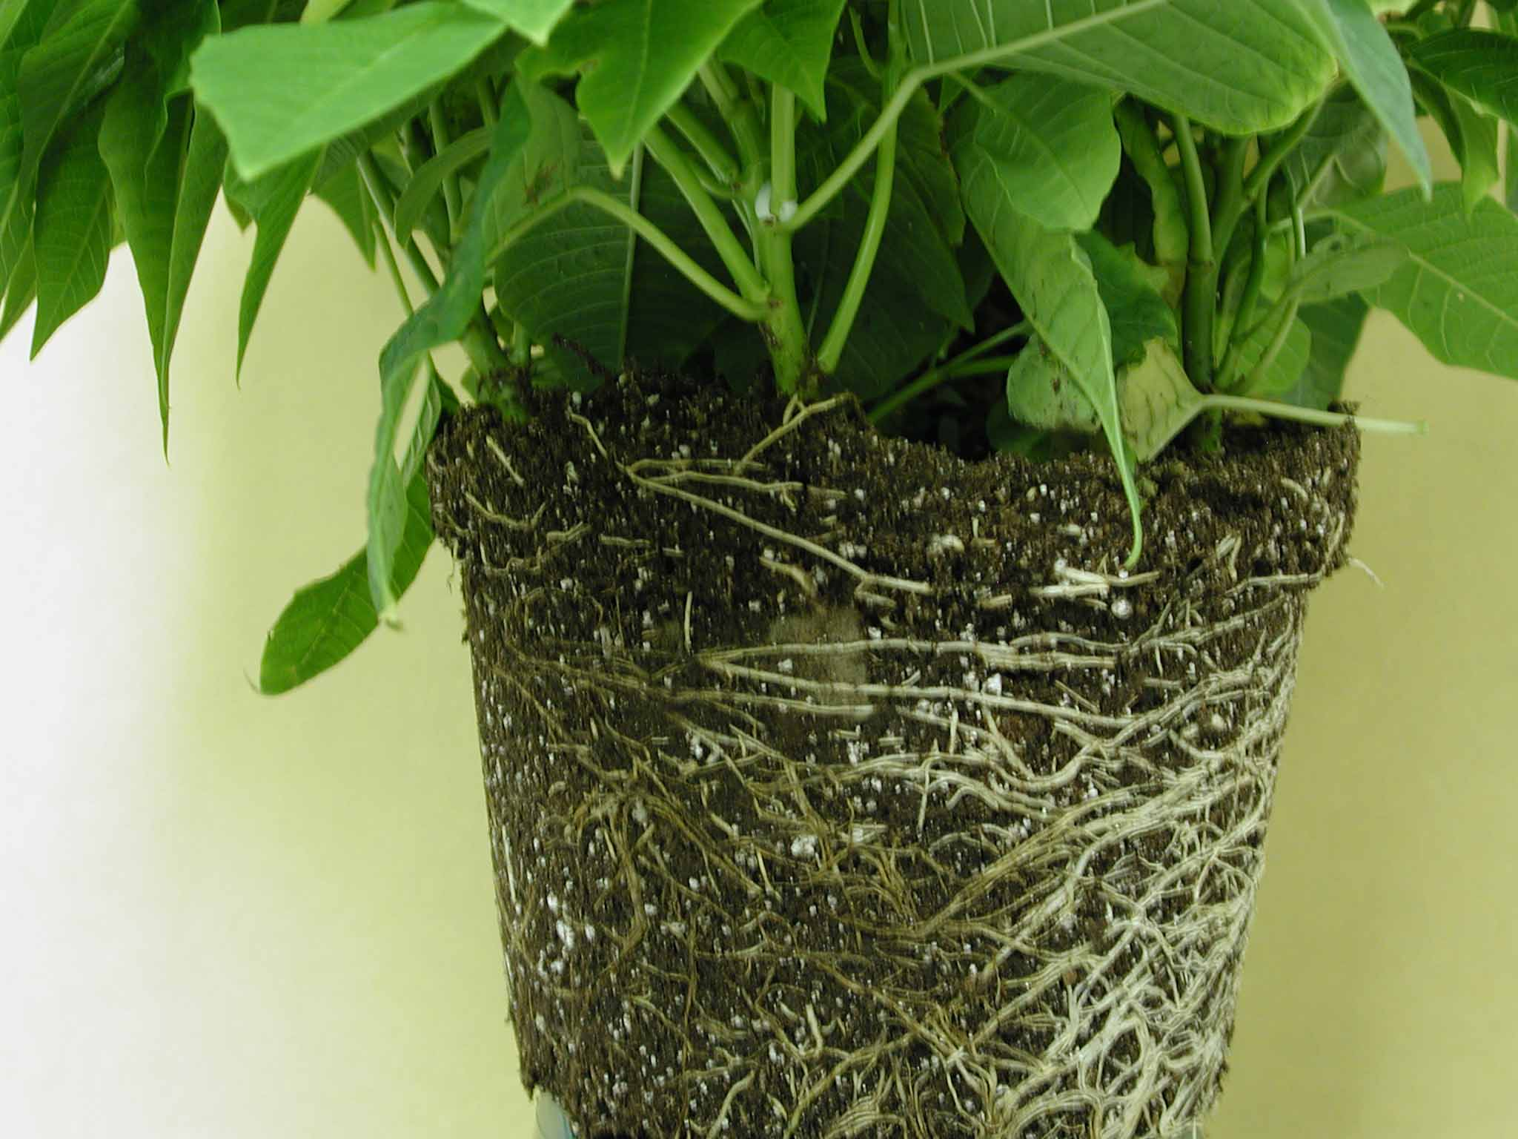
- The fungus attacks roots and they turn black and cannot absorb water and nutrients
Thielaviopsis
Notes:
Thielaviopsis may cause browning of the roots, and sometimes dark spore structures are seen at the base of the stem.

Slide 31
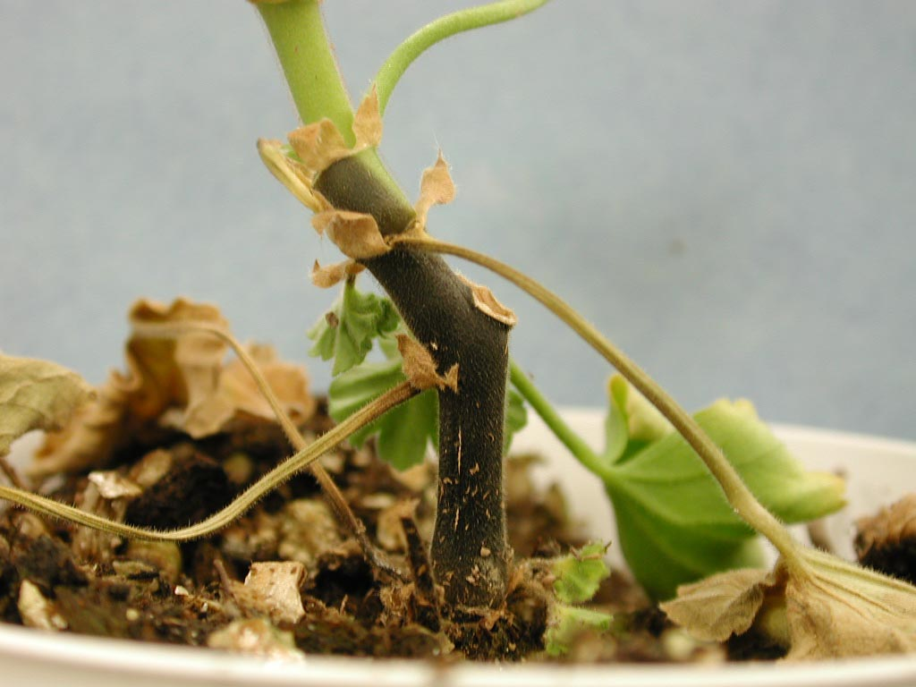
Pythium black leg
Notes:
Geranium

Slide 32
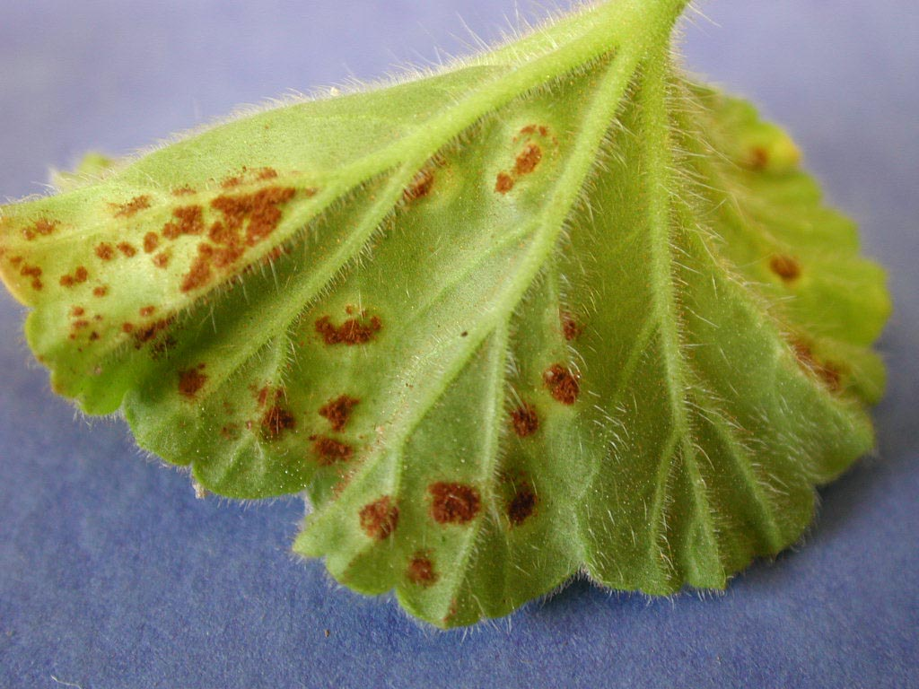
-
- Rust on geraniums. These are quarantinable diseases

Slide 33
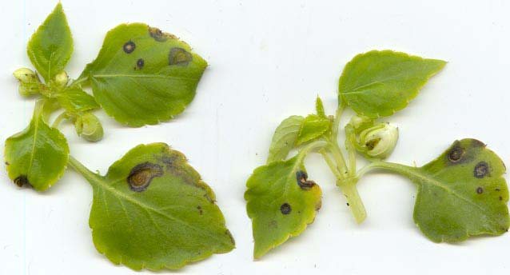
Pseudomonas on Impatiens
Notes:
Ps. syringae or Ps. cichorii may attack impatiens if leaf wetness is available for extended periods (Ps. syringae likes cooler conditions than Ps. cichorii)

Slide 34
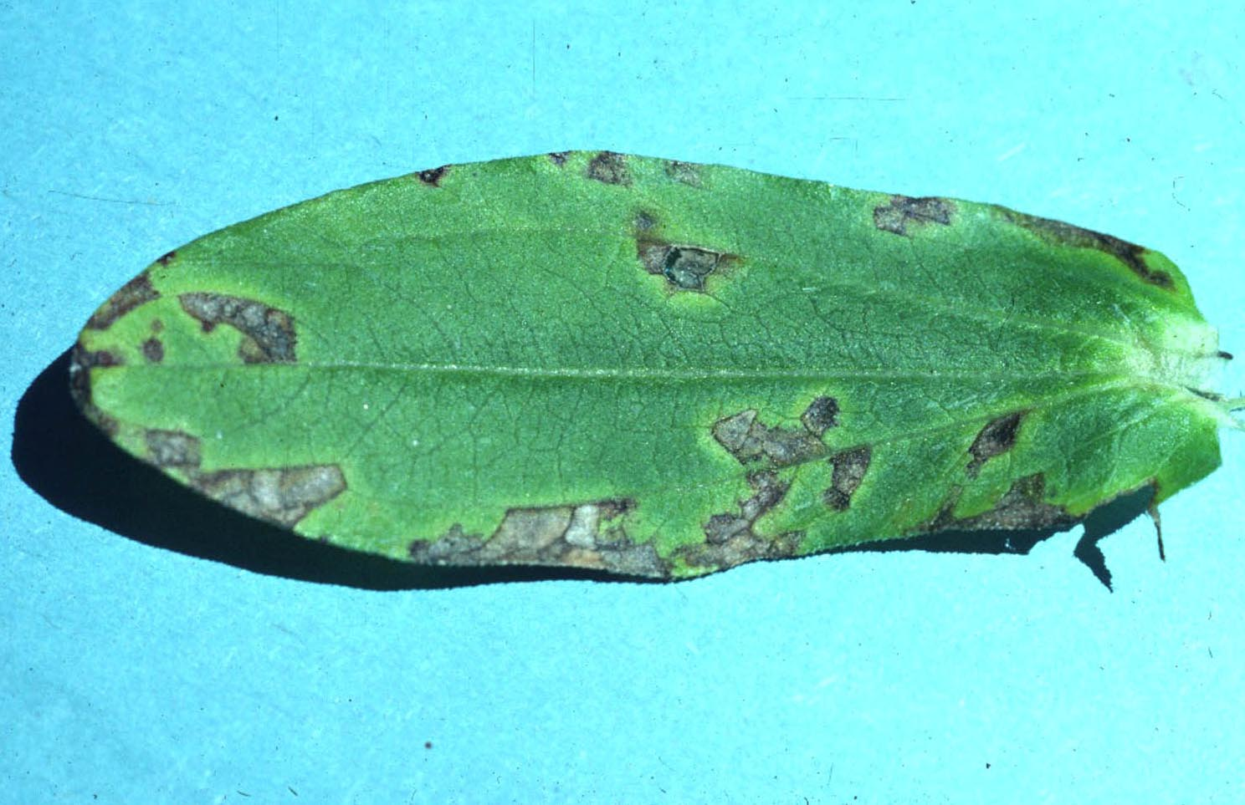
Xanthomonas zinniae
Notes:
Hard to separate visually from Alternaria leaf spot…both can show angular leaf spots with haloes.

Slide 35
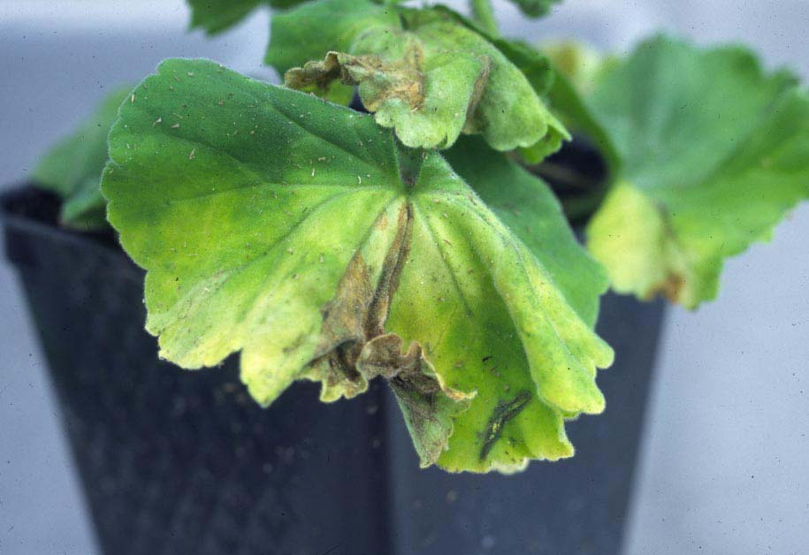
Bacterial Wilt of Geranium
Ralstonia solanacearum Race 3, Biovar 2
Notes:
The geranium problems that have rocked the industry in recent years (not 2005 thank goodness) have been from introduction of Ralstonia solanacearum Race 3, Biovar 2 from offshore sites into the US and Canada. Another Ralstonia solanacearum race, Race 1, is endemic to the southern US, and is not cold-hardy, thus is not considered the same level of threat to the N American potato industry

Slide 36
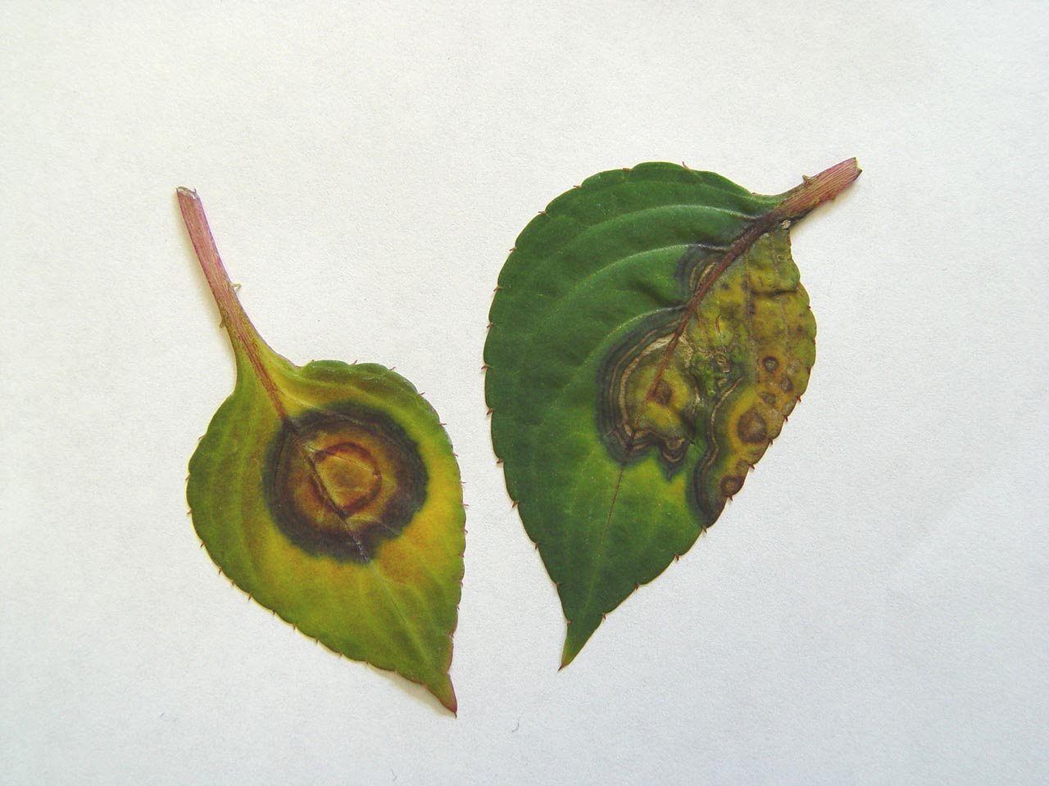
Impatiens Necrotic Spot Virus [INSV] on Impatiens
Notes:
Impatiens leaves may show zonate concentric patterns from INSV---or merely black spots

Slide 37
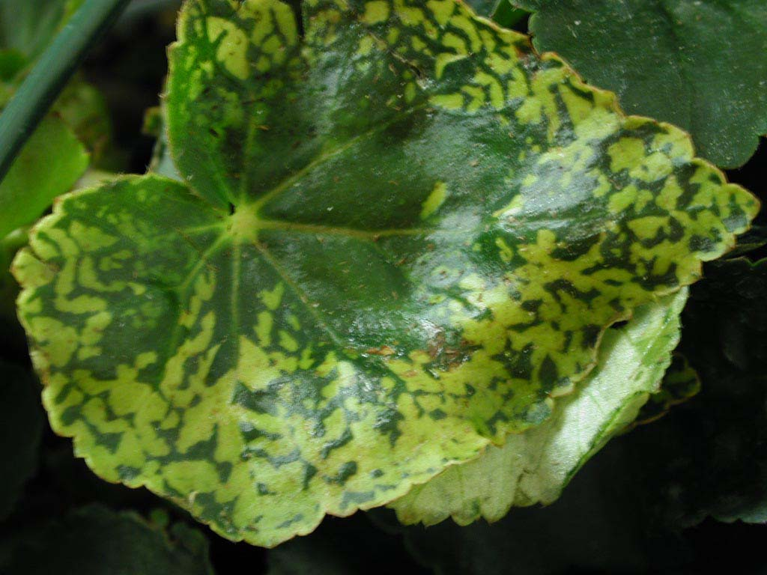
Impatiens Necrotic Spot Virus on Begonia
Notes:
The striking mottle on this begonia is not a variegation…it is a typical look of a leaf with INSV. Brown spots or darkening along veins are also common symptoms on begonia.

Slide 38
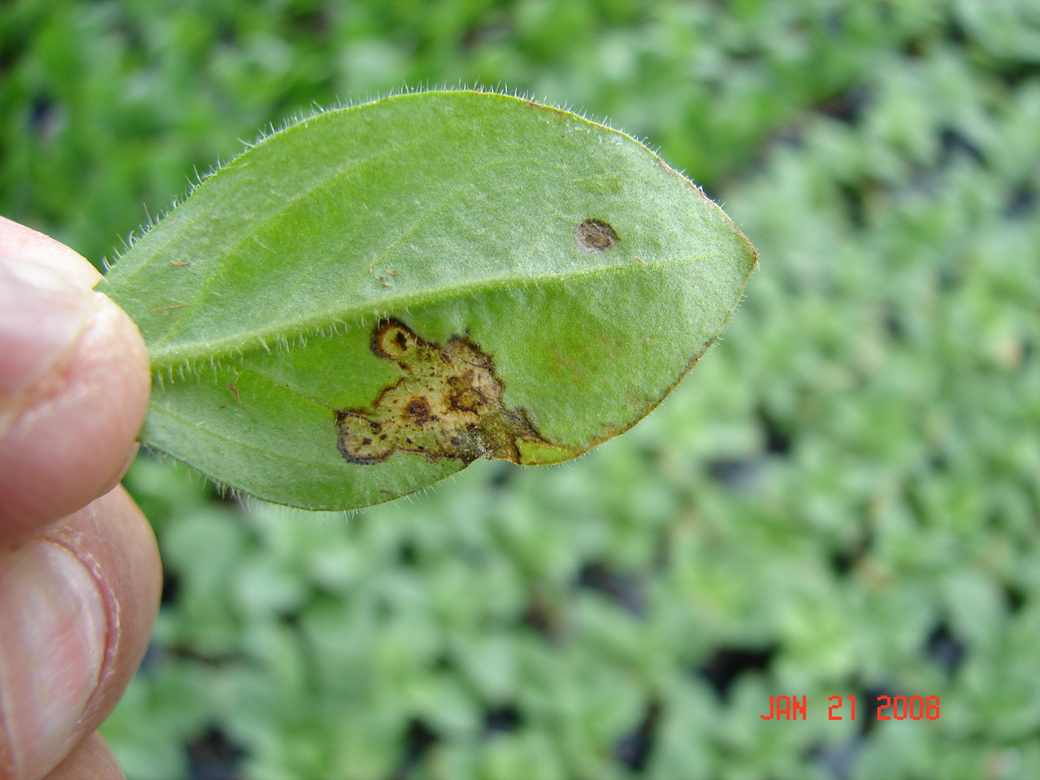
Tomato Spotted Wilt Virus

Slide 39
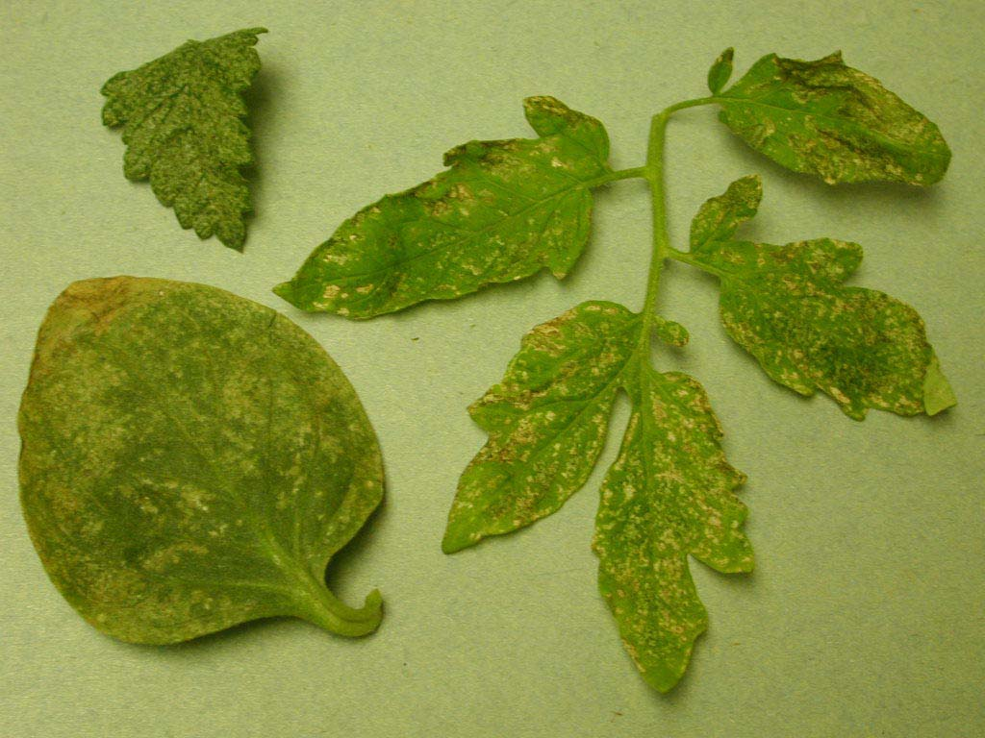
Thrips Damage
Notes:
Symptoms of Western flower thrips feeding on assorted plants….little white patches sometimes decorated with thrips frass. Seeing this much thrips feeding injury should make you suspicious that there might be INSV around also! Growers should use yellow sticky cards to keep an eye on their thirps populations

Slide 40
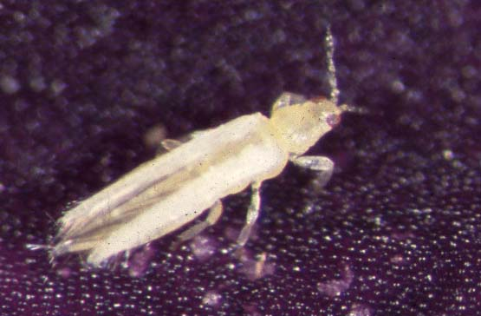
Thrips culprit
Notes:
Western flower thrips, much enlarged
Larvae feed on infected plants and pick up the virus; winged adults transmit

Slide 41
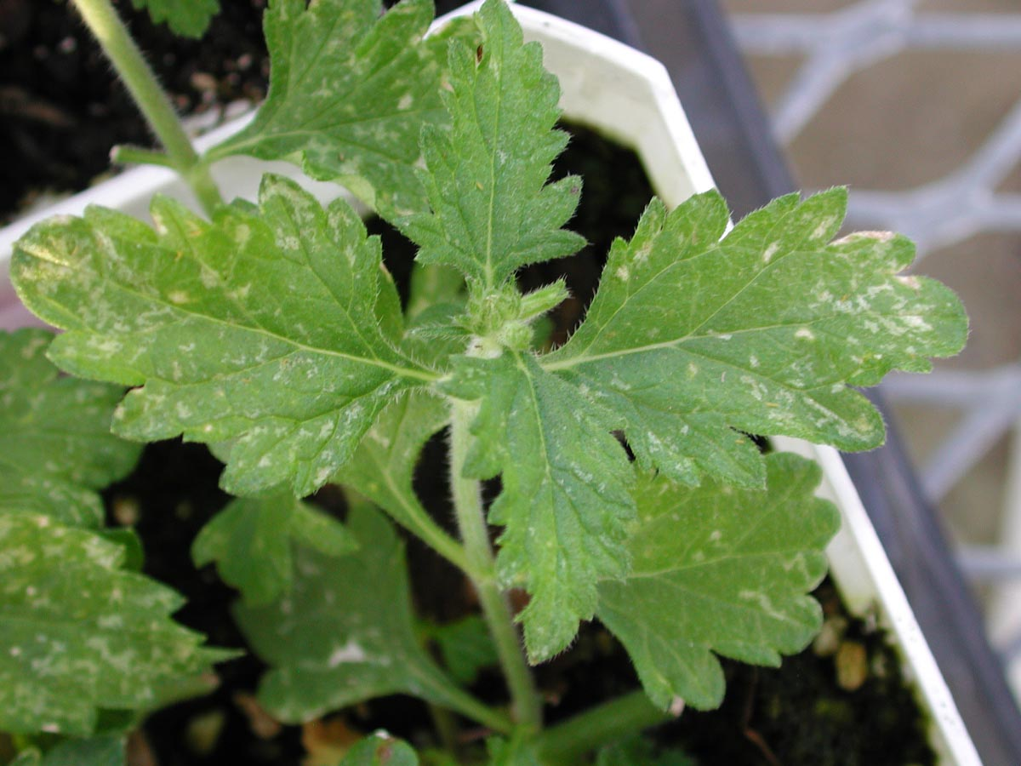
Thrips Damage on Verbena
Notes:
Heavy thrips feeding on a verbena

Slide 42
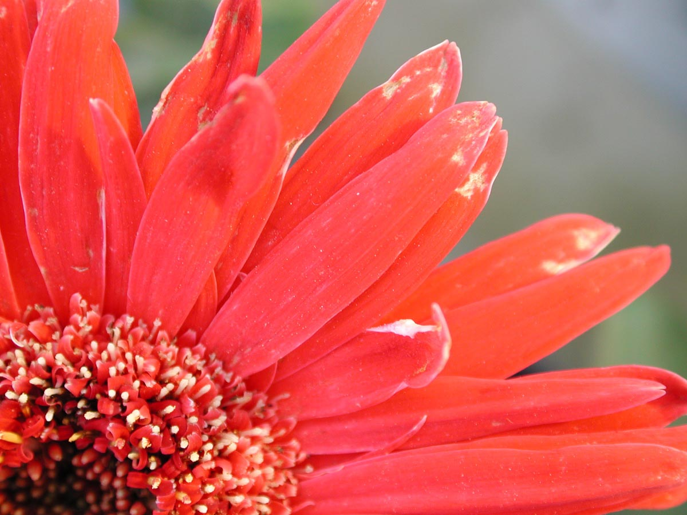
Thrips Feeding Damage on Gerbera Petals
Notes:
Thrips feeding injury on gerbera petals

Slide 43
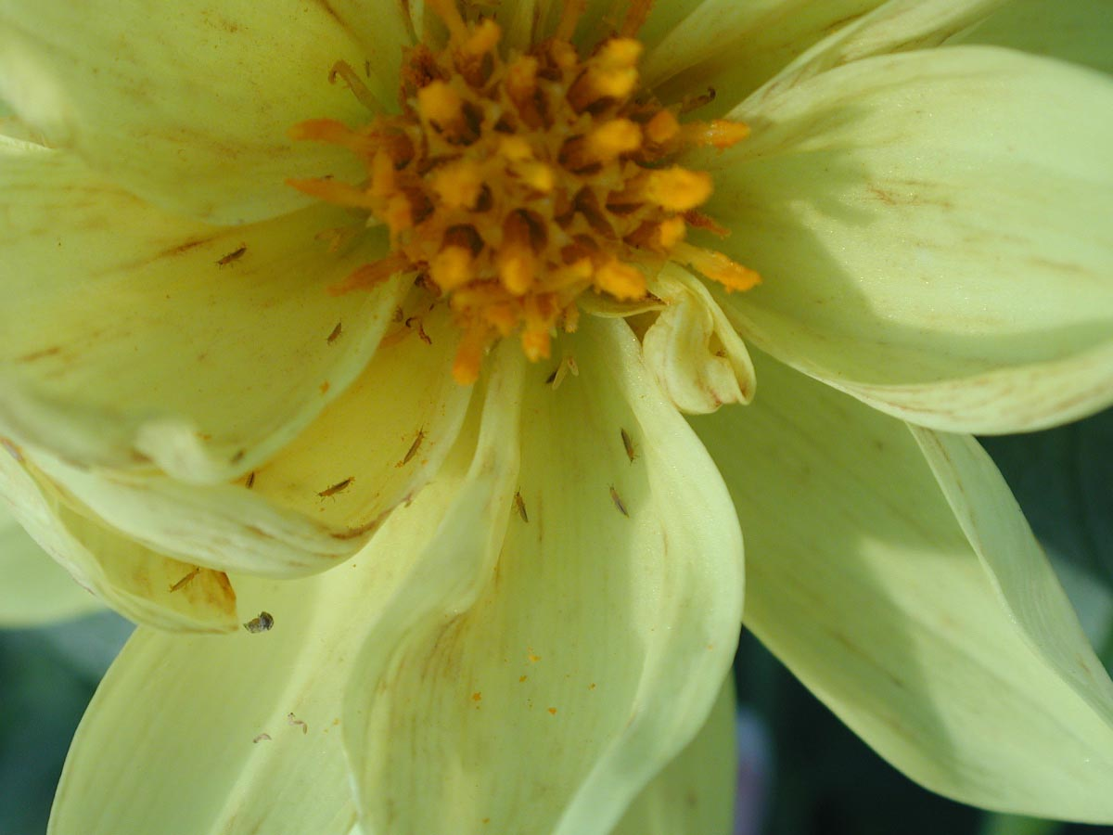
Western Flower Thrips on a Dahlia Flower
Notes:
Western flower thrips on a dahlia flower

Slide 44
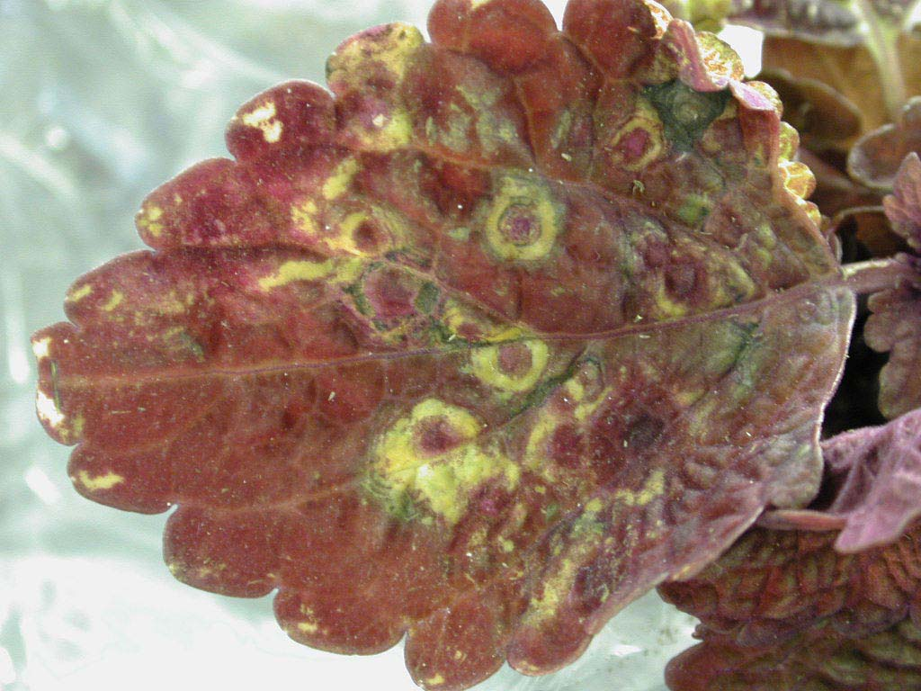
Impatiens Necrotic Spot Virus on Coleus
Notes:
Rings caused by INSV on coleus; more commonly you see just round brown spots that look like an injury more than like a virus symptom

Slide 45
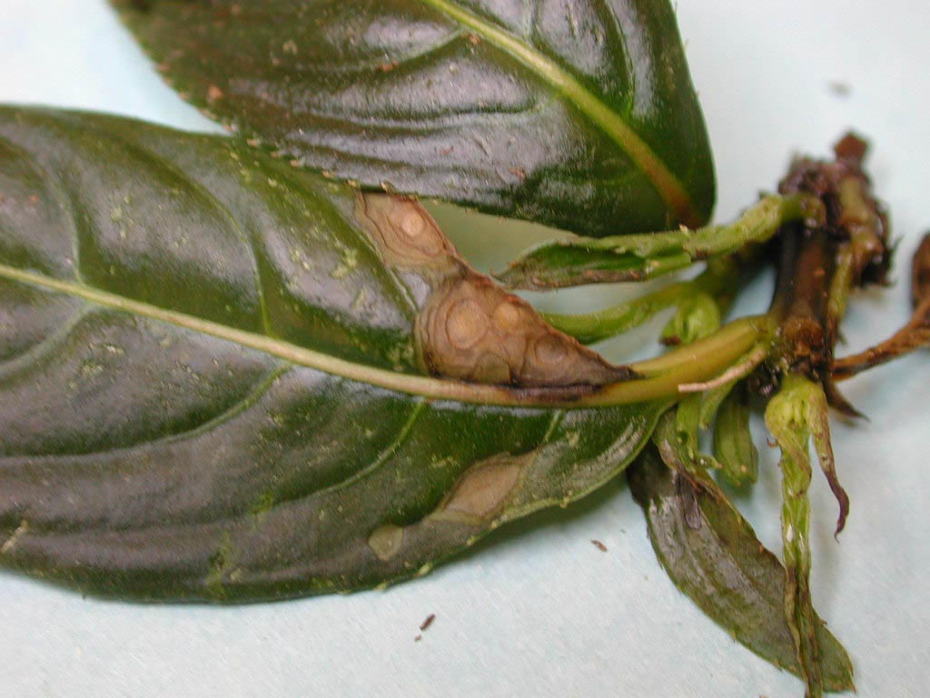
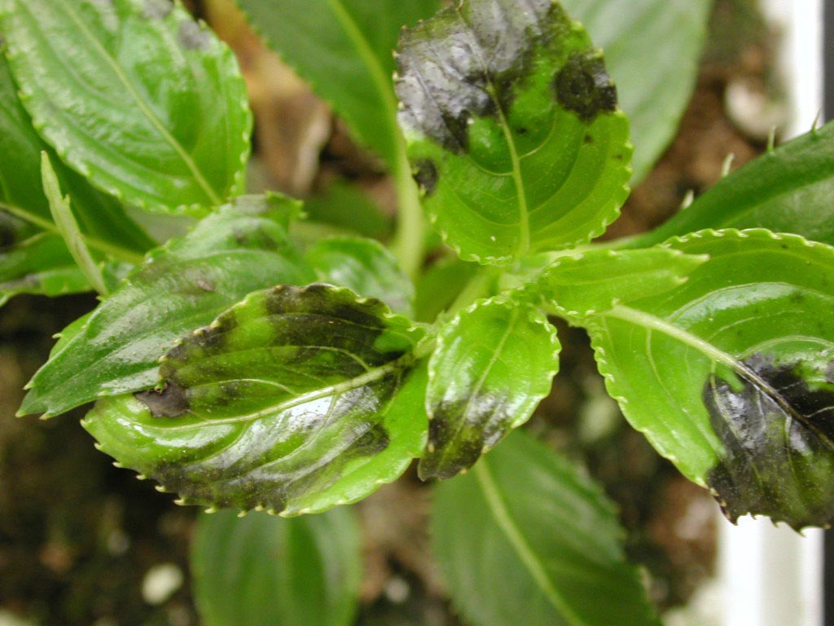
Impatiens Necrotic Spot Virus
on New Guinea Impatiens
Notes:
Brown or black lesions form on New Guinea impatiens with INSV; some cultivars are very stunted by the virus. Some show a lot of stunting of the new growth.

Slide 46
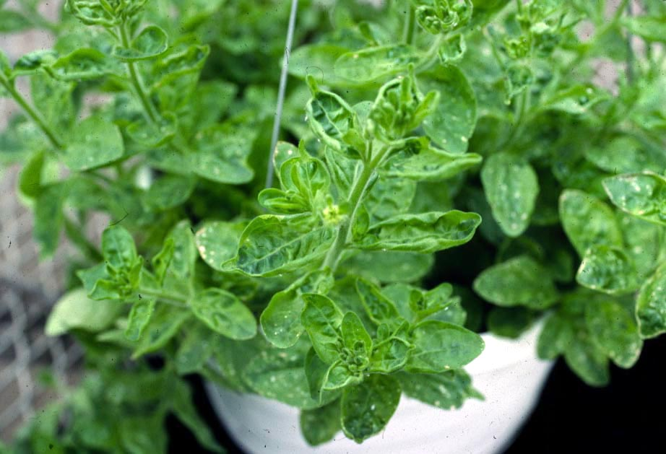
Tobacco Mosaic Virus [TMV] on Petunia
Notes:
TMV on a petunia…mottling and leaf distortion.

Slide 47
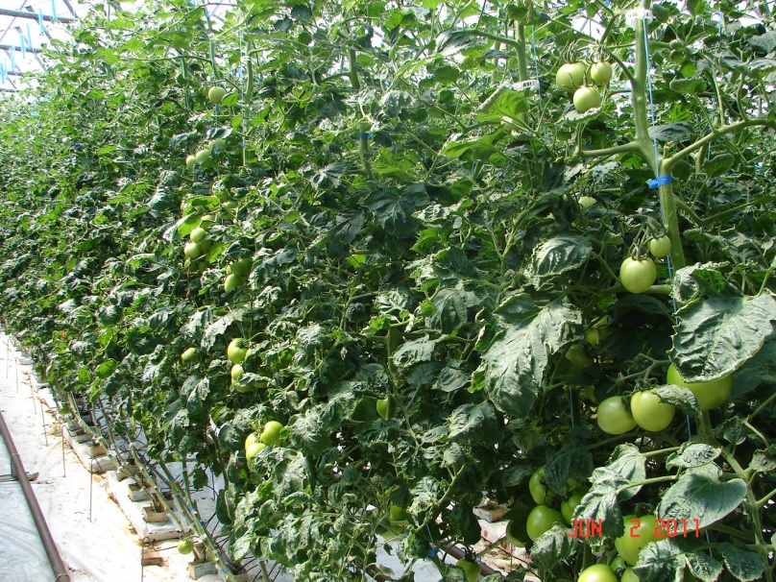
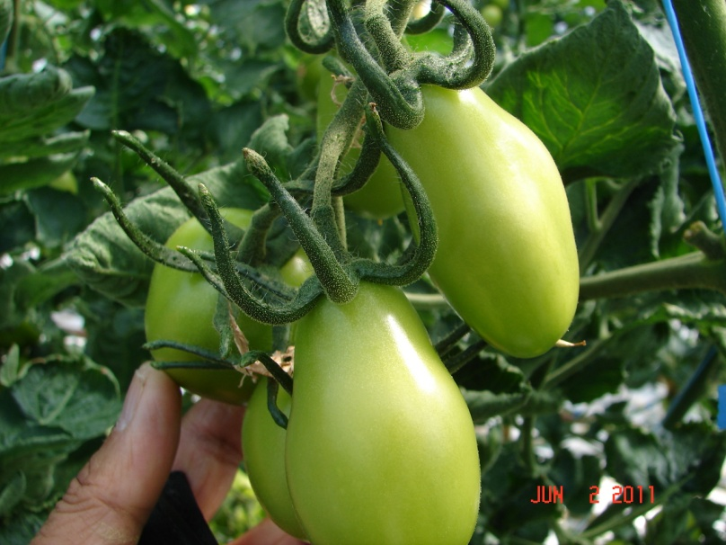
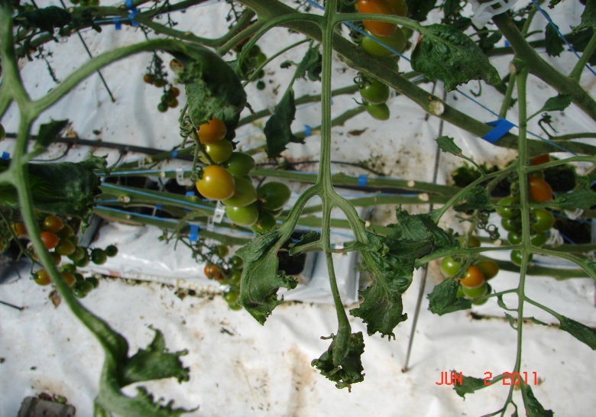
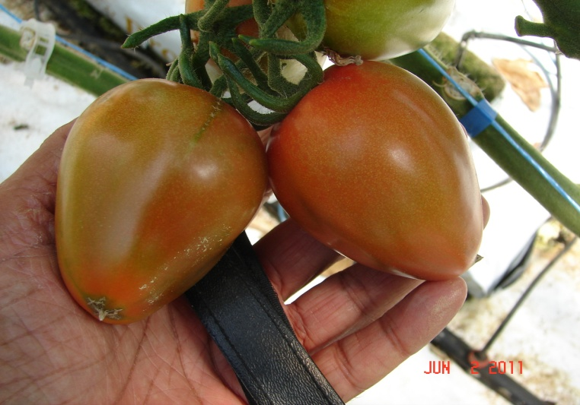
Herbicides – Tomato crop, dugout water contaminated

Slide 48




Herbicides and bedding plants and in May

Slide 49




Herbicides in bedding plants

Slide 50
Concluding thoughts
Be aware of plant’s needs
Root zone health
Irrigation practices
pH changes with plant growth, high when plants are growing fast, and low when under stress
pH is the most difficult to manage when growing several different crops.
Don’t jump quickly on diagnosis, discuss all possibilities

